Slide 1
FFRD Validation Basins
Cross-Basin Meeting
May 15th, 2026

Slide 2

Agenda
Introduction - FEMA
5/1 Overview
Technical Discussions
Basin Progress

Slide 3
5/1 Bi-Weekly Summary
Topic | Last Discussion | Update
Data Holder Outreach | Dave Rosa noted ongoing efforts to secure internal FEMA approval to proceed with outreach to data holders. | No change; approval process is still underway.
Transposition Domain Selection | The PTS teams were tasked with developing a consistent approach to select SLAM‑SIG transposition domains for validation basins. | The PTS teams have finalized a consistent approach and selected transposition domains. Additional details will be provided during Technical Discussions.
SOP Section 5.3 Transposition Domain Validation | It was identified that SLAM‑SIG/SLAM‑SIM transposition domains are not meteorologically homogeneous (STARR II, 2026), and the SOP lacks a consistent validation approach. This gap was flagged as a priority for investigation. | Added to list of potential SO3.2 innovations projects.
Metadata | Discussion included STAC metadata development (HEC‑RAS and HMS templates), initial metadata capture, and the need to define required fields, naming conventions, and data relationships. Emphasis was placed on provenance tracking, asset linkage (e.g., dams, levees, terrain), and alignment with authoritative data sources prior to SOP integration. | Added to list of potential SO3.2 innovations projects.

Slide 4
Basin Progress
 | Progress Achieved Last 2 Weeks | Progress Planned Next 2 Weeks | Backlog
Scoping and Data Preparation | Received FEMA data on the MIP from CDS and completed an initial review | Potentially Begin Data Provider Outreach | Collect all FEMA Models Update Scoping & Data Preparation Reports & Deliverables
Geospatial | Complete EDH Review/Recommendations |  | Standardize Metadata/Attributes Collect and Incorporate Bathymetric Data
Meteorology | Finalized Transposition Domain Selection |  | Update Meteorology Deliverables
Hydrology |  |  | Update HMS Model & Inputs Continue Flood Mechanism Analysis (Mixed Populations) Continue Calibration Event(s) Selection/Collection
Hydraulics |  |  | Pilot 1 RAS Model Per Basin (RAS 2026 testing?) Coordinate with USACE on RAS Model Unit Delineation Urban Drainage Systems Scoping
Dam/Levee |  |  | Finalize Dam Scoping Table Coordinate with USACE on Levee Refinement
Review and Reporting |  |  | Finalize Report and BE-PWP Internal Review

Slide 5
Technical Discussions
05-16-2026

Slide 6
SLAM-SIG Domain Selection
The PTS teams were scoped to use the UW-developed SLAM domains for the validation basins (ARC, COMPASS, and STARR II, 2025) .
  See Wright et al. (2025) for additional details on the development of the SLAM domains.
Each PTS team reviewed the SLAM transposition domains following SOP Section 5.10.1.2.1 (FEMA & USACE, 2025) and determined that the domains did not pass the review.
  This was documented as an area for further investigation in FEMA Innovations SO3.2 Project Backlog.
  See STARR II (2026) and FEMA et al., (2026 a-d) for additional details
To maintain progress, FEMA directed the PTS teams to select a SLAM‑SIG domain for each basin using a consistent method (FEMA et al., 2026d).
The following discussion outlines the selection process and presents the SLAM‑SIG domains selected for each basin.
Notes:
Erica

Slide 7
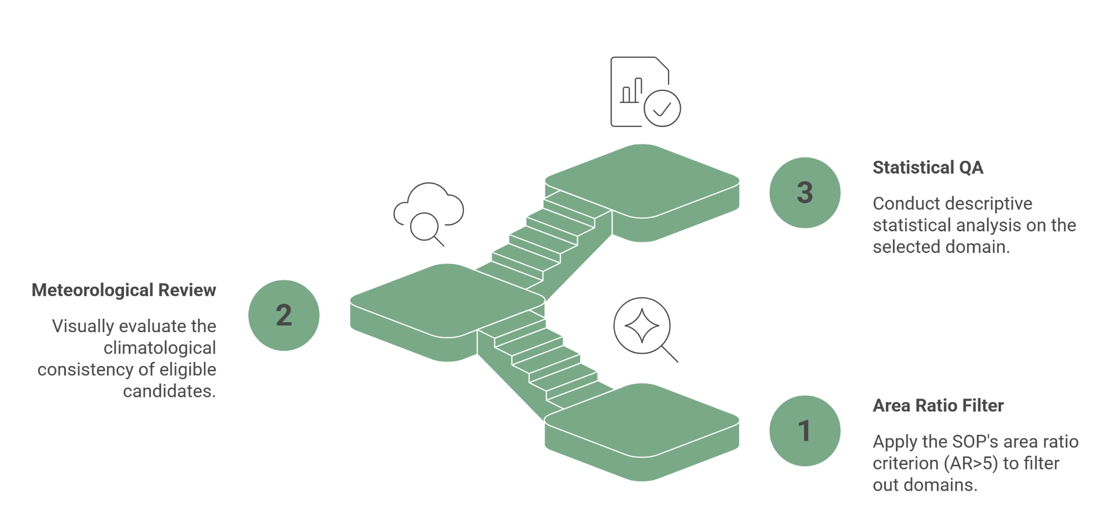
Three-Stage SOP Driven Domain Selection Approach
SOP Volume II, Section 5.3
The fundamental assumption made by using SST is that a region of homogeneous meteorology containing the study watershed can be constructed. The domain is used to identify and select storm events to use in the catalog and to define the limits of where events can be moved during stochastic simulations. Development of a transposition domain requires expert judgment and remains a subjective process until a repeatable, objective process is developed. The region must contain the study watershed in its entirety and be several times larger, with a recommended lower limit of 5 times the watershed area.
For SLAM-SIG, the approach begins by computing the geometric intersection of the 24 hr and 72 hr transposition domains, which defines the candidate TD at each GSL.
Notes:
Mohsen

Slide 8
Stage 1: Hard filter on the area ratio (AR > 5)
The SOP requires that the transposition domain have an area ratio greater than 5. This is an explicit pass/fail criterion. Apply it first and discard any GSL whose AR is at or below 5.
Stage 2: Meteorological review on the SOP-eligible candidates
For each candidate that survives Stage 1, the meteorologist visually evaluates whether the domain's climatology is consistent with the watershed's. The deliverables for this stage are visual aids that support expert judgment:
Plot the basin polygon together with the candidate polygon and the underlying PRISM precipitation / dewpoint / elevation envelope surface. Translate 3/3, 2/3. 1/3 into easily understandable labels.
The meteorologist selects one polygon. This step is judgment-based, and the documentation should record the meteorologist's reasoning rather than a numeric score.
Stage 3: Statistical QA on the selected polygon only
Once a single domain has been selected by Stages 1 and 2, distributional statistics (KS, Wasserstein, mean / median / quantile differences) can be reported as descriptive QA on that one polygon to characterize how its climatology compares with the basin.
These numbers go into the documentation and the final memo. The PRISM coverage fraction inside the selected polygon (and inside the basin) is noted, so any truncation effect is documented.
Notes:
Mohsen

Slide 9
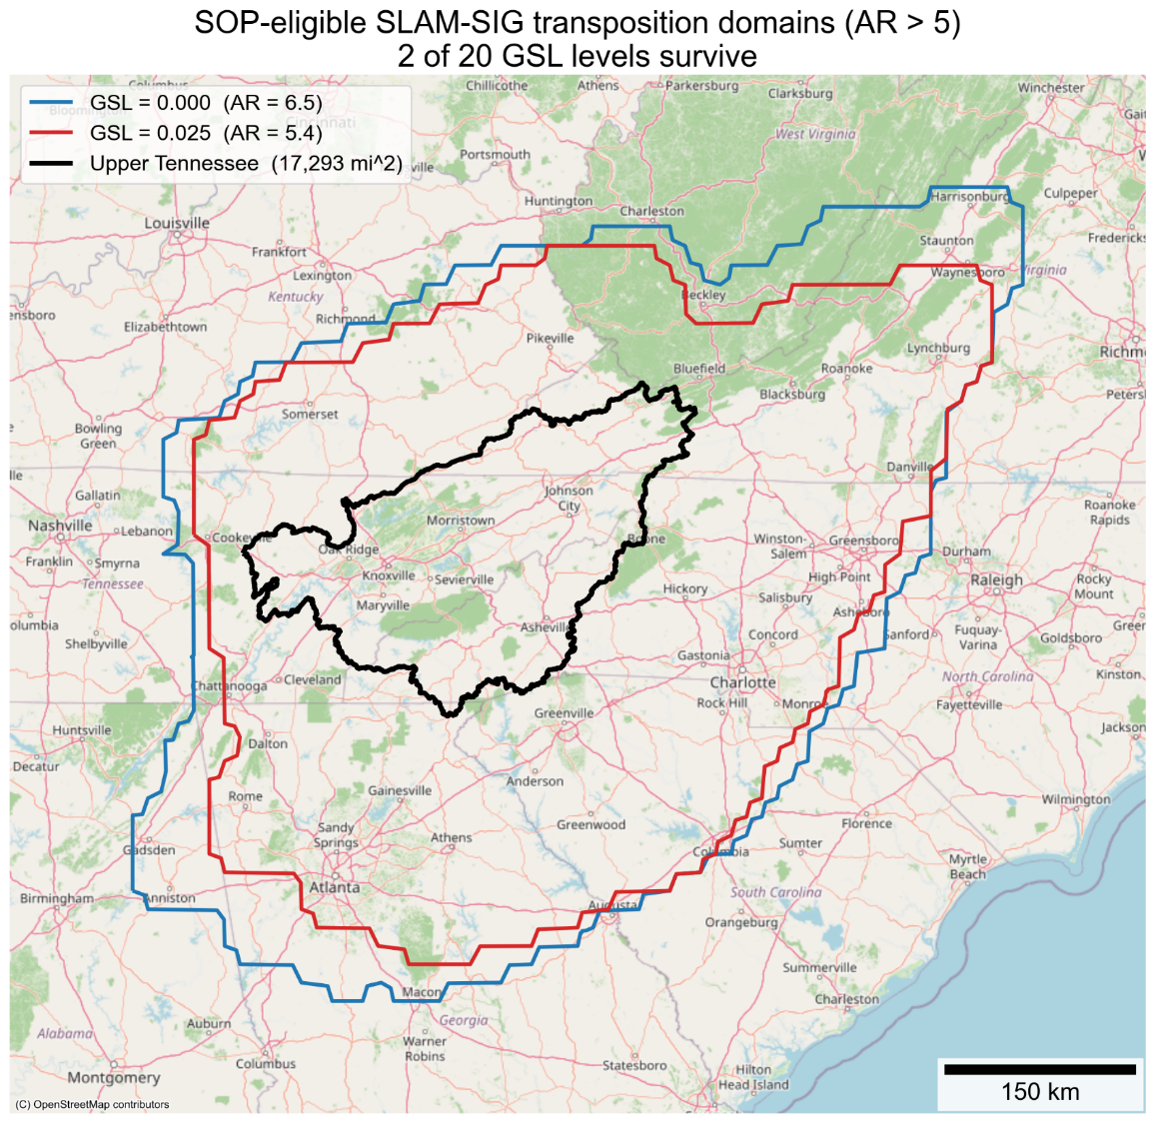
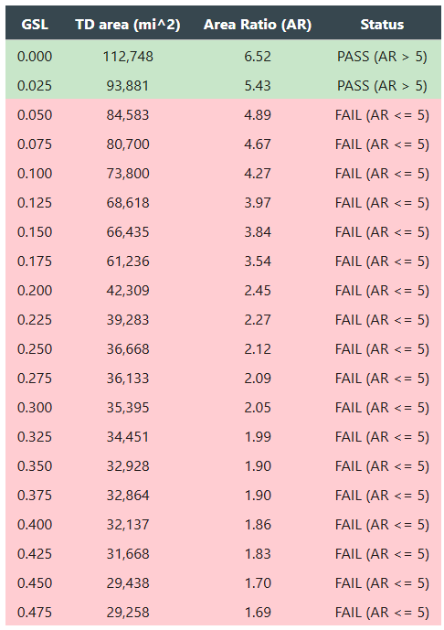
Stage 1
Basin: Upper Tennessee (HUC 0601)
Notes:
Mohsen

Slide 10
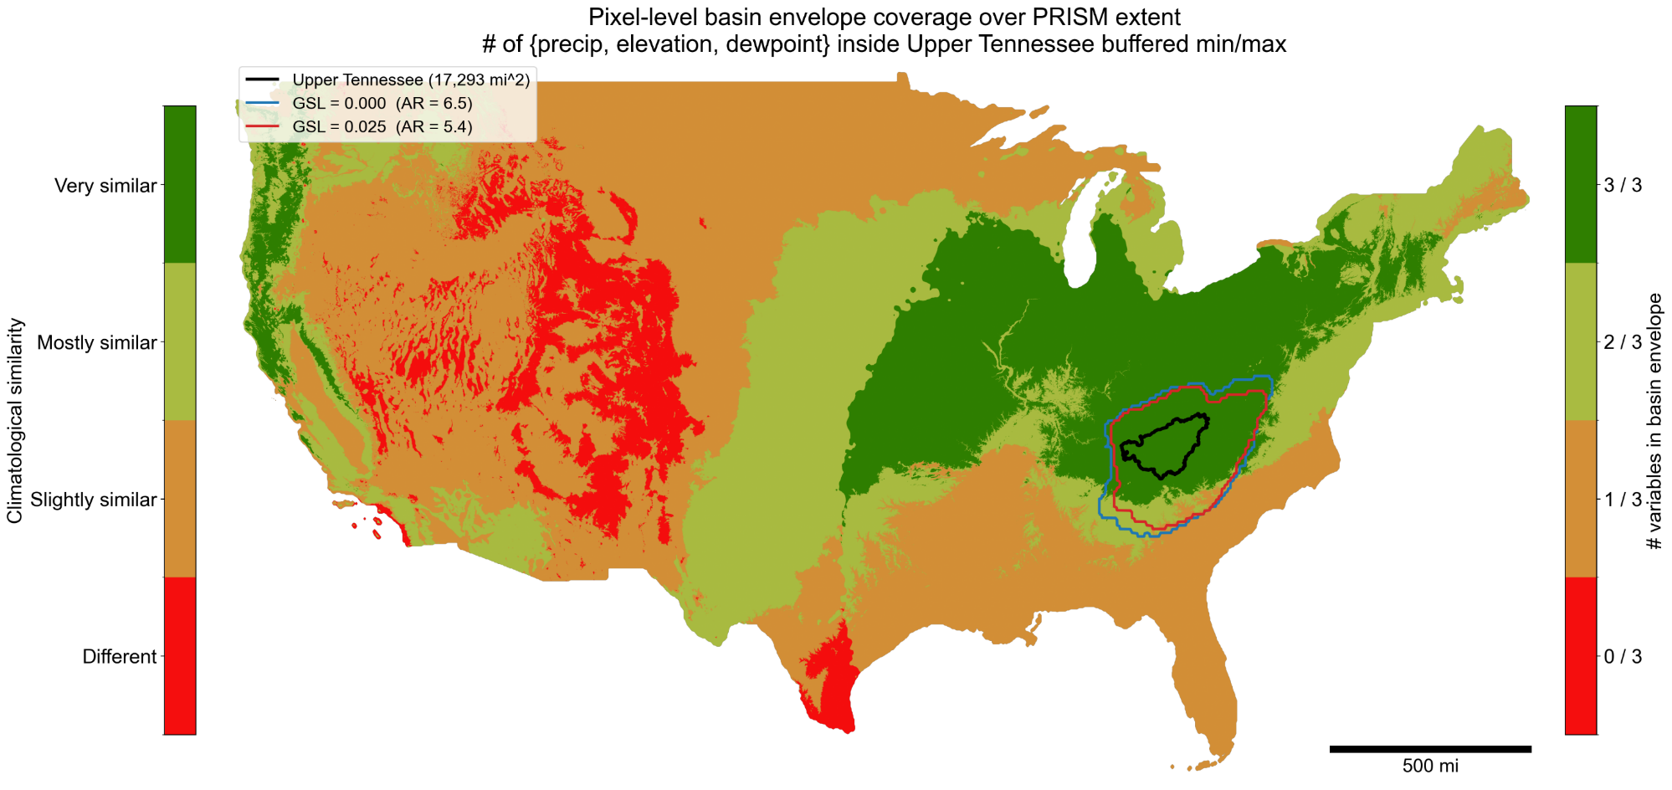
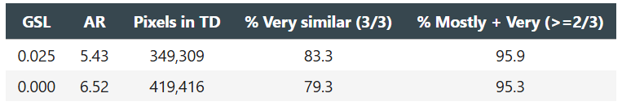
Stage 2
Basin: Upper Tennessee (HUC 0601)
±5%
Notes:
Mohsen

Slide 11
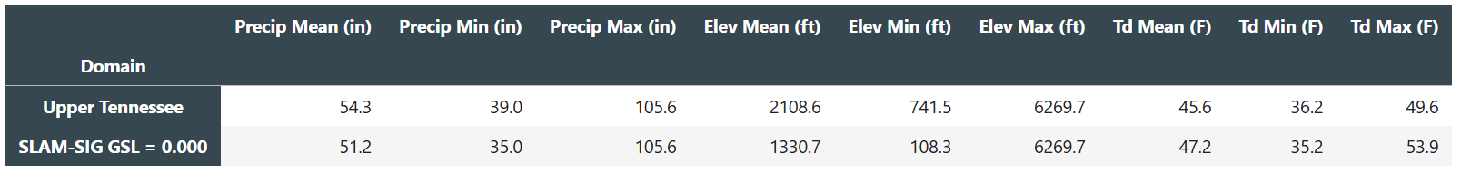
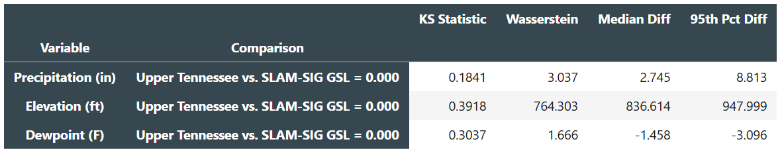
Stage 3
Basin: Upper Tennessee (HUC 0601)
Summary of findings
Selected domain for Upper Tennessee: SLAM-SIG at GSL = 0.000, AR = 6.52, Tcap = 300 yr.
Stage 1 eliminated 18 of 20 candidate GSLs on the SOP requirement that AR > 5; only GSL = 0.000 and GSL = 0.025 remained.
Stage 2 envelope coverage shows the two survivors are climatologically near-identical inside their footprints. The larger polygon does not introduce a meaningfully different climatology.
Tcap distinguishes the survivors: GSL = 0.000 carries 50 yr more effective return-period reach than GSL = 0.025 at no climatological cost.
Stage 3 statistics describe the chosen polygon's climatology relative to the basin. The KS and Wasserstein values are reported as descriptive distance metrics.
Notes:
Mohsen

Slide 12
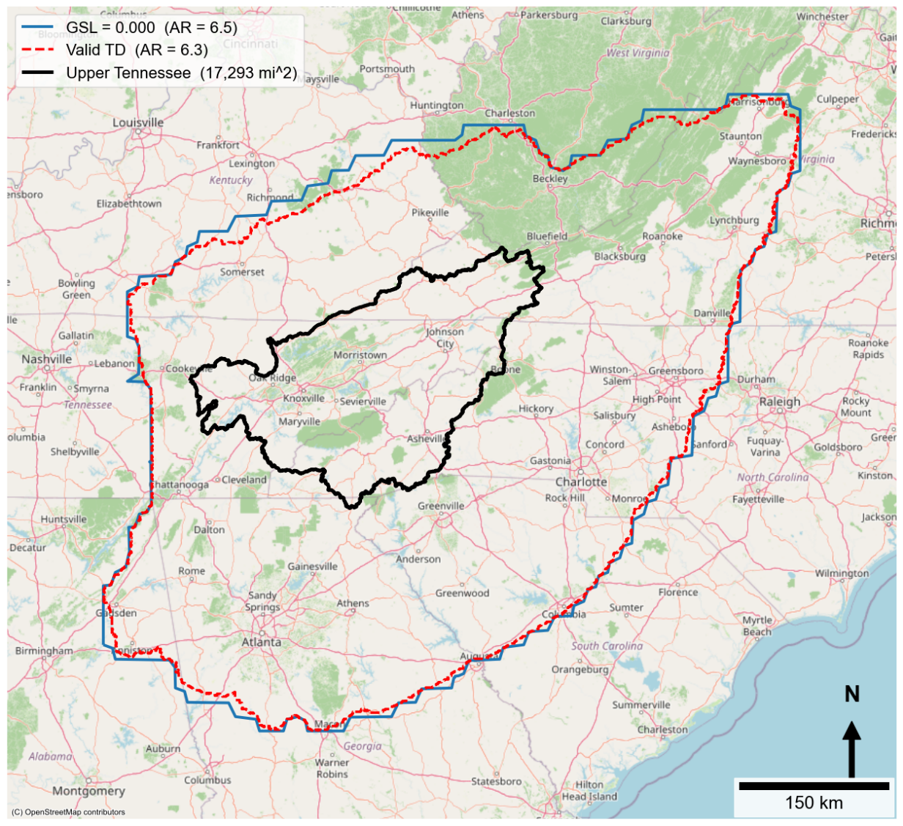
Selected Transposition Domain for Upper Tennessee (HUC 0601)
The valid transposition domain is the usable portion of the transposition domain. It includes only the locations where the watershed can be transposed while remaining fully within the selected transposition region.

Slide 13
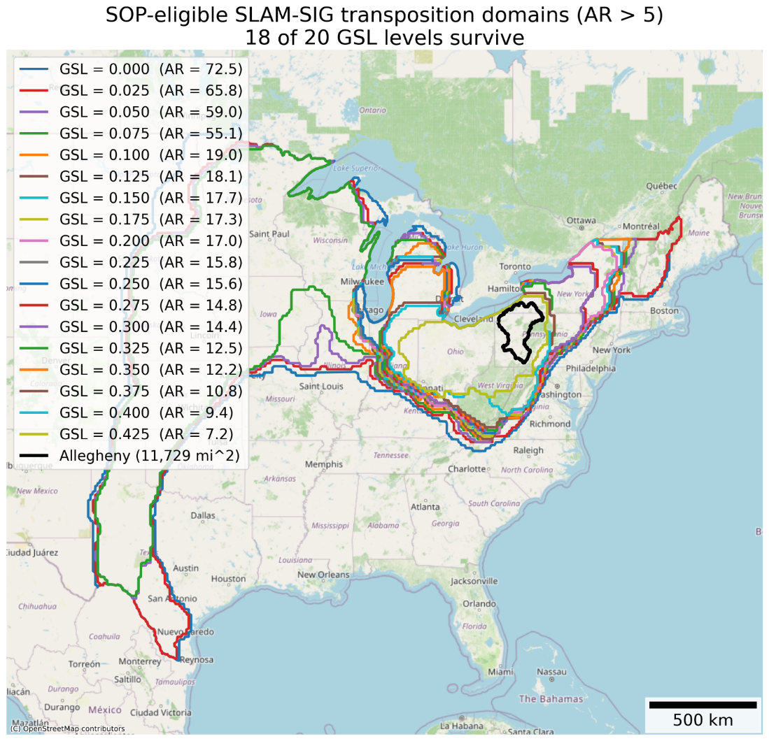
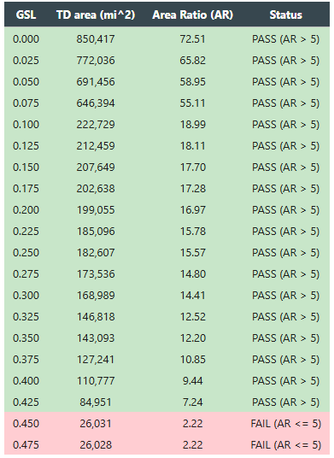
Stage 1
Basin: Allegheny (HUC 0501)
Clipped to CONUS Extent
Notes:
Zach

Slide 14
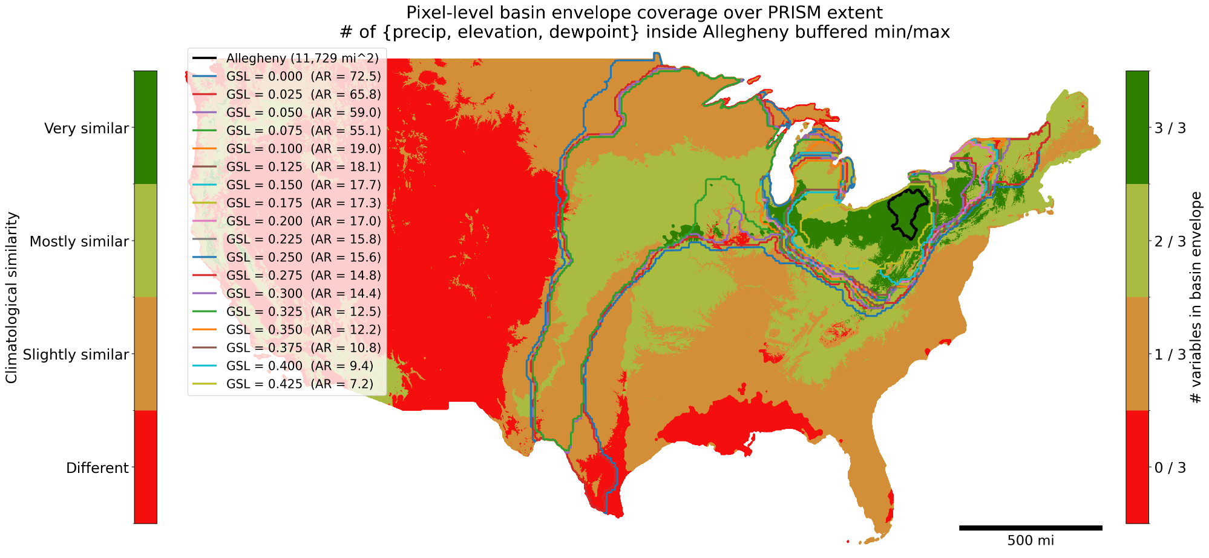
Stage 2
Basin: Allegheny (HUC 0501)
Clipped to CONUS Extent
±5%
Notes:
Zach

Slide 15
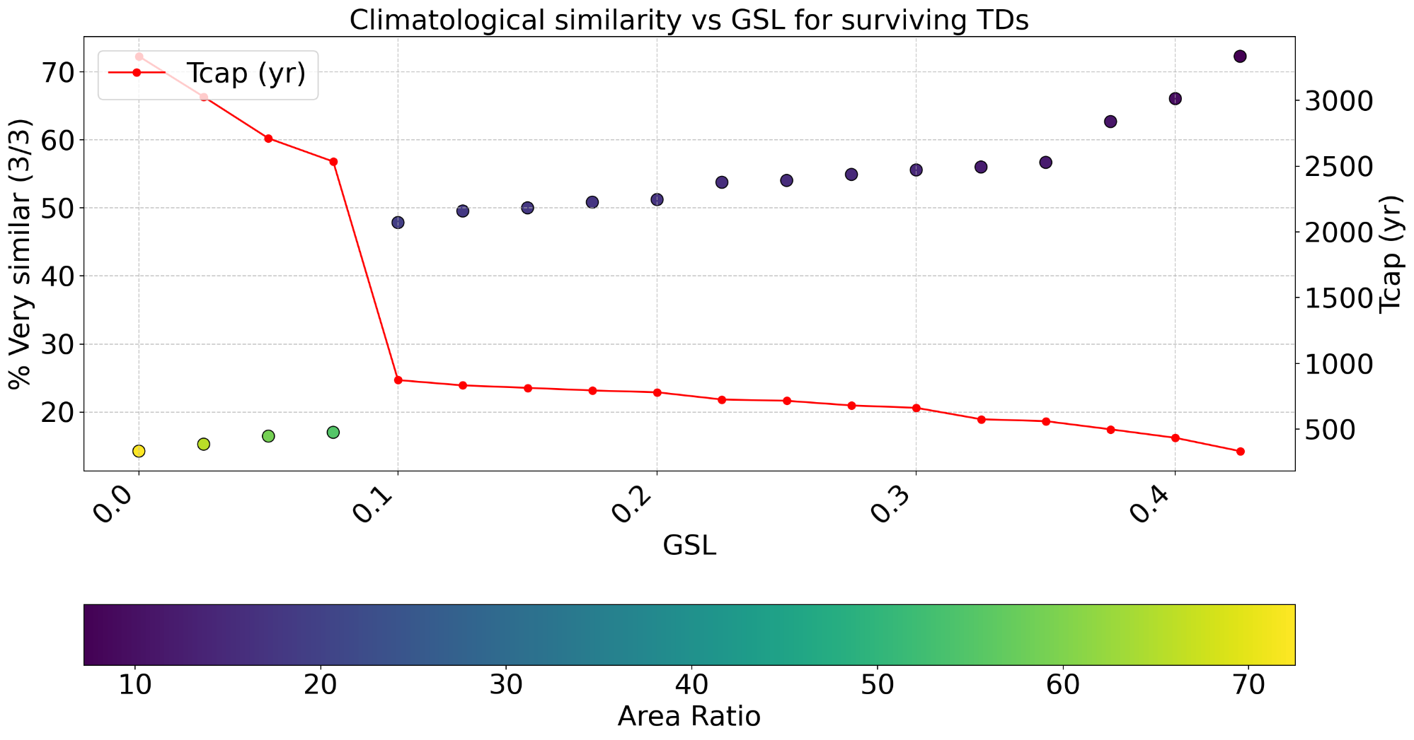
Selected GSL
Notes:
Zach

Slide 16
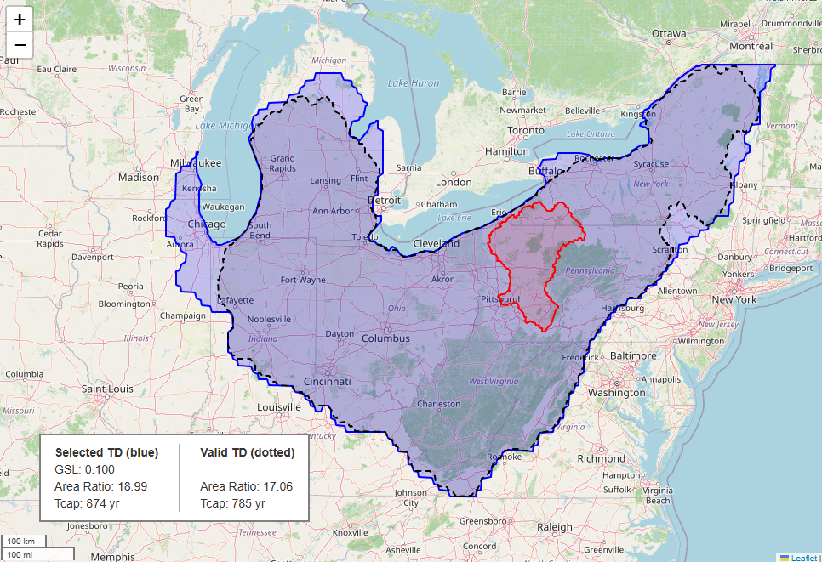
Geometrically Valid TD
Selected GSL TD

Slide 17
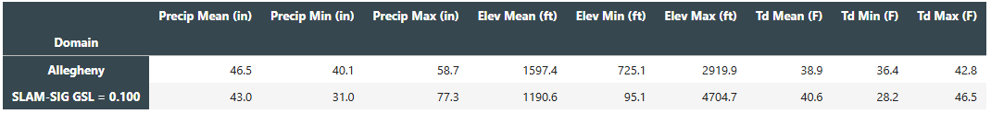
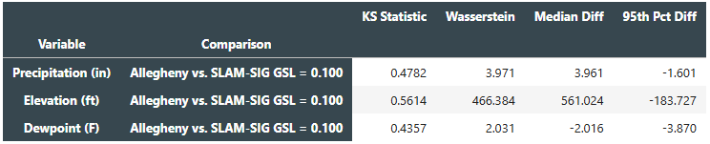
Stage 3
Basin: Allegheny (HUC 0501)
Summary of findings
Selected domain for Allegheny: SLAM-SIG at GSL = 0.1, AR = 17.06, Tcap = 785 yr.
Stage 1 kept 18/20 candidate GSLs on the SOP requirement that AR > 5.
Stage 2 envelope coverage shows a plateau of climatologically similar survivors at GSLs >= 0.1. Smaller polygon beyond this point do not introduce a meaningfully different climatology.
Stage 3 statistics describe the chosen polygon's climatology relative to the basin using the geometrically valid domain derived from stormhub. The KS and Wasserstein values are reported as descriptive distance metrics.

Slide 18
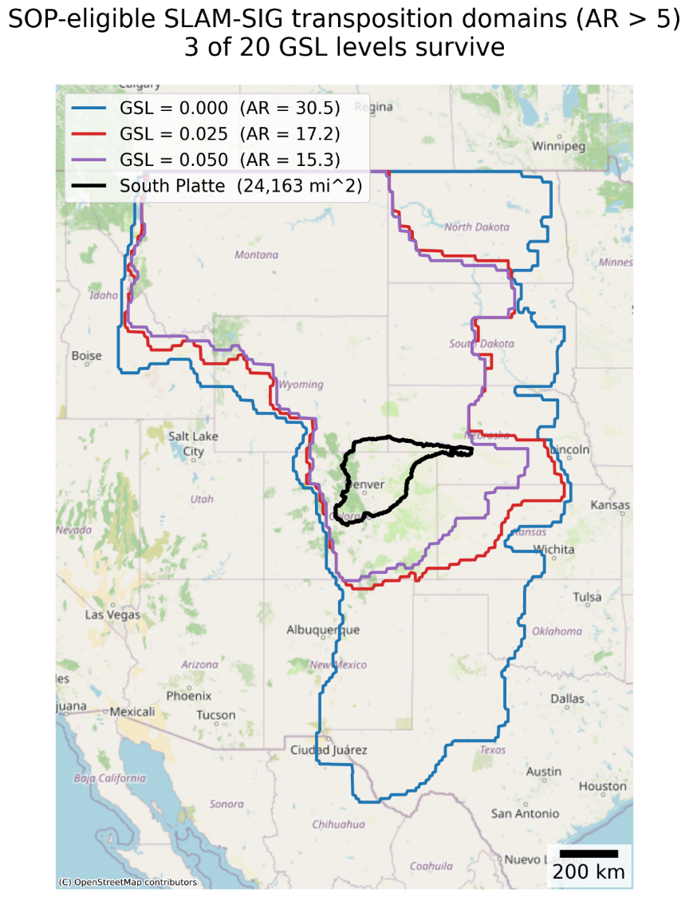
Stage 1: South Platte (HUC 1019)
GSL | TD area (mi^2) | Area Ratio (AR) | Status
0.000 | 737,367 | 30.52 | PASS (AR > 5)
0.025 | 415,970 | 17.22 | PASS (AR > 5)
0.050 | 370,225 | 15.32 | PASS (AR > 5)
0.075 | 100,264 | 4.15 | FAIL (AR <= 5)
0.100 | 96,563 | 4.00 | FAIL (AR <= 5)
0.125 | 87,245 | 3.61 | FAIL (AR <= 5)
0.150 | 84,247 | 3.49 | FAIL (AR <= 5)
0.175 | 82,030 | 3.39 | FAIL (AR <= 5)
0.200 | 78,288 | 3.24 | FAIL (AR <= 5)
0.225 | 78,006 | 3.23 | FAIL (AR <= 5)
0.250 | 76,702 | 3.17 | FAIL (AR <= 5)
0.275 | 75,884 | 3.14 | FAIL (AR <= 5)
0.300 | 70,558 | 2.92 | FAIL (AR <= 5)
0.325 | 70,357 | 2.91 | FAIL (AR <= 5)
0.350 | 68,388 | 2.83 | FAIL (AR <= 5)
0.375 | 65,359 | 2.70 | FAIL (AR <= 5)
0.400 | 63,902 | 2.64 | FAIL (AR <= 5)
0.425 | 50,057 | 2.07 | FAIL (AR <= 5)
0.450 | 49,412 | 2.04 | FAIL (AR <= 5)
0.475 | 46,705 | 1.93 | FAIL (AR <= 5)
Clipped SLAM-SIG above 49th
Note: Clipping out Canada had no impact on which GSLs passed the AR > 5 test, just the AR values
Notes:
Erica

Slide 19
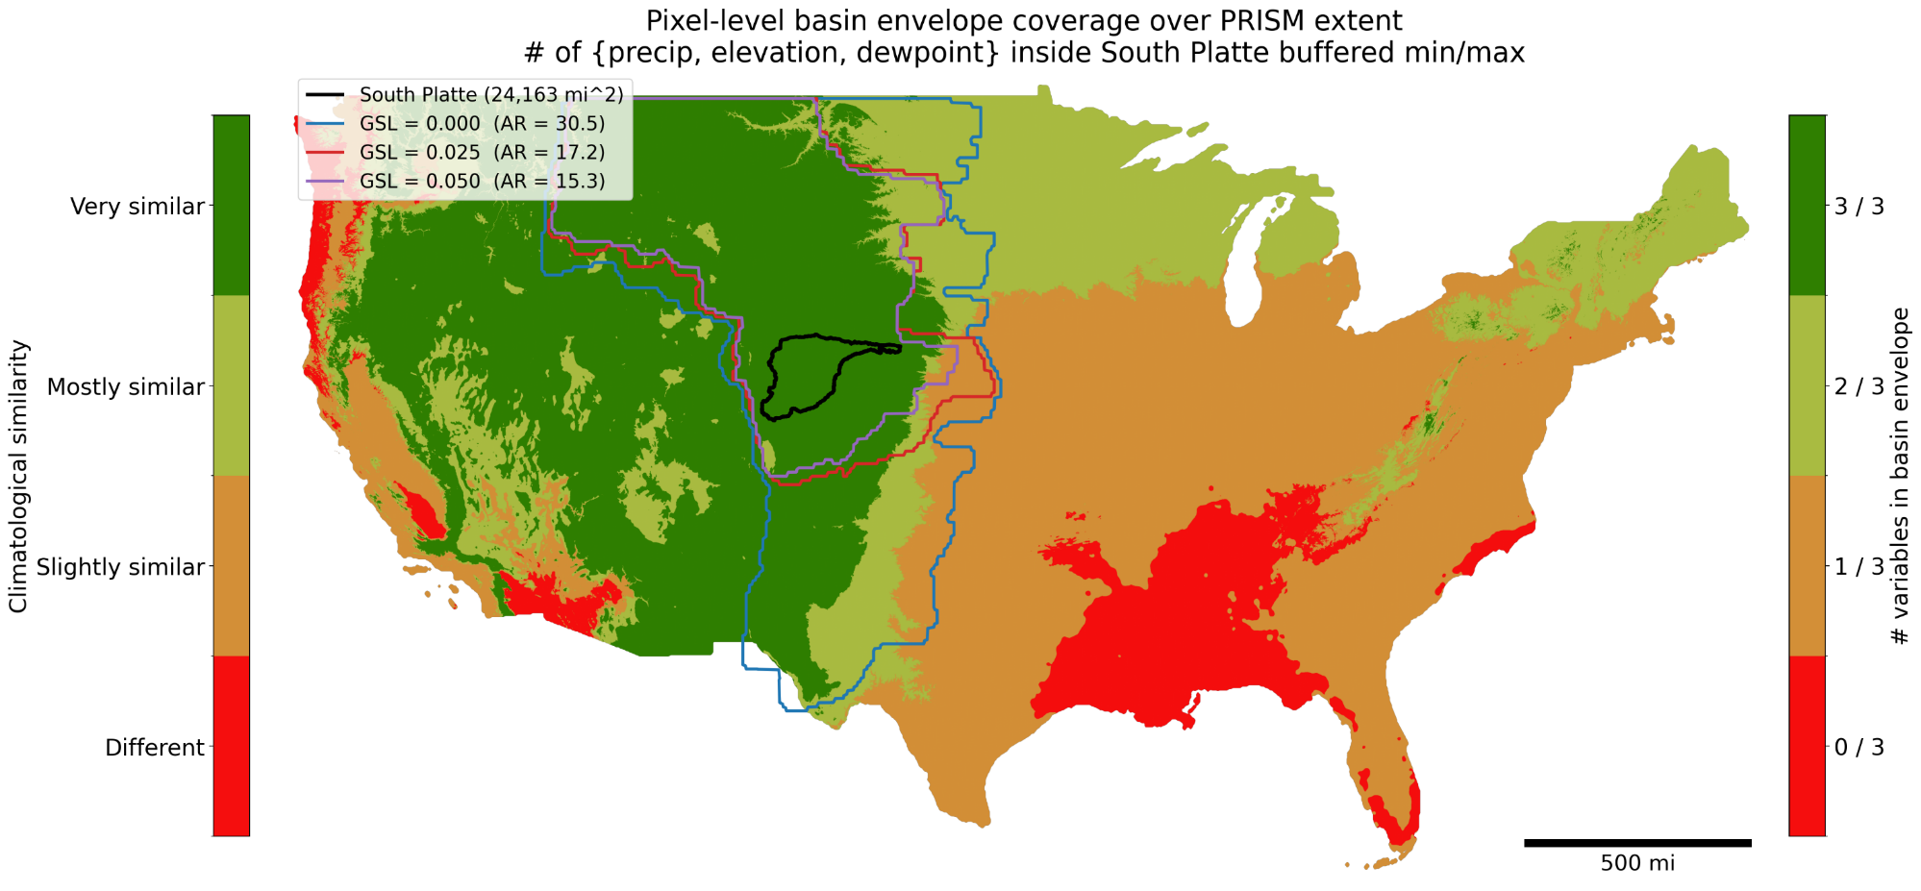
Stage 2: South Platte (HUC 1019)
Meteorological judgement: getting eastern-southeastern extent biggest concern. Dewpoint increases and elevation decreases as you move east -> different storm environments
GSL | AR | Pixels in TD | % Very similar (3/3) | % Mostly + Very (>=2/3) | Y (yr) | Tcap = Y * AR (yr)
0.050 | 15.32 | 1,546,422 | 91.9 | 99.2 | 46 | 705
0.025 | 17.22 | 1,728,117 | 88.0 | 96.6 | 46 | 792
0.000 | 30.52 | 2,928,855 | 68.8 | 92.2 | 46 | 1,404
Notes:
Erica

Slide 20
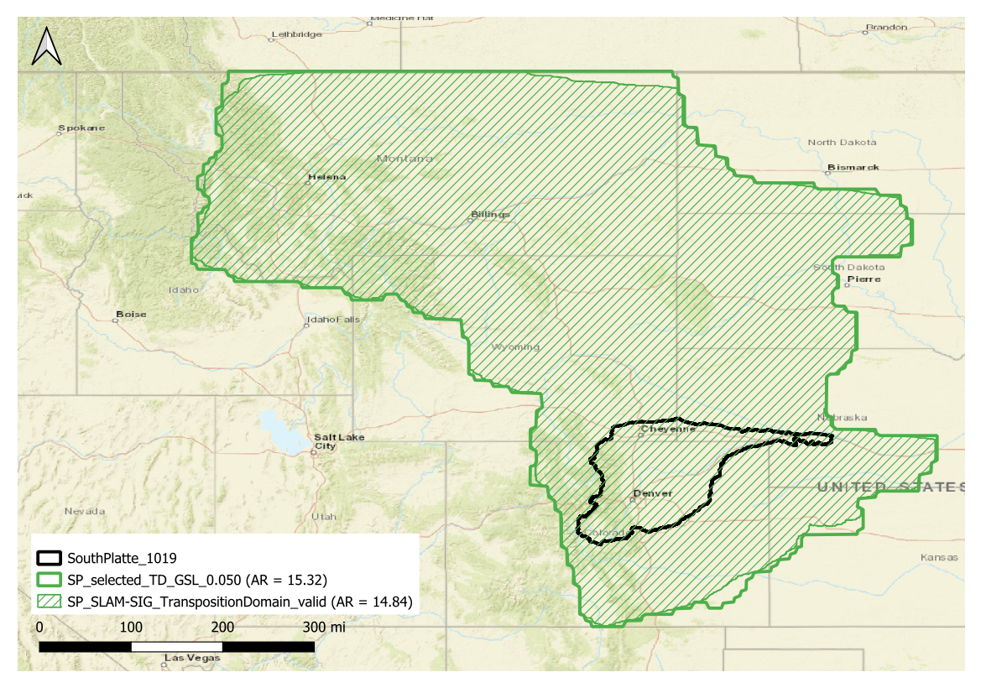
Valid Transposition Domain: South Platte (HUC 1019)
Notes:
Erica

Slide 21
Stage 3: South Platte (HUC 1019)
 | Precip Mean (in) | Precip Min (in) | Precip Max (in) | Elev Mean (ft) | Elev Min (ft) | Elev Max (ft) | Td Mean (F) | Td Min (F) | Td Max (F)
South Platte | 17.5 | 10.5 | 53.0 | 5926.3 | 2772.3 | 14009.2 | 28.9 | 6.8 | 36.8
SLAM-SIG GSL = 0.050 | 18.1 | 6.3 | 87.9 | 4502.4 | 1450.1 | 14019.0 | 29.2 | 4.8 | 39.5
 |  | KS Statistic | Wasserstein | Median Diff | 95th Pct Diff
Variable | Comparison
Precipitation (in) | South Platte vs. SLAM-SIG GSL = 0.050 | 0.1321 | 1.636 | -0.037 | -6.223
Elevation (ft) | South Platte vs. SLAM-SIG GSL = 0.050 | 0.4205 | 1435.373 | 1220.472 | 1466.535
Dewpoint (F) | South Platte vs. SLAM-SIG GSL = 0.050 | 0.1425 | 0.930 | 1.134 | -0.918
Summary of findings:
Selected domain for South Platte: Valid area of SLAM-SIG at GSL = 0.05, AR = 14.84, Tcap = 683 years
Stage 1 kept 3/20 candidate GSLs on the SOP requirement that AR > 5 – no impact to number of passing GSLs from removing Canadian portions of domain
Stage 2 envelope coverage used to define eastern-southeastern extent
Stage 3 statistics describe the chosen polygon's climatology relative to the basin. The KS and Wasserstein values are reported as descriptive distance metrics
Notes:
Erica

Slide 22
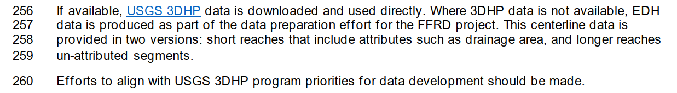
EDH Discussion
Issue: Elements of the December 2025 FFRD SOP (Job Aid 2 – 1.4.2) indicate that FFRD should directly utilize and generally be in alignment with the priorities of USGS 3DHP. Aligning FFRD to USGS 3DHP could be very costly.
Discussion: An evaluation was performed by ARC in February 2025 to assess the alignment of FFRD and USGS 3DHP as well as provide recommendations for synergy between them.
Reference: December 2025 FFRD SOP – Job Aid 2 – Secion 1.4.2

Slide 23
EDH Discussion
FFRD & USGS 3DHP Evaluation – February 2025
Goal: Evaluation of the potential benefits and challenges in shared hydrography efforts between FEMA’s Future of Flood Risk Data (FFRD) initiative and the U.S. Geological Survey (USGS) 3D National Hydrography Program (3DHP).
Findings:
  FFRD EDH was significantly cheaper than USGS 3DHP to produce.
  FFRD EDH is too coarse to benefit USGS 3DHP.
  Existing USGS 3DHP could be leveraged for FFRD EDH but would need to be filtered or modified.
    Streamlines: 3DHP can be leveraged for FFRD but vertices would need to be filtered.
    Hydroconnectors: Both efforts provide minimal benefit to each other. 3DHP hydroconnectors could be leveraged but width is not important to 3DHP so those would have to be adjusted for FFRD. Also, placement would need to be reviewed since 3DHP terrain is in a metric resolution where as FFRD is in feet.
    Breaklines: Neither efforts provide much value to each other. Breaklines are not an influential layer to 3DHP.

Slide 24
EDH Discussion
Suggested Updates and Clarification:
Update text within the FFRD SOP to suggest leveraging existing USGS 3DHP data with some filtering and modification for use in FFRD.
Where USGS 3DHP is not available, EDH would generally be autogenerated using the following general process:
      Use FFRD SOP Terrain (4ft Resolution)
      Apply Hydro-Enforcement
        Incorporate Bathymetry Where Available
        Hydro-connections
      Use ArcHydro (or other industry standard processes) to delineate the EDH.
      Post-Processing (General Cleaning & Smoothing)

Slide 25
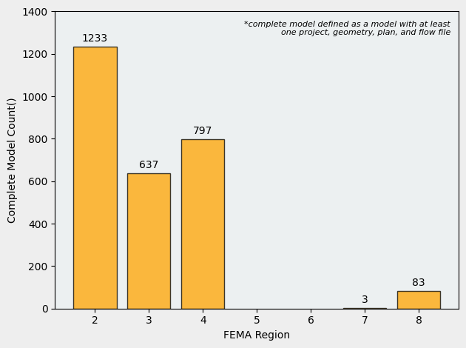
Review of MIP Scrape

Slide 26
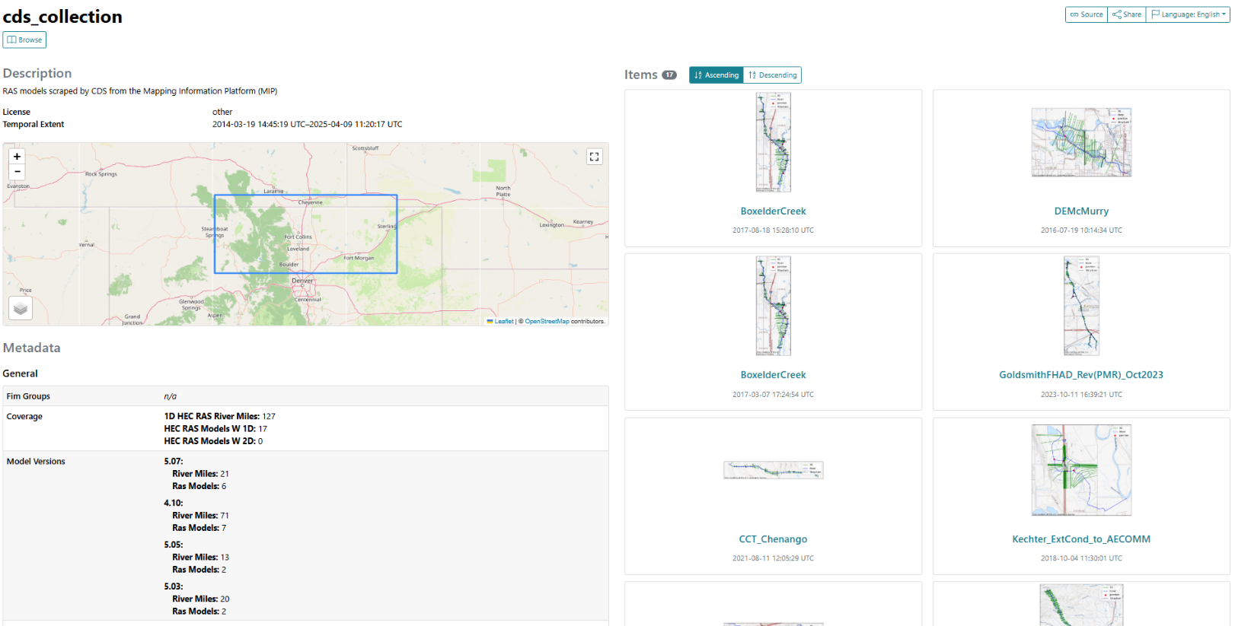
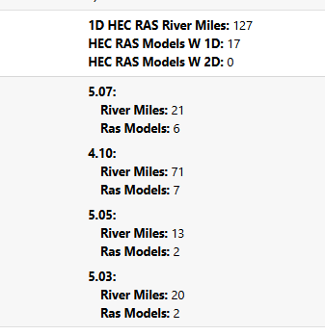
Review of MIP Scrape- South Platte

Slide 27
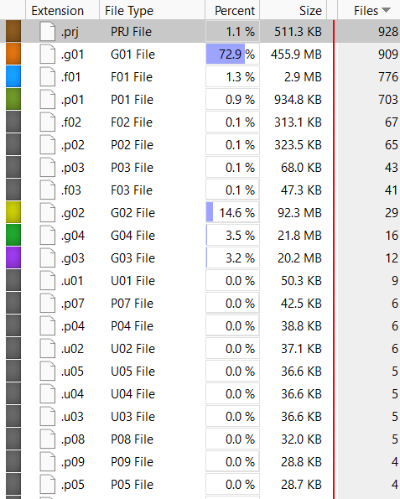
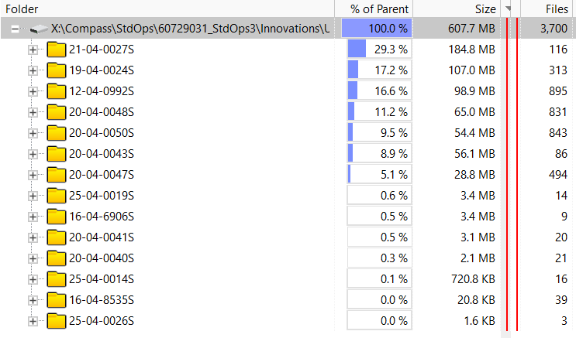
Review of MIP Scrape – Upper TN
File Contents
File Types

Slide 28
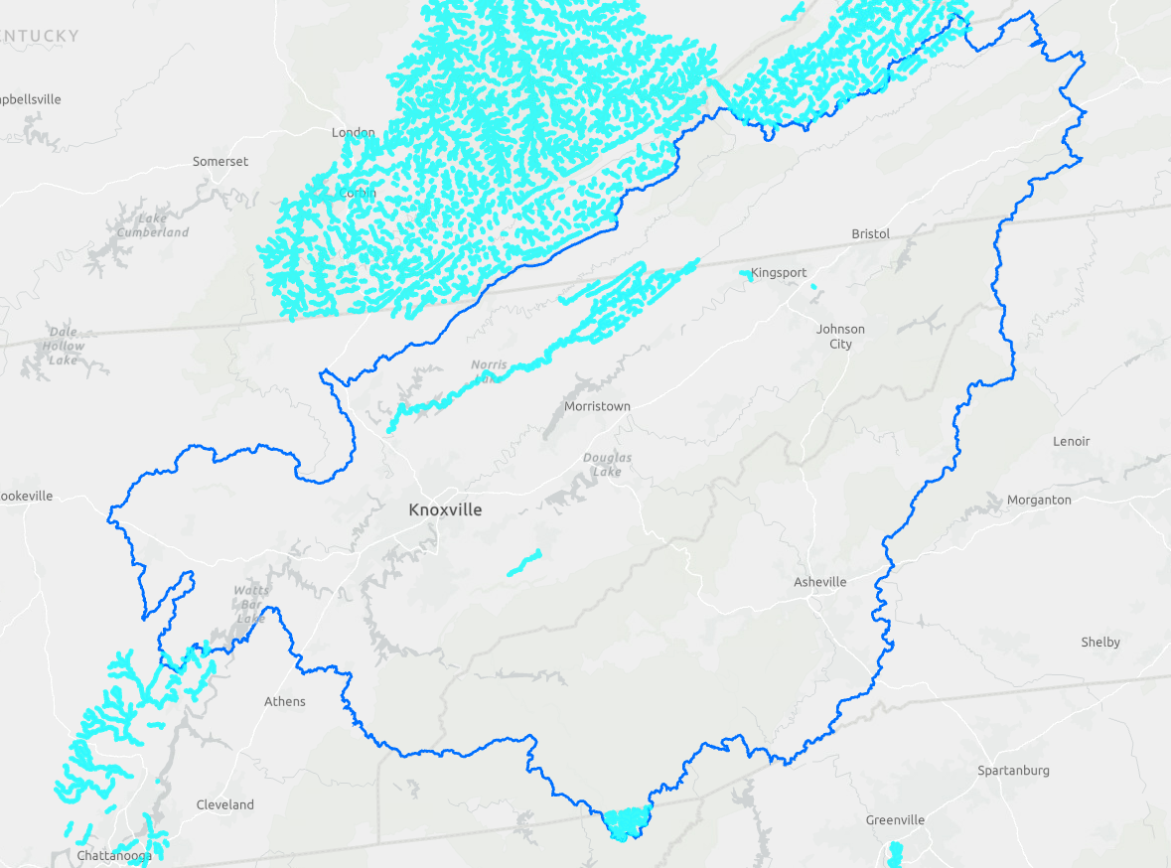
Review of MIP Scrape – Upper TN
Geometry Features Extracted from MIP Data*
Challenges
  Data with different projections
  Image does not have all projections fully resolved
Many 1D BLE Areas
  Not as directly useful as Zone AE
Missing Key Areas
  Detailed streams near Asheville, Knoxville, and Kingsport
Areas outside of Basin
* First Pass with export of spatial data from .g0x files

Slide 29
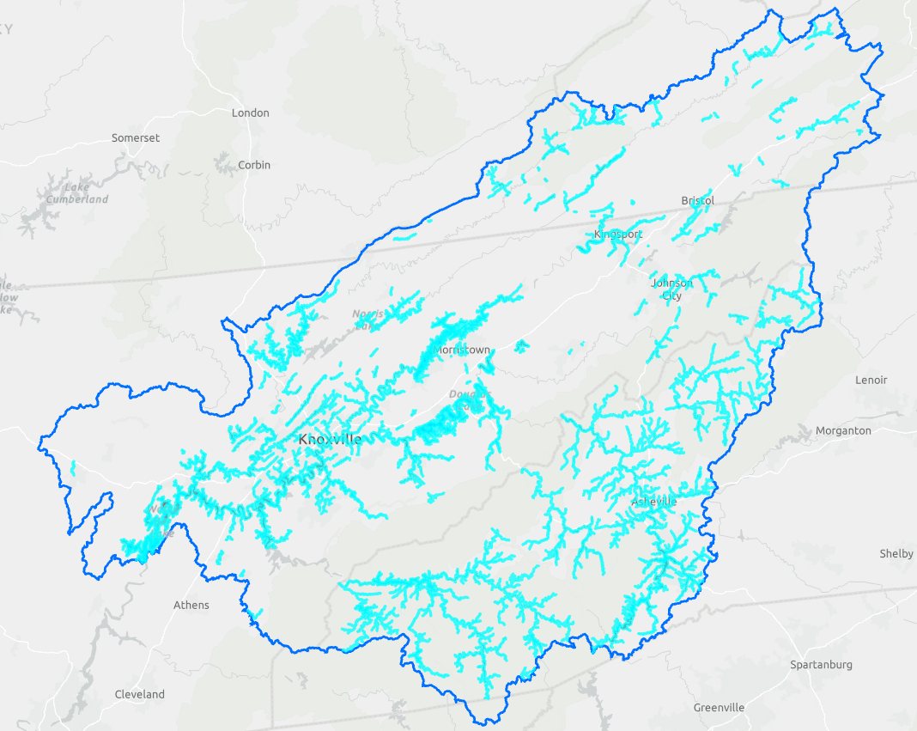
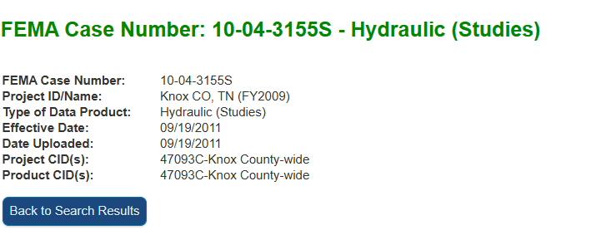
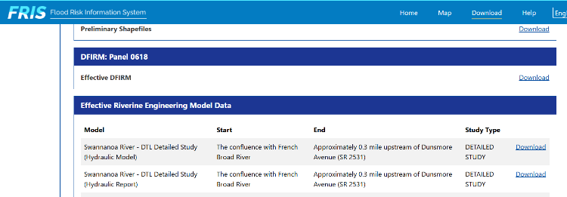
Review of MIP Scrape – Upper TN
Existing Detailed Studies in Upper TN
Calculated with NFHL Data
Areas of Interest to leverage geometric data for structures and bathymetry
Ex: Key Missing Studies

Slide 30
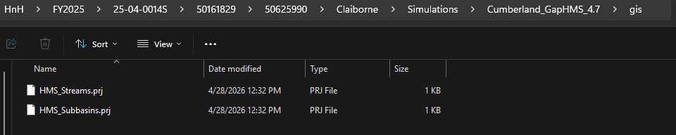
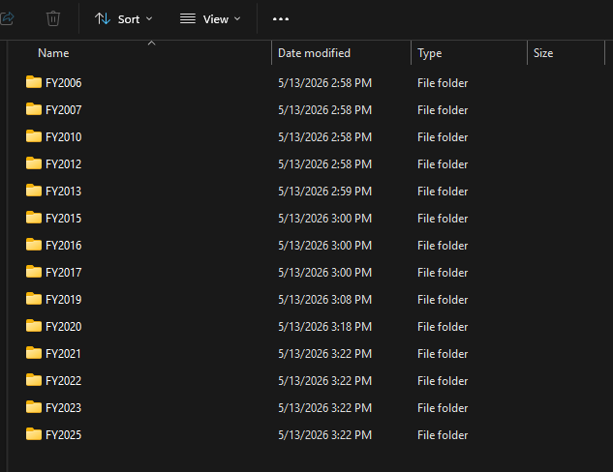
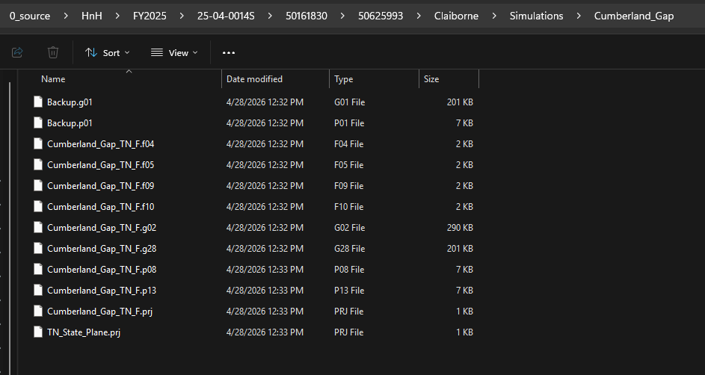
Review of MIP Scrape – Allegheny
2.4 GB – 25,677 Files

Slide 31
References
ARC, Compass, and STARR II (Joint PTS). (2025, December). Validation Basin(s) – Hydrology First Prospectus (Final, December 12, 2025).
ARC, COMPASS, & STARR II (Joint PTS). (2026, February). FFRD SOP: Proposed terrain tiling standards. FEMA Future of Flood Risk Data Program. Internal memorandum.
Federal Emergency Management Agency & U.S. Army Corps of Engineers. (2025, December). Future of Flood Risk Data methodology standard operating procedure—Inland (Volume II: Technical standards and procedures, Version 1 draft).
STARR II. (2026, March). South Platte Transposition Domain Investigation. FEMA Future of Flood Risk Data Program. Internal memorandum.
Williams, T. (n.d.). ffrd-grid-tiling [Source code]. GitHub. https://github.com/fema-ffrd/ffrd-grid-tiling
Wright, D. B., FitzGerald, B., & Yan, L. (2025). Advancing the science of extreme storms for hydrological and hydraulic modeling: Year 1 (1 September 2025—30 November 2025) Deliverables D1, D2, and D3 (DHS Coastal Resilience Center Report). University of Wisconsin–Madison. FEMA Contract No. 70RSAT21G00000013.

Slide 32
Federal Emergency Management Agency, U.S. Army Corps of Engineers, & Joint PTS Team (ARC, COMPASS, and STARR II). (2026a, February 20).FFRD Validation Basin bi‑weekly meeting transcript and recording. Internal project record.
Federal Emergency Management Agency, U.S. Army Corps of Engineers, & Joint PTS Team (ARC, COMPASS, and STARR II). (2026b, March 6).FFRD Validation Basin bi‑weekly meeting transcript and recording. Internal project record.
Federal Emergency Management Agency, U.S. Army Corps of Engineers, & Joint PTS Team (ARC, COMPASS, and STARR II). (2026c, April 17).FFRD Validation Basin bi‑weekly meeting transcript and recording. Internal project record.
Federal Emergency Management Agency, U.S. Army Corps of Engineers, & Joint PTS Team (ARC, COMPASS, and STARR II). (2026d, May 1).FFRD Validation Basin bi‑weekly meeting transcript and recording. Internal project record.

