Slide 1
FFRD Validation Basins
Cross-Basin Meeting
May 1st, 2026

Slide 2

Agenda
Introduction - FEMA
Data Provider Outreach
Technical Discussions
Basin Progress

Slide 3
Data Provider Outreach
Status Update
Next Steps/Actions

Slide 4
Basin Progress
 | Progress Achieved Last 2 Weeks | Progress Planned Next 2 Weeks | Backlog
Scoping and Data Preparation | Updated Data Provider Outreach | Potentially Begin Data Provider Outreach Urban Stormwater Scoping | Collect all FEMA Models Update Scoping & Data Preparation Reports & Deliverables
Geospatial | Begun to collect and review past pilot study data for EDH recommendations. | Complete EDH Review/Recommendations | Standardize Metadata/Attributes Collect and Incorporate Bathymetric Data
Meteorology | Begun Transposition Domain Evaluations | Finalize Transposition Domain Selection | Update Meteorology Deliverables
Hydrology |  |  | Update HMS Model & Inputs Continue Flood Mechanism Analysis (Mixed Populations) Continue Calibration Event(s) Selection/Collection
Hydraulics |  |  | Pilot 1 RAS Model Per Basin
Dam/Levee |  |  | Finalize Dam Scoping Table Coordinate with USACE on Levee Refinement
Review and Reporting |  |  | Finalize Report and BE-PWP Internal Review

Slide 5
Technical Discussions
04-17-2026

Slide 6
SLAM-SIM vs. SLAM-SIG Domain Selection
Current Meteorology work to date based on SLAM-SIM version 1 (24/72hr) overlap
  Received February 13th
Since then, a new version of SLAM-SIM and SLAM-SIG domains have been posted
  SLAM-SIG domains contain both 72hr and 24hr versions, with varying GSLs
PTS to evaluate various domains in consistent manner to determine consistent domain usage
  Utilize PRISM comparison metrics from South Platte Transposition Domain Investigation (Mar 2026)

Slide 7
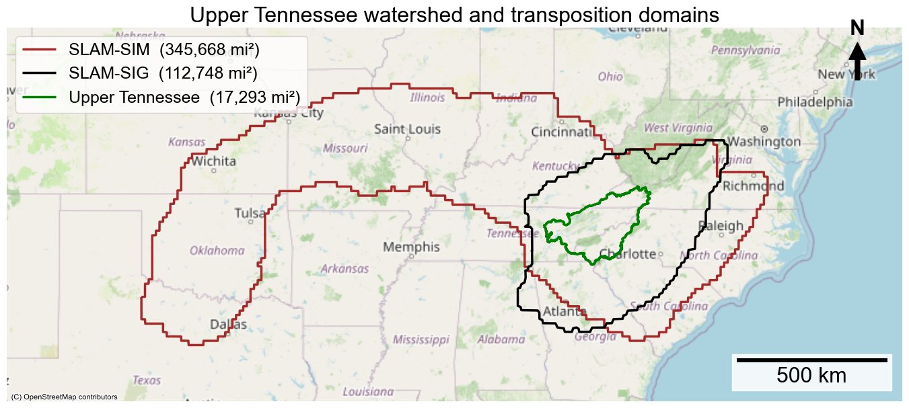
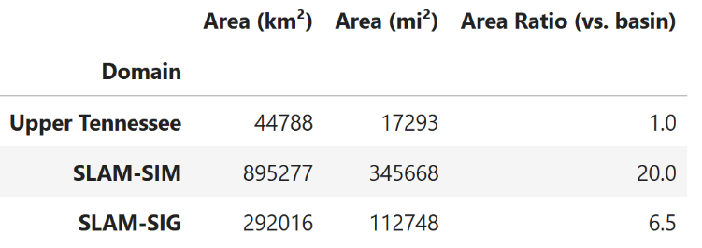
Updated SIM domain (AR=20)
Updated SIG domain (GSL=0.0)
24-hr &72-hr intersection
30-yr Normal Meteorology
Storm Catalog Distribution

Slide 8
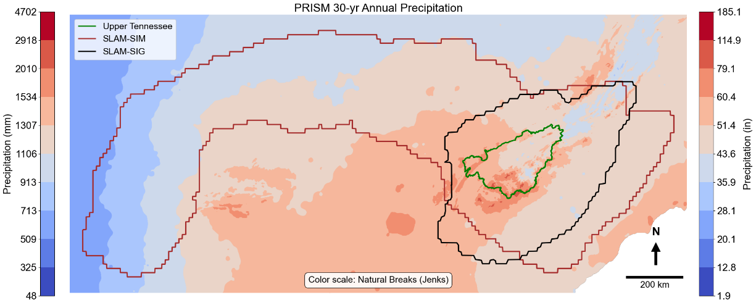
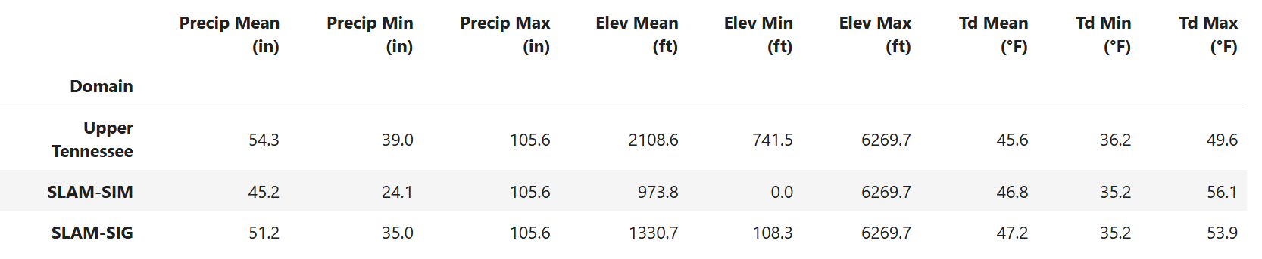
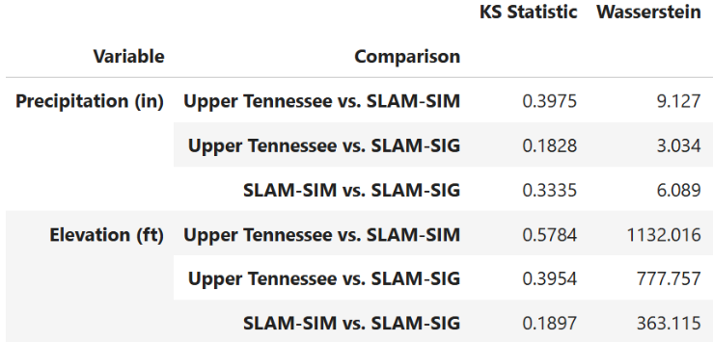
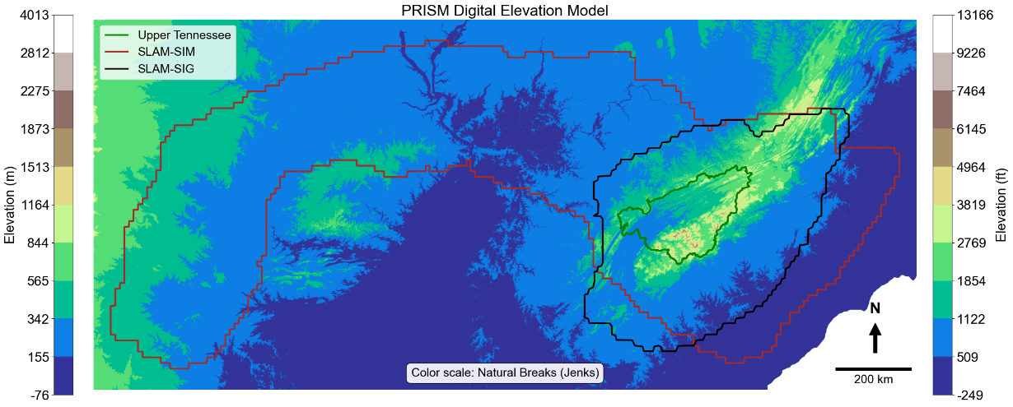

Slide 9
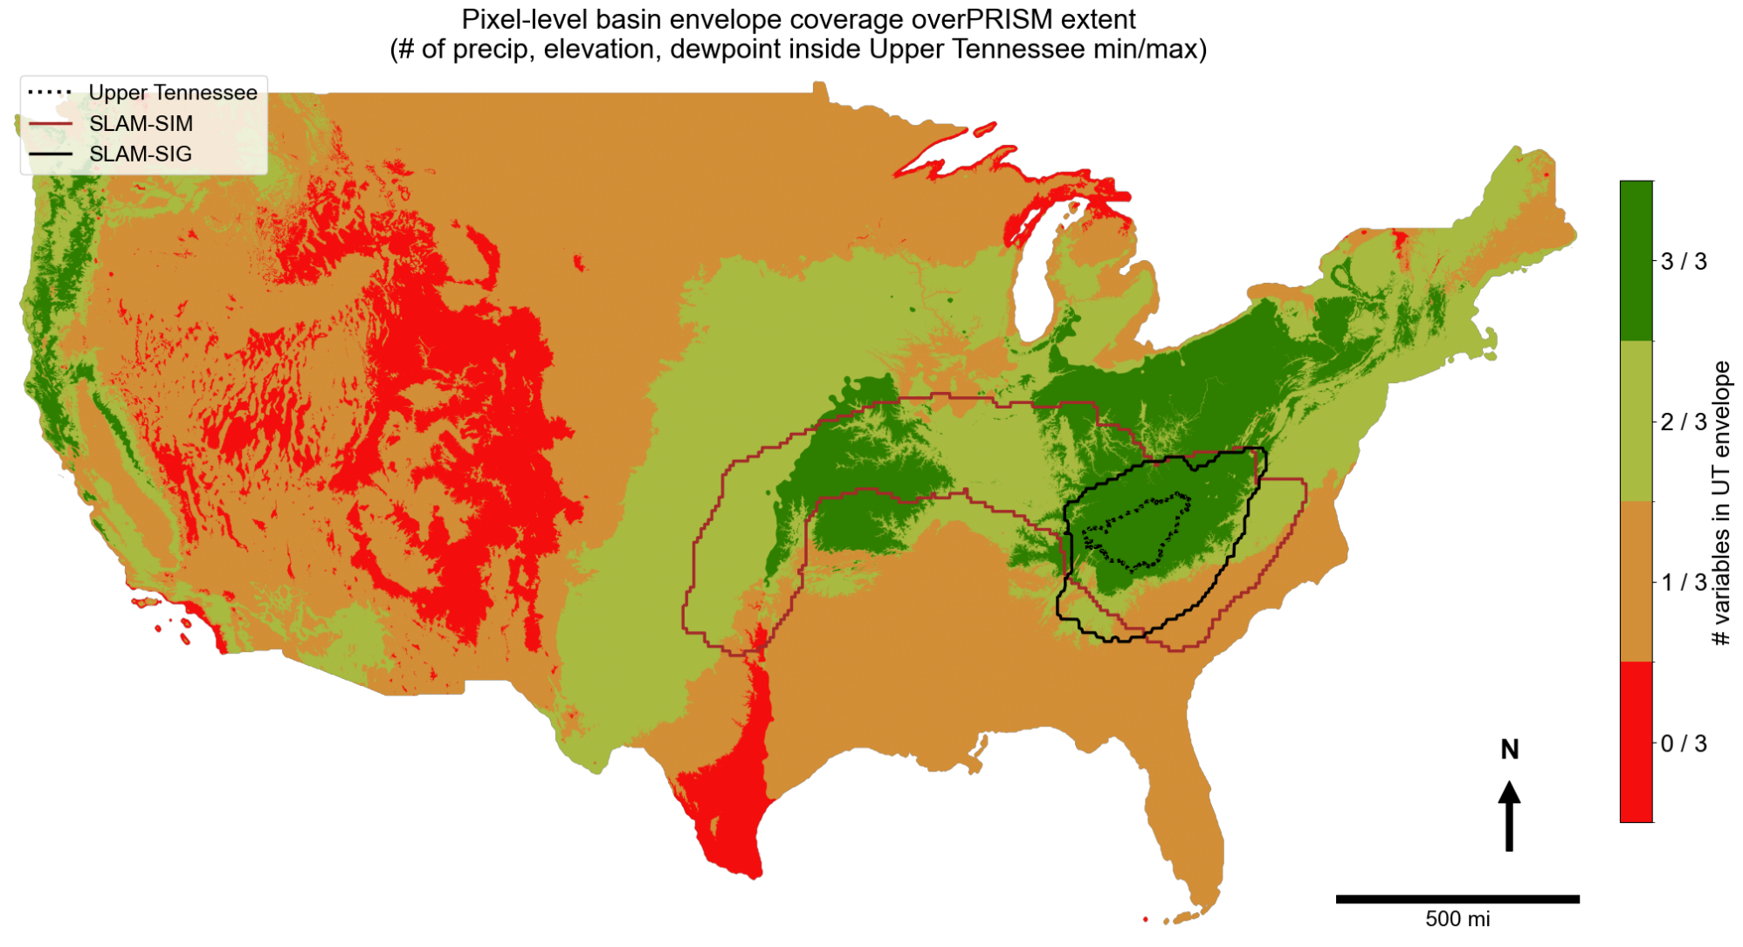

Slide 10
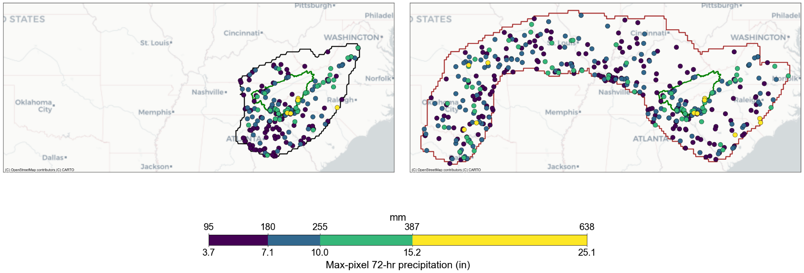
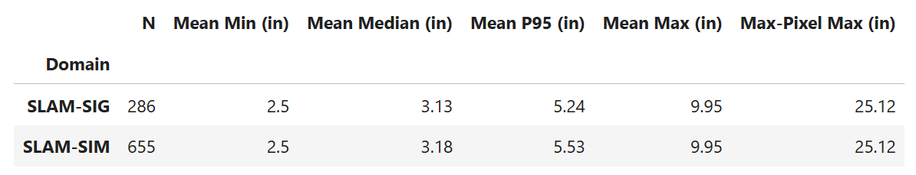
Storm Peak Locations (filtered by basin mean>2.5 in)
Color scale: natural breaks

Slide 11
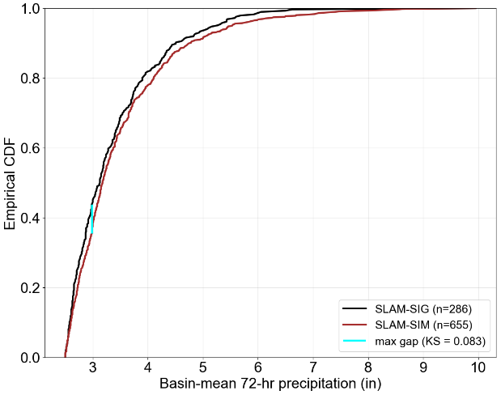
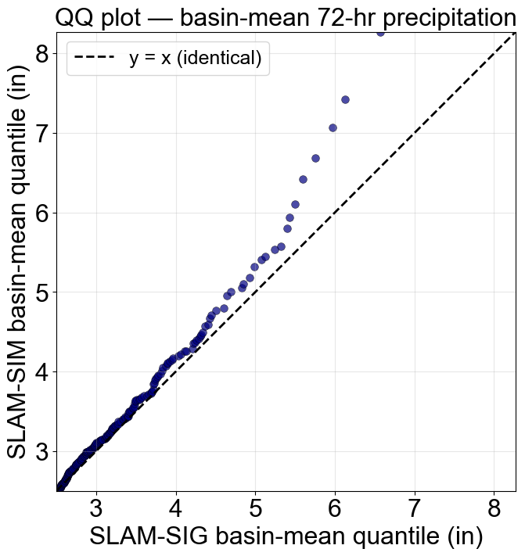
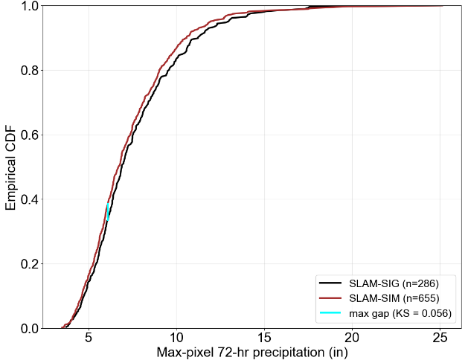

Slide 12
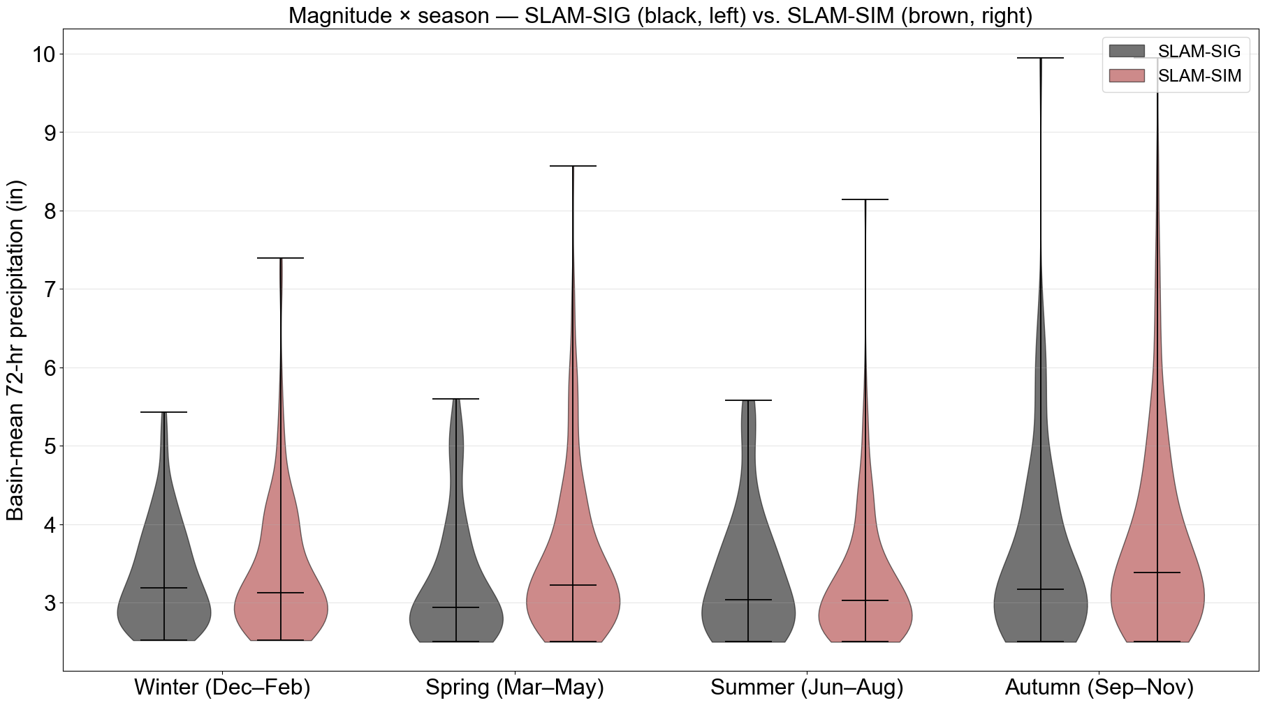
Magnitude, Distribution, and Seasonality

Slide 13
 | Consistency Across Basins | SST Limit (Tcap) | Precipitation Magnitude | Seasonality | SOP Alignment (Meteorologically Similar)
SLAM-SIM | X | X | X
SLAM-SIG |  |  | X | X | X
Underlying SLAM assumption
SLAM (Wright et al. 2025) defines the transposition domain as the region within which the statistical moments (L-moments) of annual maximum precipitation behave similarly.
Allegheny River Basin (72-hr),
  GSL=0.0, AR=99.2
Upper Tennessee River Basin (72-hr),
  GSL=0.0, AR=6.4
South Platte River Basin (72-hr),
  GSL=0.0, AR= 36.1
SOP Volume II, Section 5.3
The fundamental assumption made by using SST is that a region of homogeneous meteorology containing the study watershed can be constructed. The domain is used to identify and select storm events to use in the catalog and to define the limits of where events can be moved during stochastic simulations. Development of a transposition domain requires expert judgment and remains a subjective process until a repeatable, objective process is developed. The region must contain the study watershed in its entirety and be several times larger, with a recommended lower limit of 5 times the watershed area.
Upper Tennessee River Basin (72-hr),
  SLAM-SIG, Tcap = ~295 yr
  SLAM-SIM, Tcap = ~920 yr

Slide 14
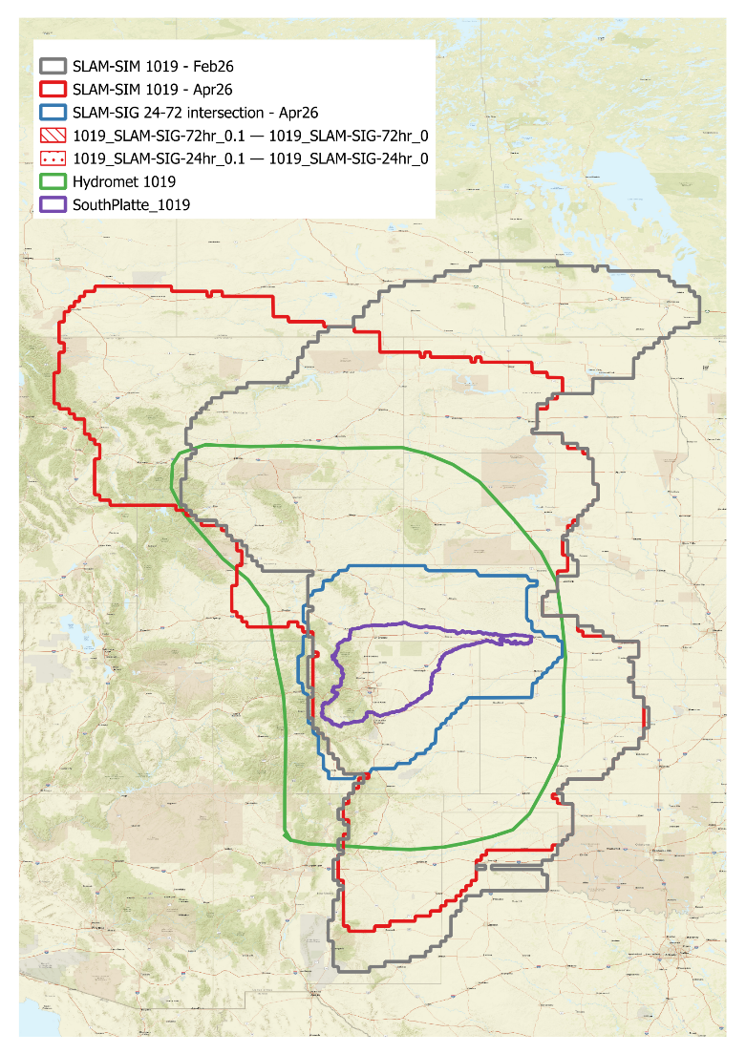
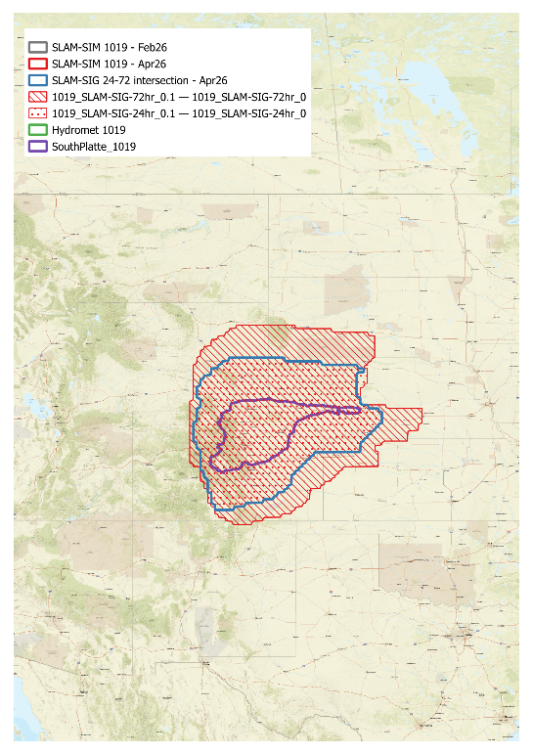
SLAM-SIM February
  ~20x area ratio
SLAM-SIM April
  ~20x area ratio
  Largest difference in northern extent with updated version
SLAM-SIG
  ~4x area ratio
  Intersection of 24-hour and 72-hour
Hydromet Domain
  ~12x area ratio

Slide 15
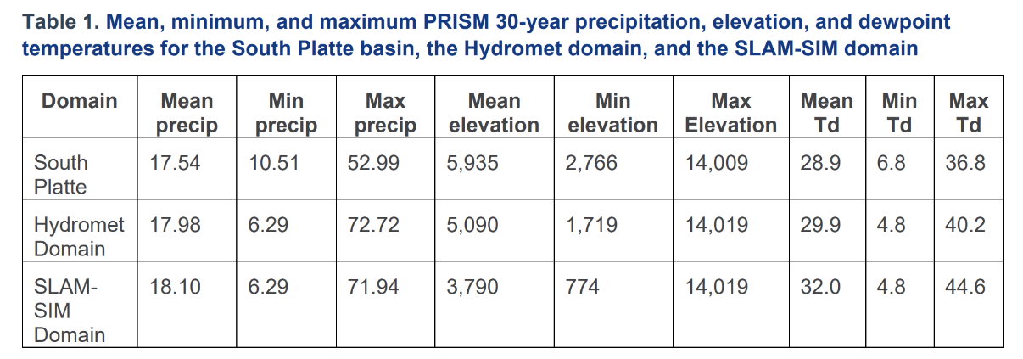


SLAM-SIG | 18.06 (-0.52) | 7.16 (3.35) | 72.72 (-19.73) | 5515 (420) | 2293 (473) | 14019 (-10) | 29.68 (-0.78) | 5.13 (1.67) | 38.08 (-1.28)
SLAM-SIM (Apr 26) | 17.89 (-0.35) | 6.29 (4.22) | 75.51 (-22.52) | 4036 (1899) | 1240 (1526) | 14009 (0) | 31.17 (-2.27) | 4.8 (2) | 43.38 (-6.58)
Difference = South Platte – SLAM domain
Notes:
Differences in max precip not as worried about – even the hydromet domain has that and can be ‘washed out’ in normalization
Significant differences in average elevation
SLAM-SIM April slight improvement from February but still ~1900 ft difference
SLAM-SIG not bad, but again tiny domain
Dewpoint temperature
SLAM-SIG slightly more moisture
6.5 degree difference in dewpoint temperature b/ SP and SLAM-SIM April, still seeing storms from a much moister environment

Slide 16
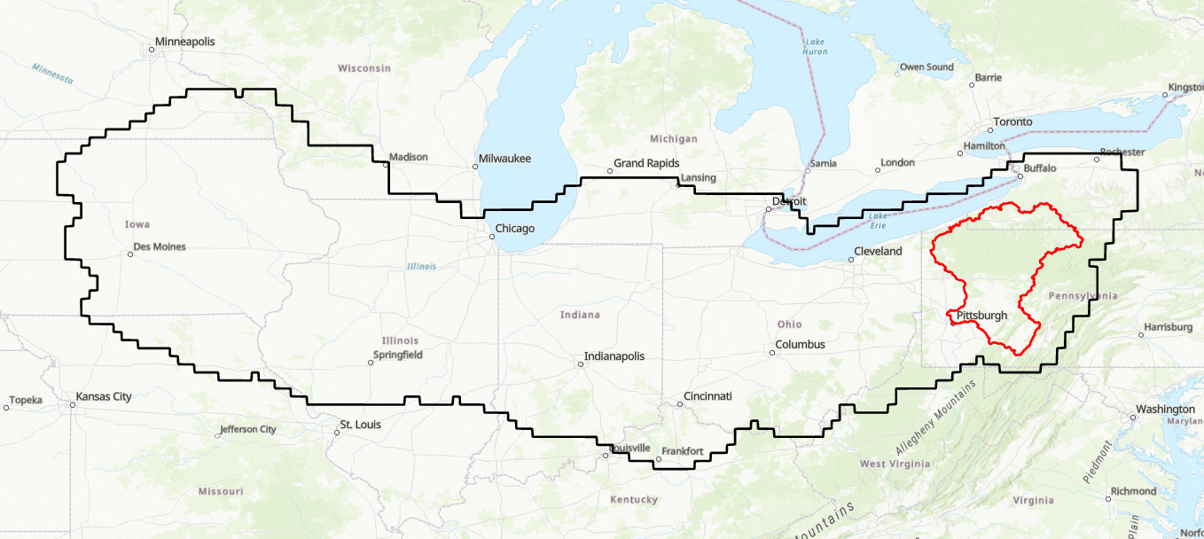
SLAM-SIMv1
Used by ARC during SO3.1
Mosaic of both 24 and 72-hour storm durations.
Received Feb 13, 2026, after revising from PTS comments

Slide 17
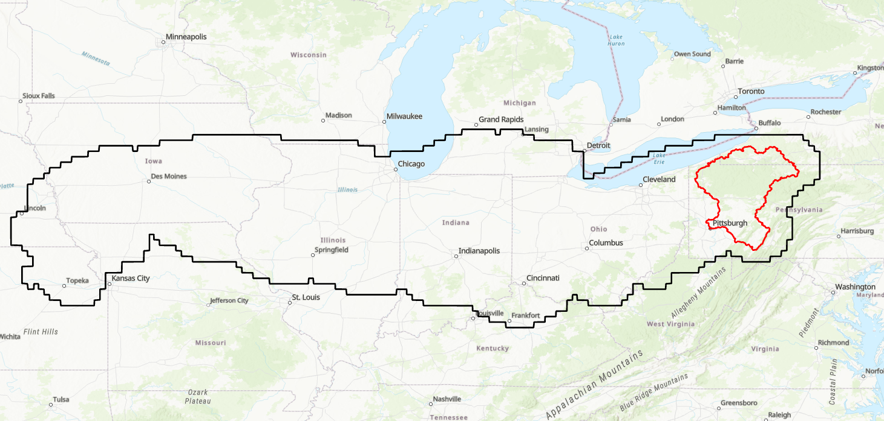
SLAM-SIMv2
Mosaic of both 24 and 72-hour storm durations
Produced March 25, 2026

Slide 18
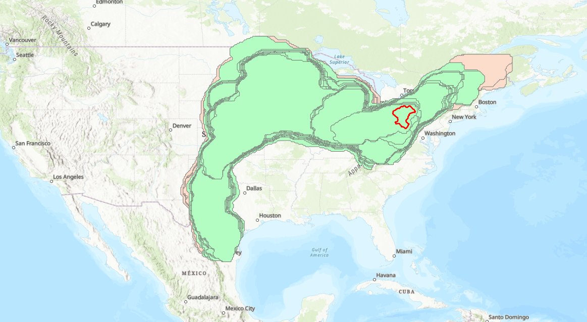
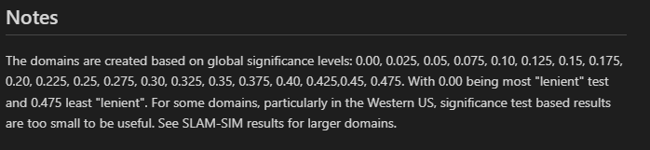
SLAM-SIGv0
Individual TD’s for both 24 and 72-hour storm durations
Partitioned by “global significance levels - GSL”
Produced March 31, 2026

Slide 19
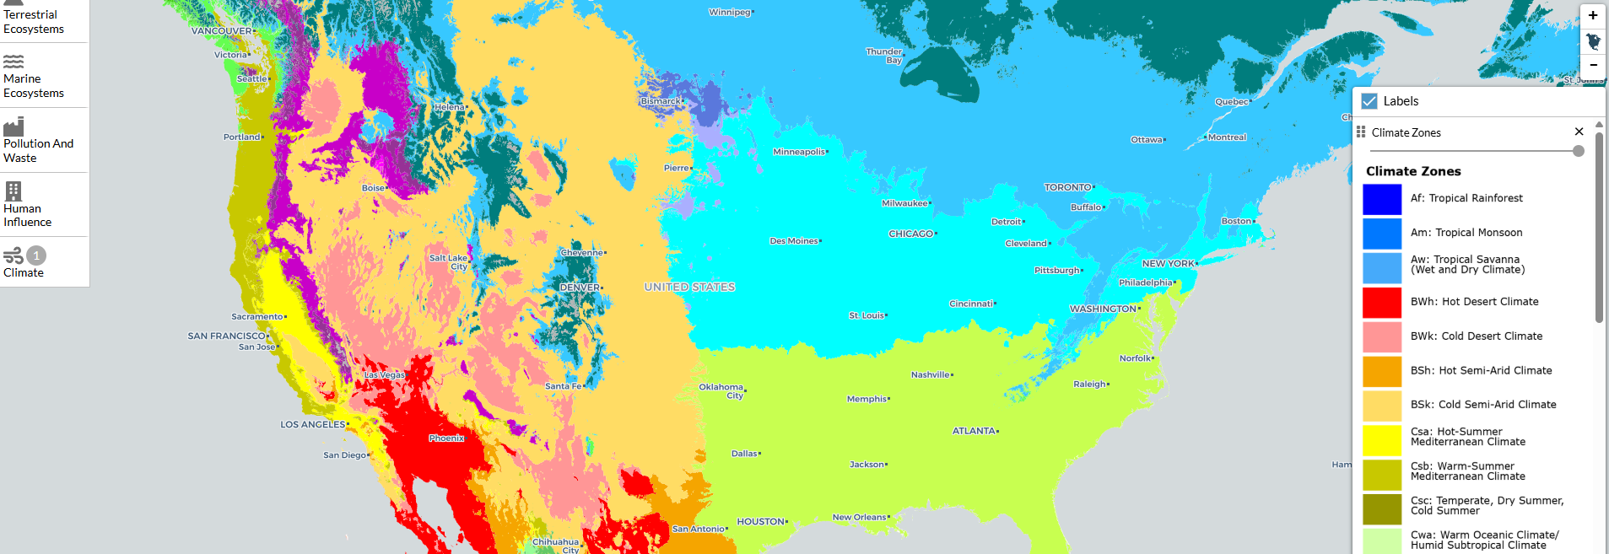
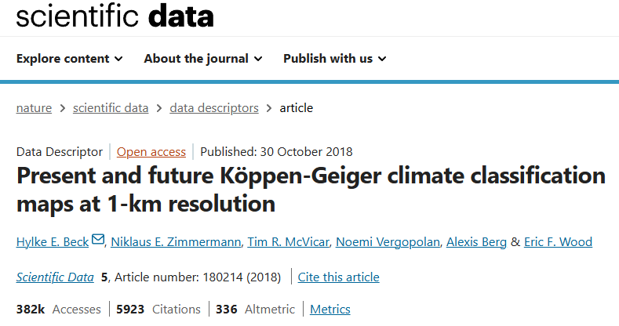
Comparisons to Climate Zones
North American Environmental Atlas

Slide 20
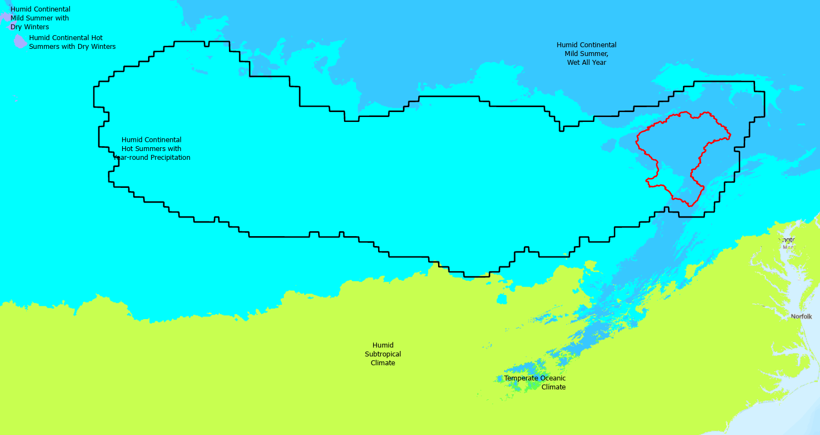
SLAM-SIMv1

Slide 21
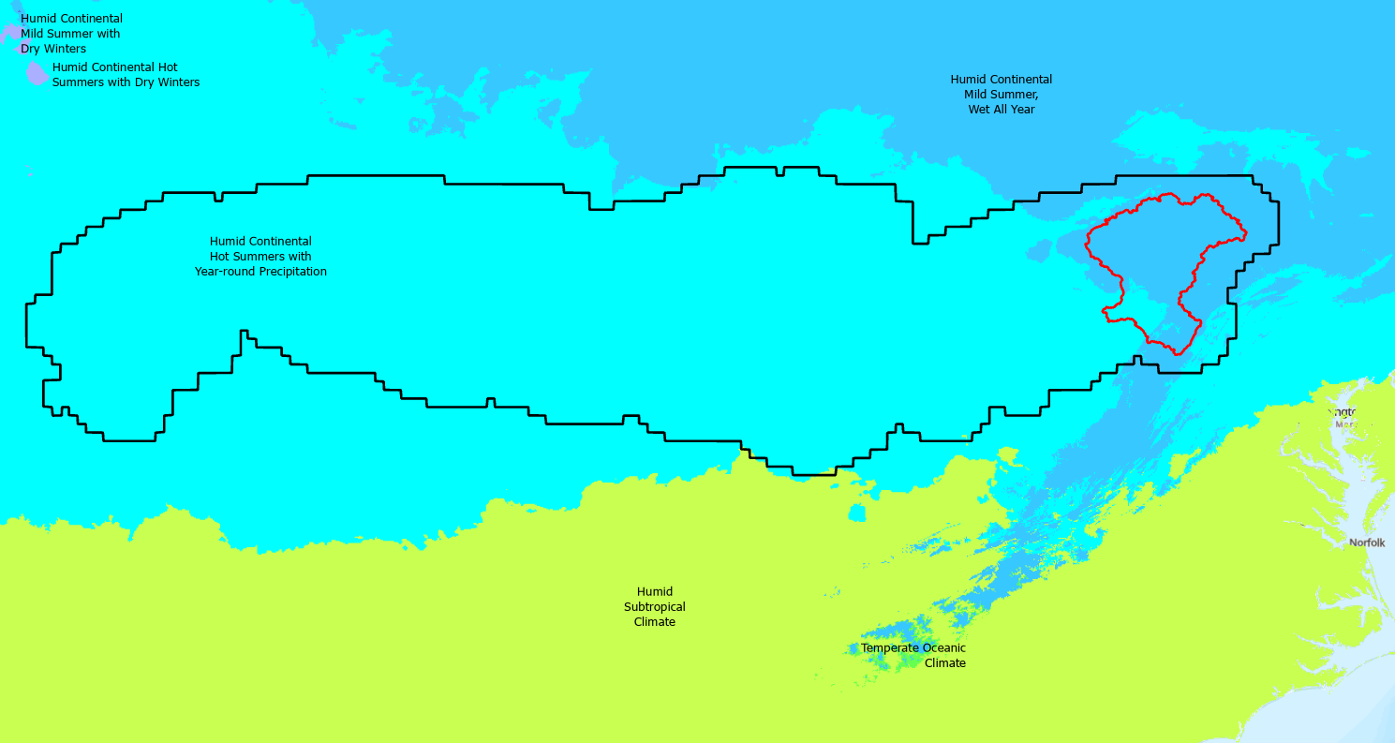
SLAM-SIMv2

Slide 22
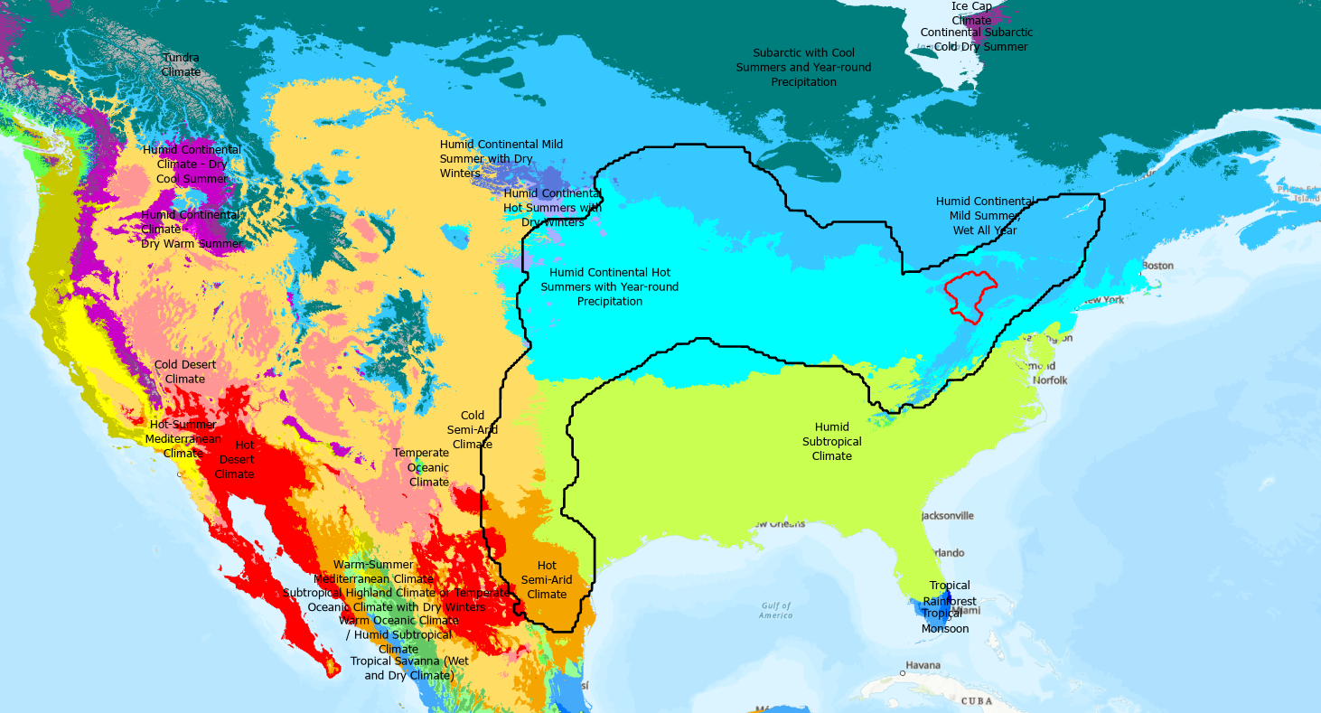
SLAM-SIGv0 (GSL=0.1)

Slide 23
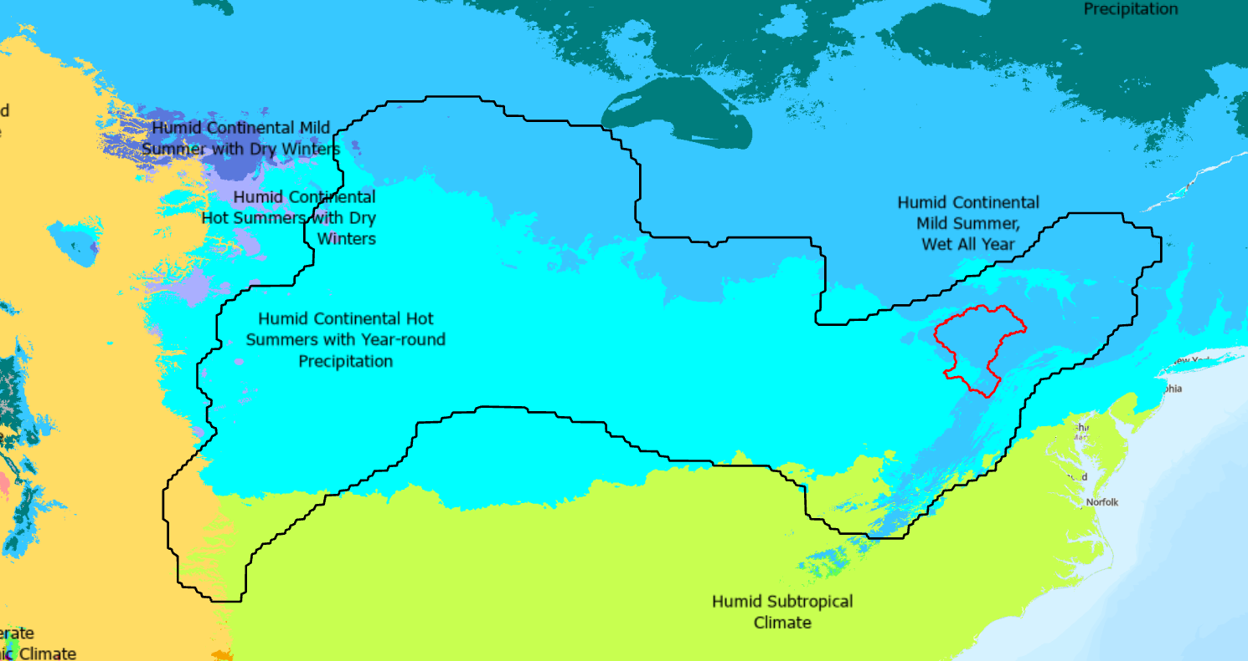
SLAM-SIGv0 (GSL=0.3)

Slide 24
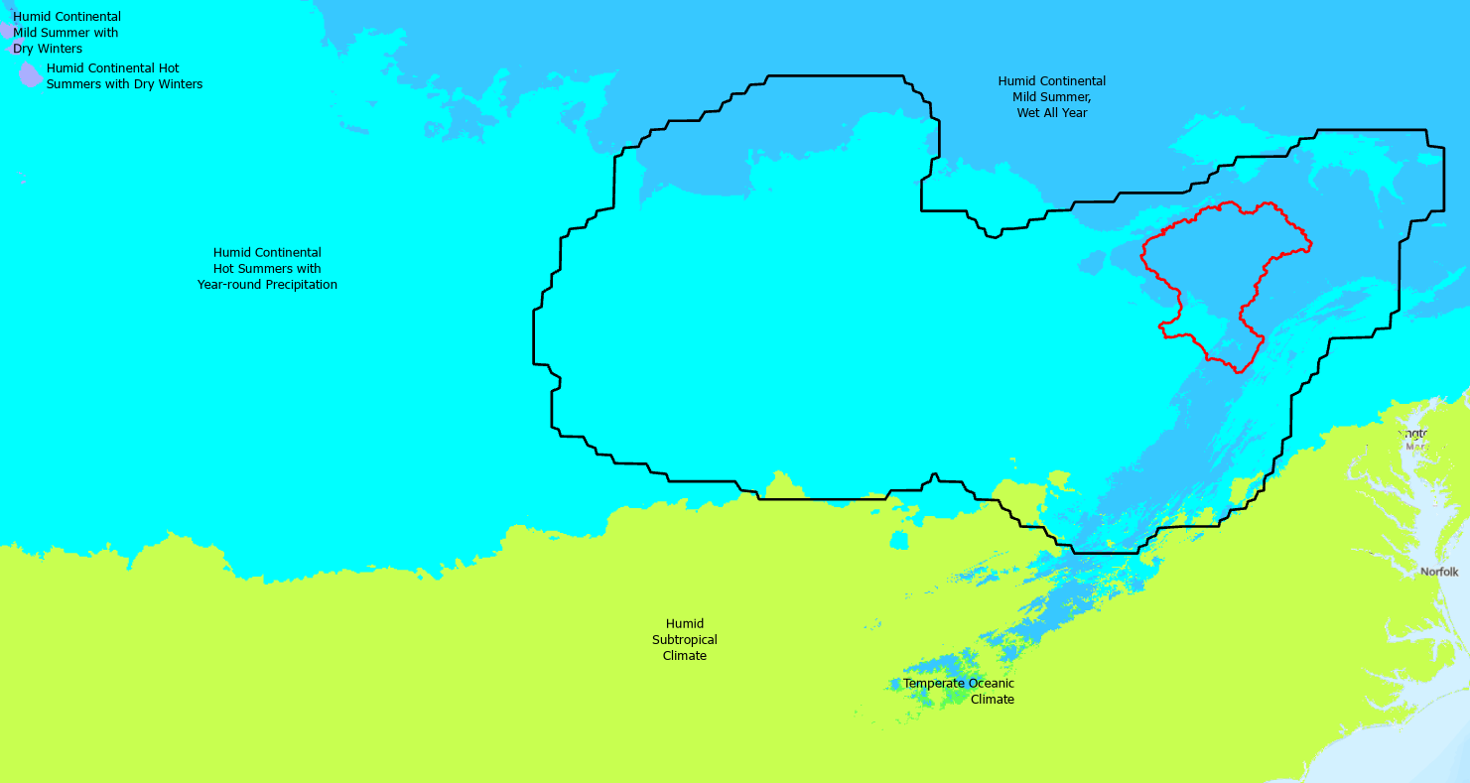
SLAM-SIGv0 (GSL=0.4)

Slide 25
STAC for data delivery and SOP Integration
Existing templates and examples
  Models
  Supporting Data
Integrating STAC into job aids
  Machine readability and consistency
  Metadata fields
  Collections

Slide 26
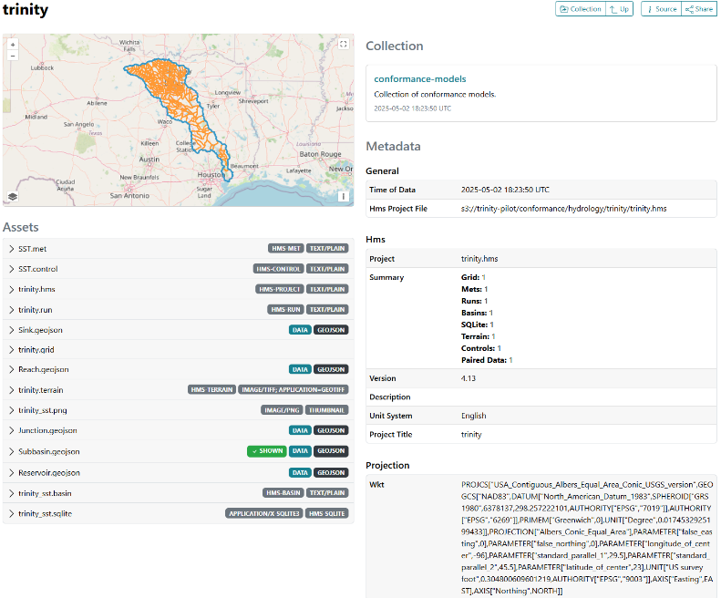
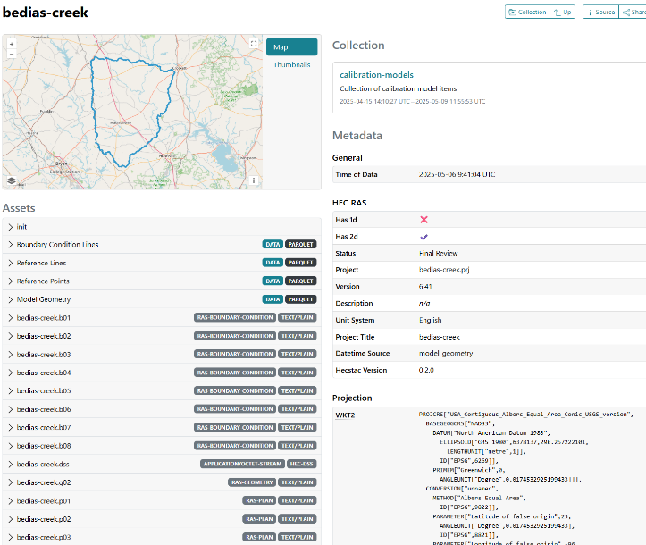
Models
RAS & HMS templates and tools
Need to define what fields / properties to include
Ensure linking (to foundational datasets)

Slide 27
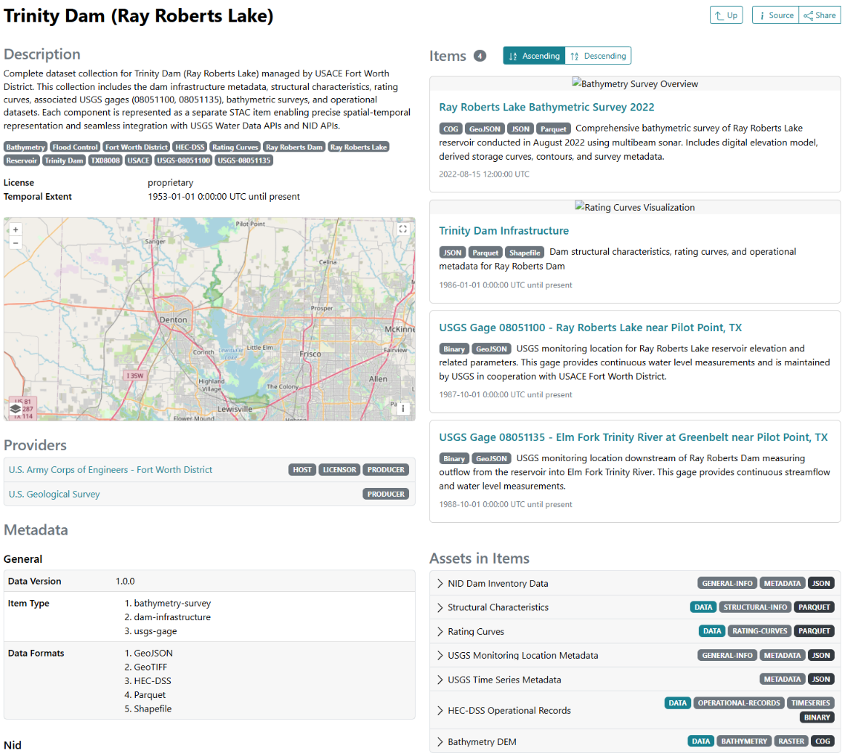
Foundational
Data
Dam Example
Assets with data integrated into models
Backup and other related data
Links (NID, SOP, etc)

Slide 28
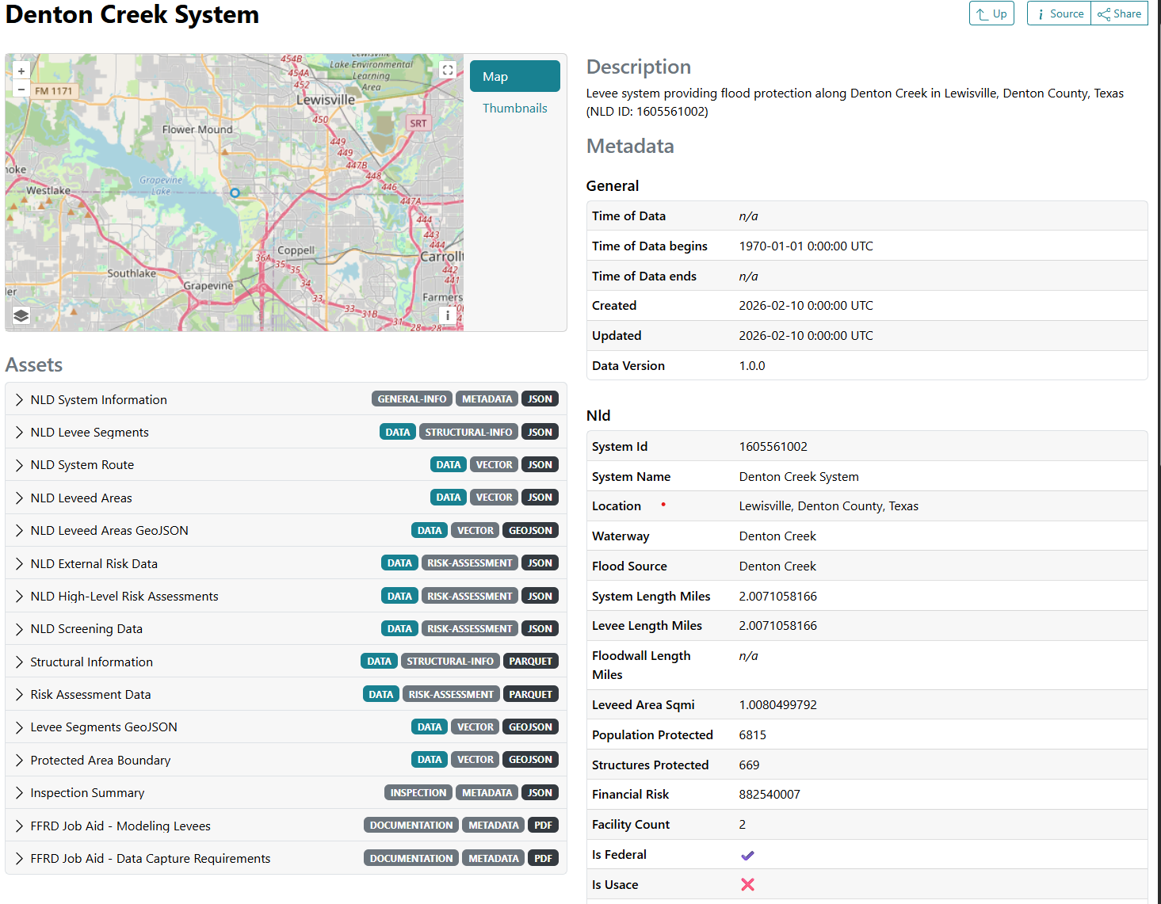
Foundational
Data
Levee Example
Assets with data integrated into models
Backup and other related data
Links (NID, SOP, etc.)

Slide 29
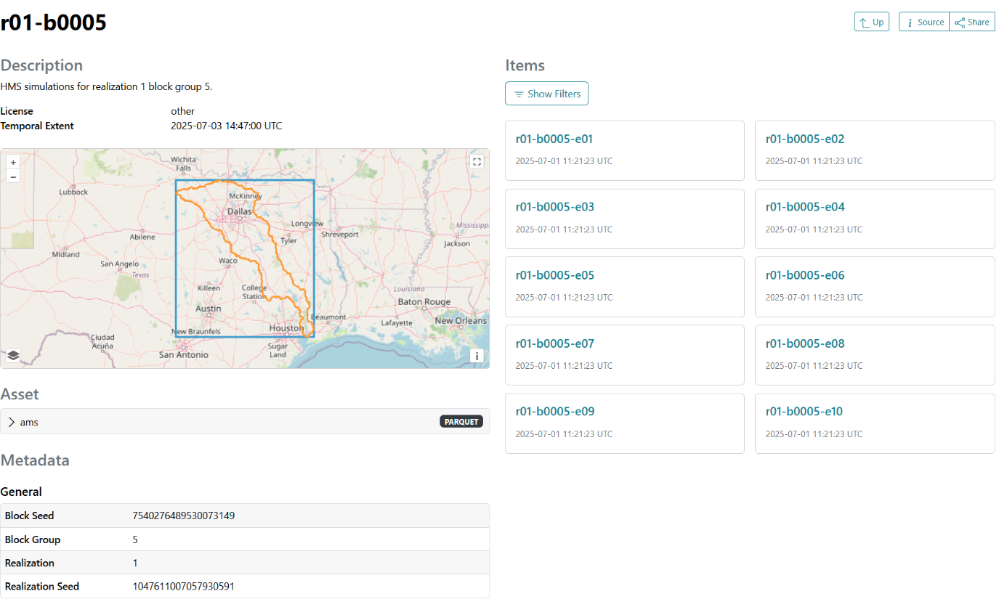
Collections and Linkages
Define metadata approach for collections
Use linkages for validation
Source for data quality and integrity

Slide 30
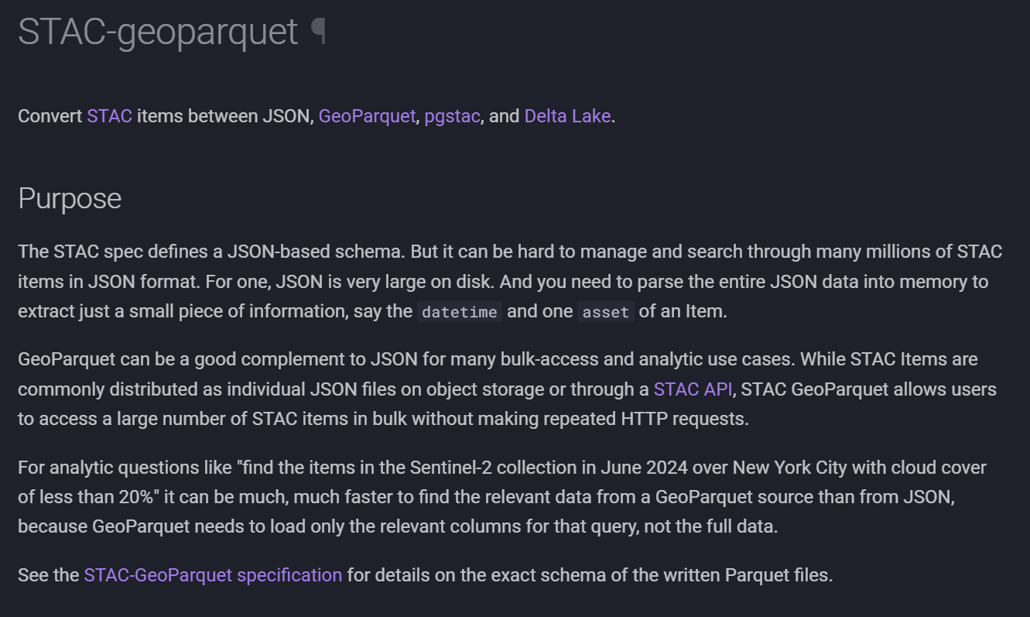
Collection Mirrors

Slide 31
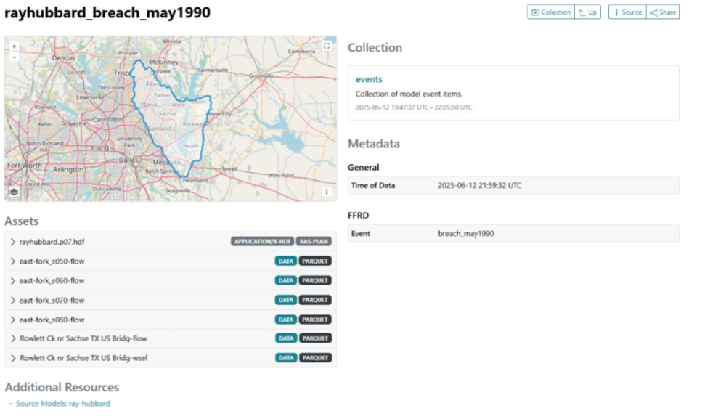
Events Collections
Calibration
Conformance

Slide 32
SOP integration and Job Aids
Machine Readability
Excel Spreadsheets --> CSV
Versioning
Guidance and documentation
Schemas and other standards
Properties
Schemas and other standards
Item specific requirements

