Slide 1
Technical Discussions
04-17-2026

Slide 2
SLAM-SIM vs. SLAM-SIG Domain Selection
Current Meteorology work to date based on SLAM-SIM version 1 (24/72hr) overlap
Since then there has been a new version of SLAM-SIM and SLAM-SIG domains posted
  SLAM-SIG domains contain both 72hr and 24hr versions, with varying GSLs
PTS to evaluate various domains in consistent manner to determine consistent domain usage
  Utilize PRISM comparison metrics from South Platte Transposition Domain Investigation (Mar 2026)
  2nd order comparison – generate storm catalog for top candidates

Slide 3
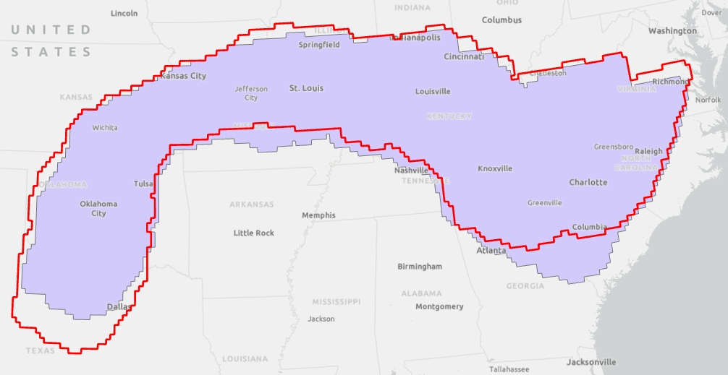
SLAM SIM version differences

Slide 4
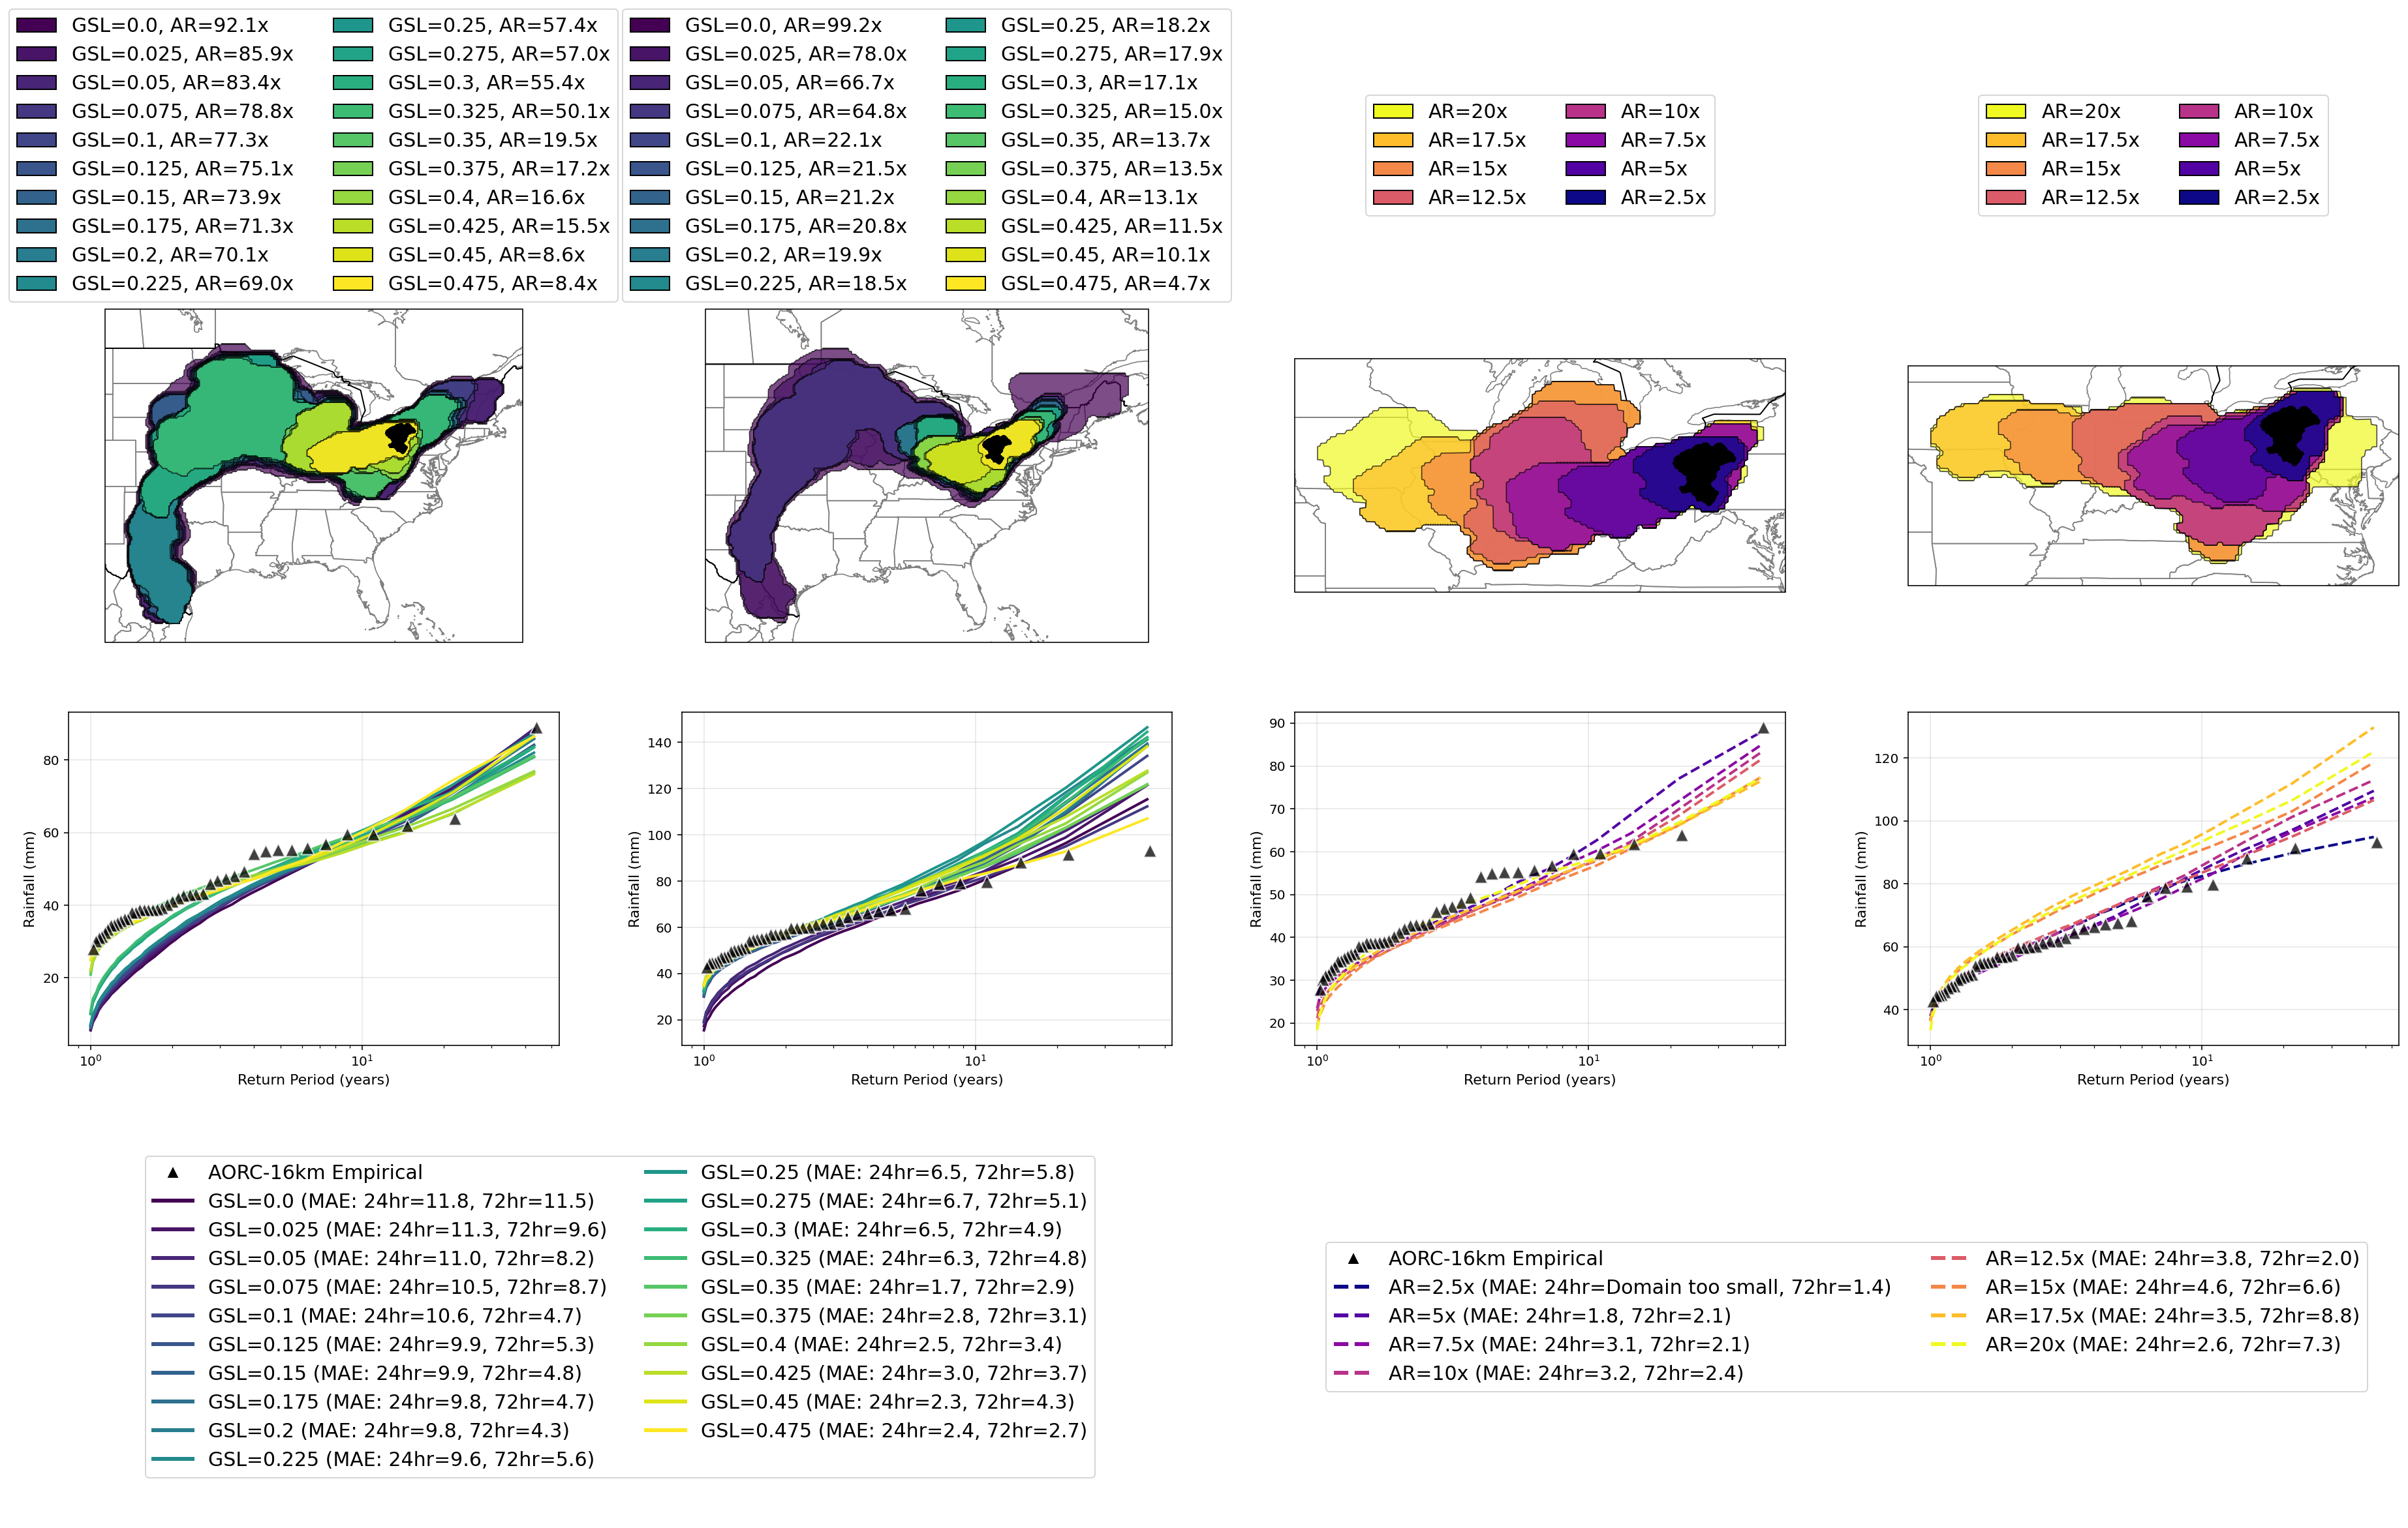
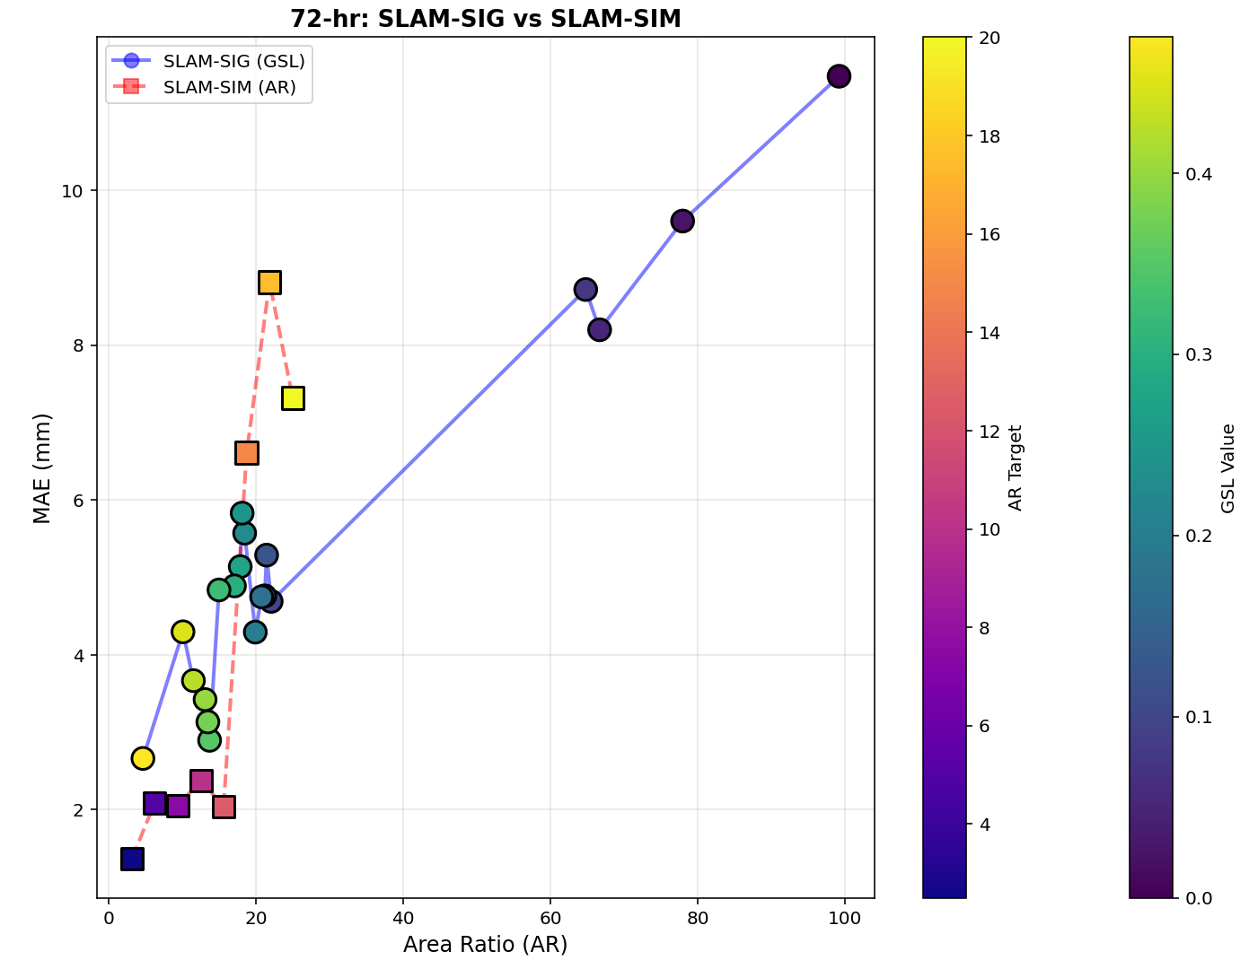
HUC4: 0501, Allegheny River Basin (72-hr)
Reference: Slides from Dan Wright – UW/UNC Team
SLAM-SIG
SLAM-SIM
Error to domain size comparison.

Slide 5
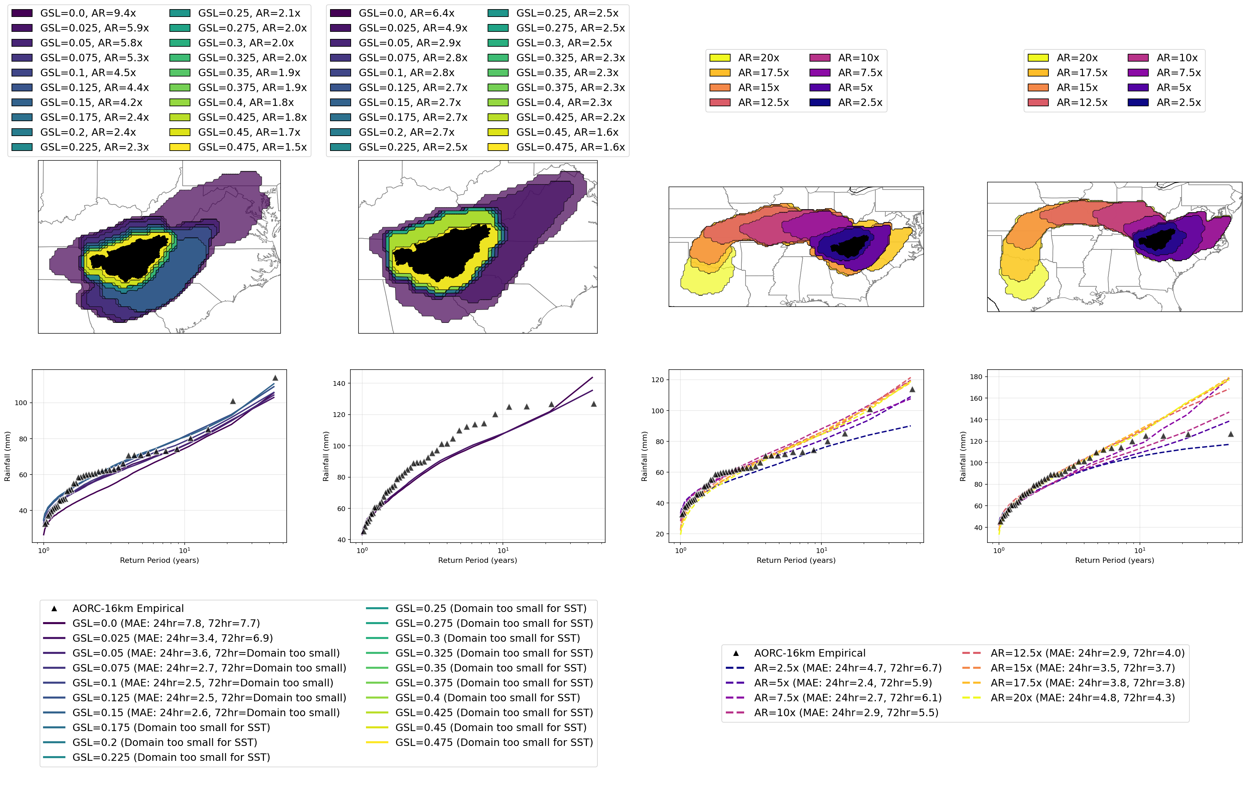
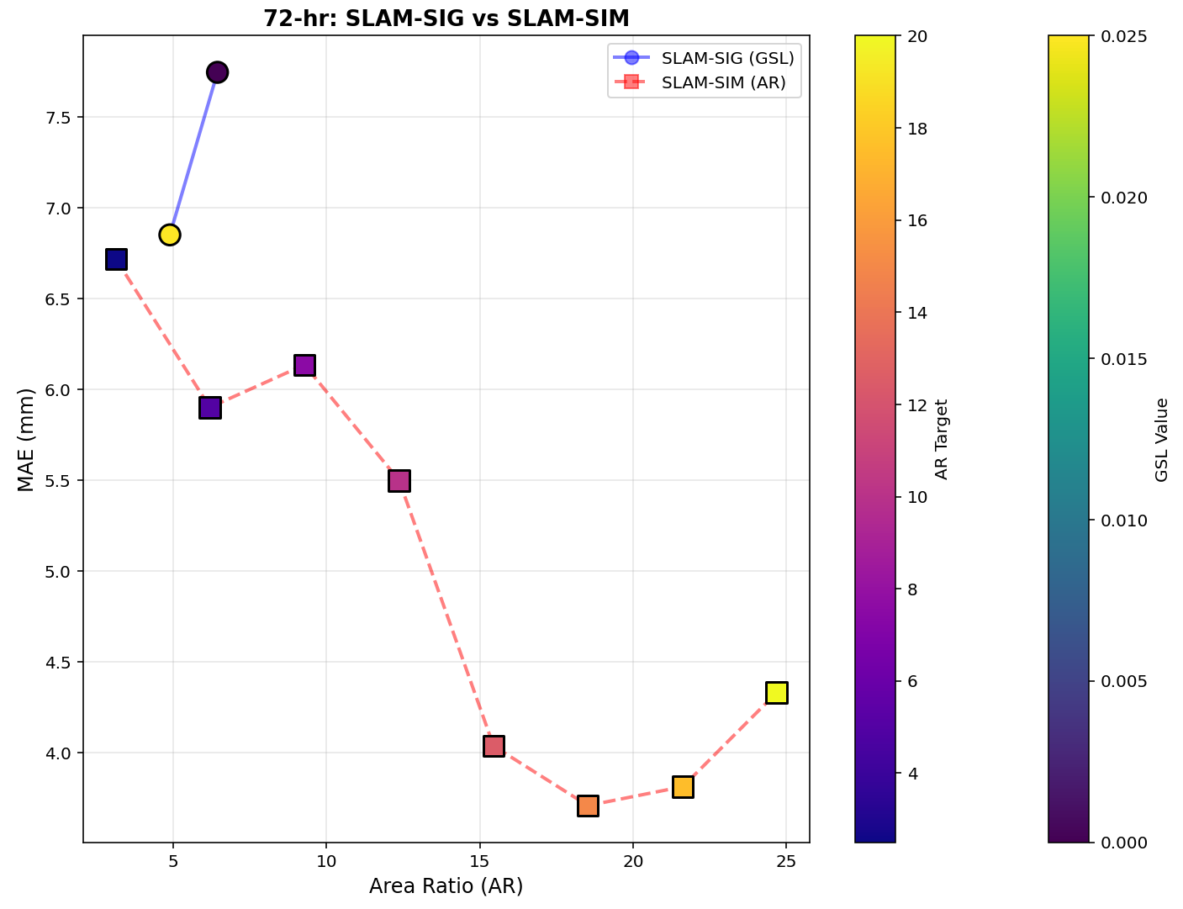
HUC4: 0601, Upper Tennessee River Basin (72-hr)
Reference: Slides from Dan Wright – UW/UNC Team
SLAM-SIG
SLAM-SIM
Error to domain size comparison.

Slide 6
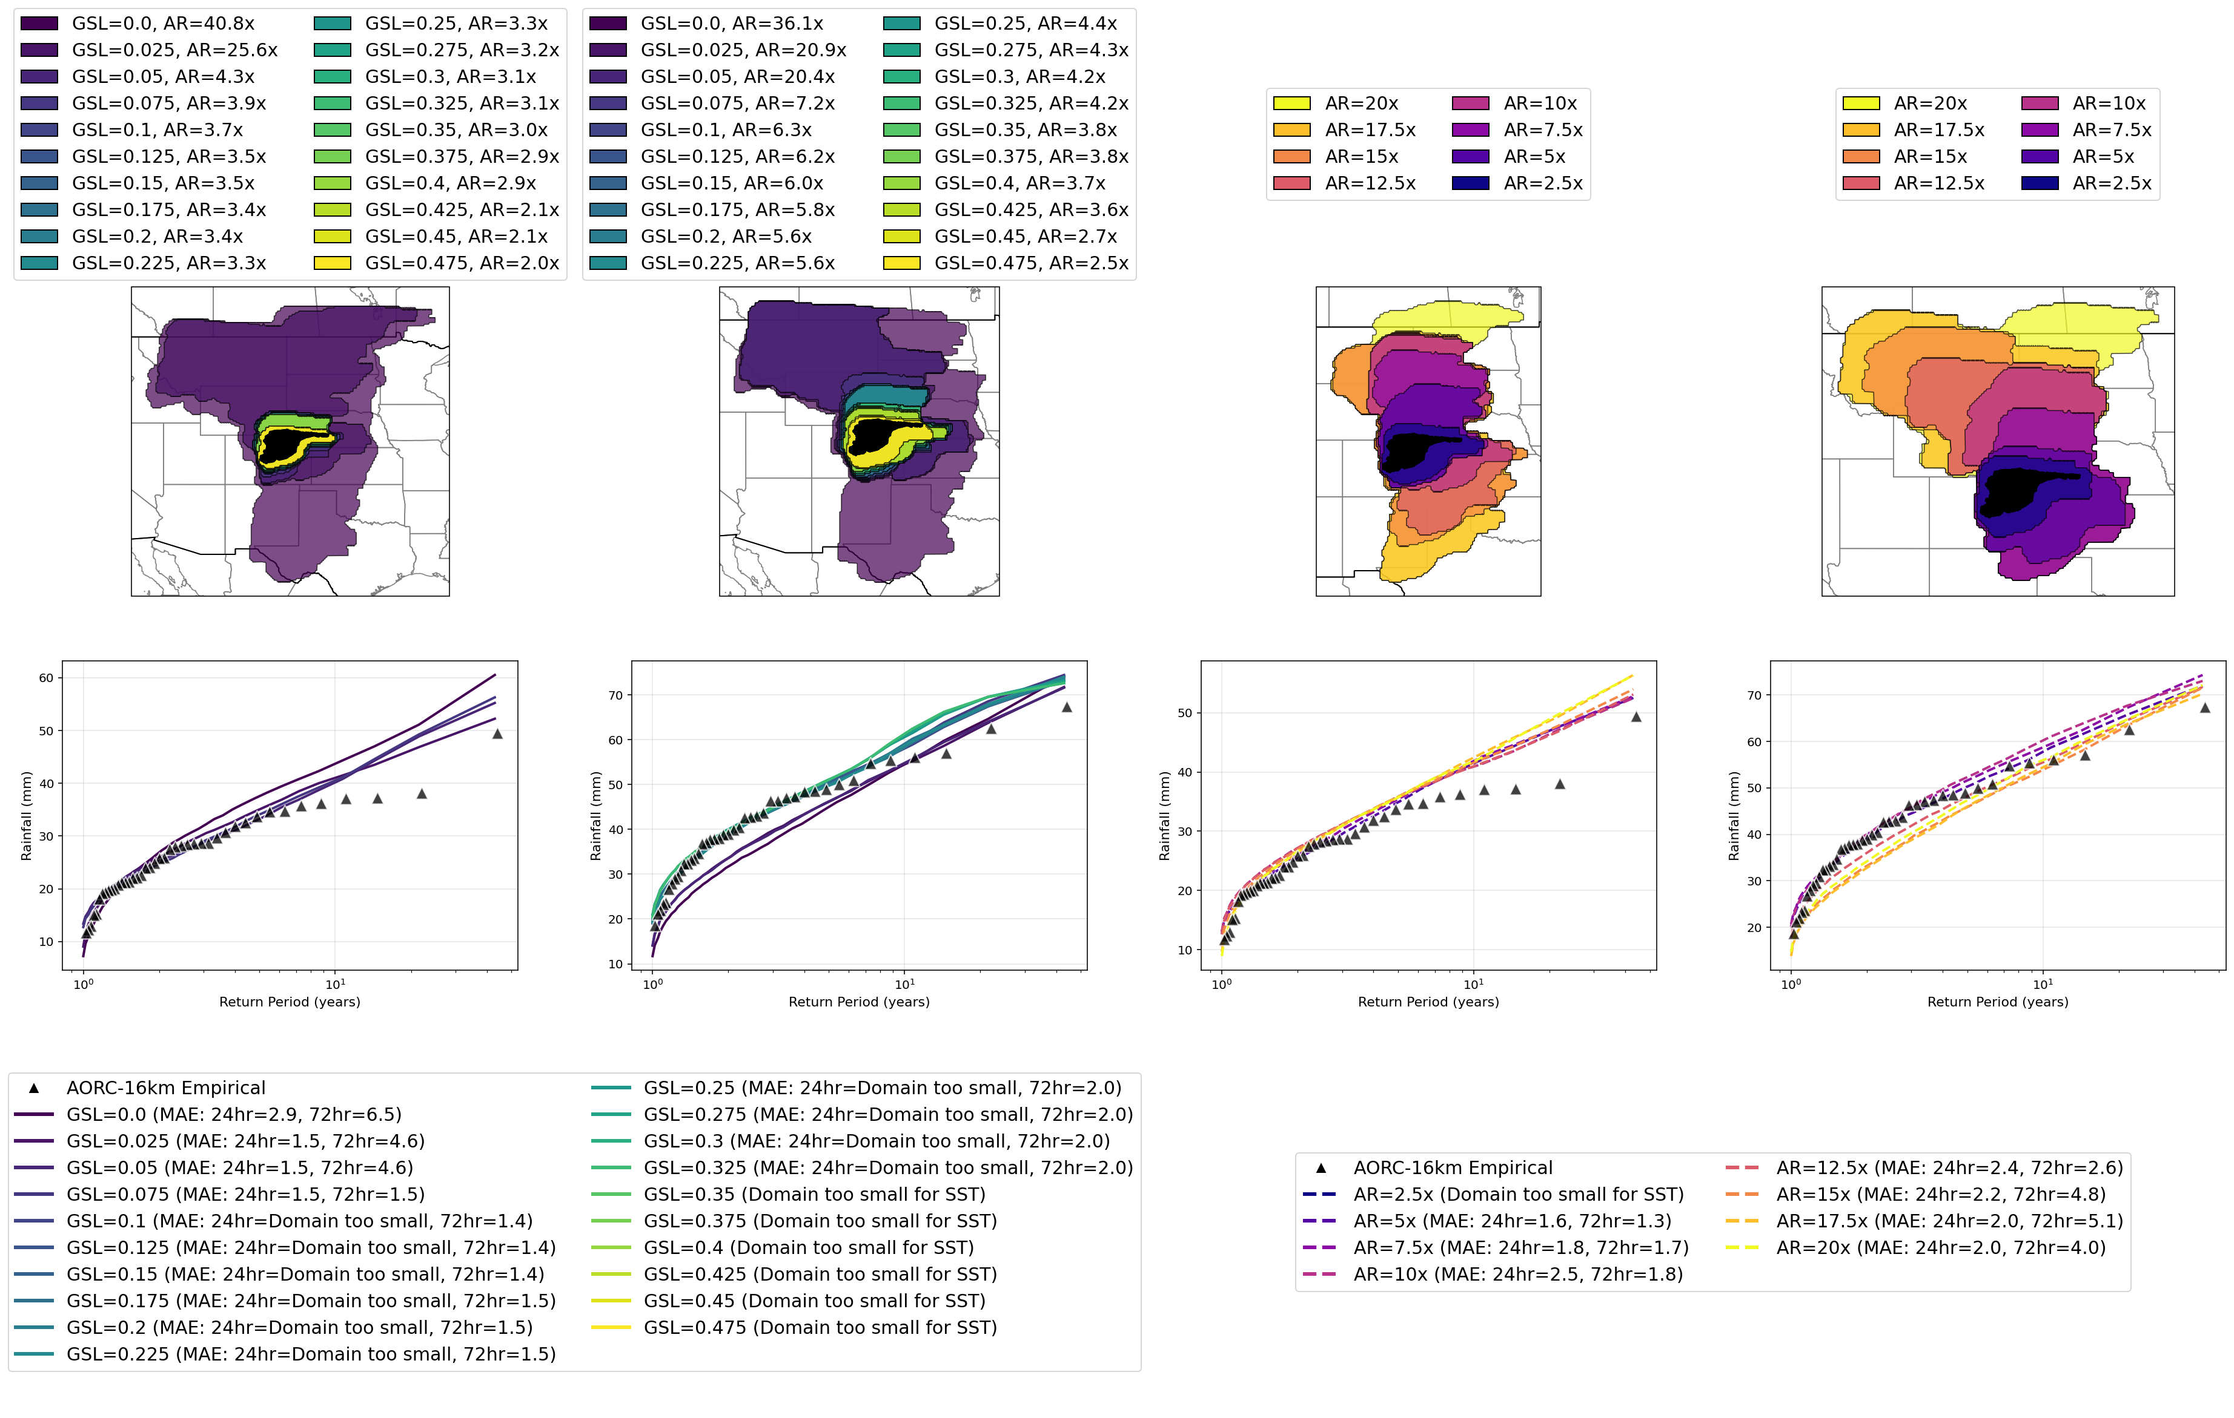
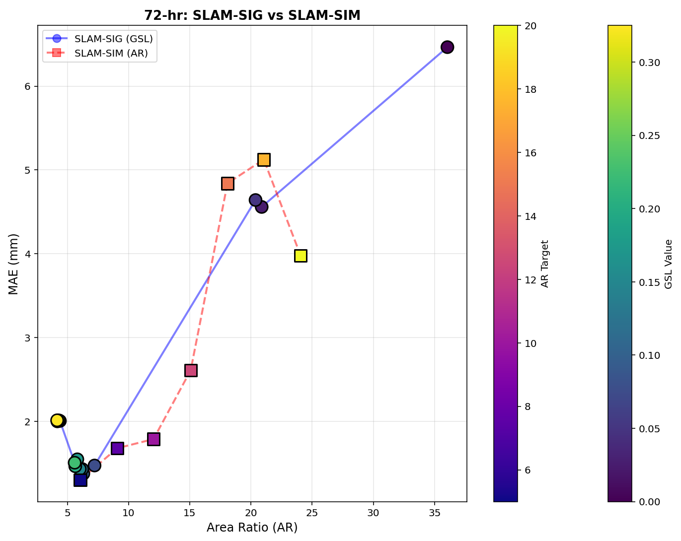
HUC4: 1019, South Platte River Basin (72-hr)
Reference: Slides from Dan Wright – UW/UNC Team
SLAM-SIG
SLAM-SIM
Error to domain size comparison.

Slide 7
RAS 2025 vs RAS 6 Mesh for Validation Basins
Open discussion on opinions of using RAS 2025 to develop meshes for Validation Basins.
Pros
  Better mesh capabilities and alignment
  Potentially more efficient run times for level of detail
Cons
  Still in Beta version
  Could lead to some inefficiency and troubleshooting
    Develop RAS 2025 mesh > export to RAS 6 > all subsequent edits need to go through RAS 2025 (2 versions of each model)
  Deviation from SOP

Slide 8
EDH and Terrain Modification Specifications
Feedback: SOP could be further specified in this area
SOP(JA2)
  “All identified streams with a drainage area of greater than 0.25 square miles should be included in the EDH delivery.”
  “Efforts to align with USGS 3DHP program priorities for data development should be made.”
For basins this size, this could be a significant effort to…
  manually refine of hydro connected terrain modifications to generate accurate flowlines
  Develop USGS 3DHP spec which includes additional attribution, 1m Horizontal accuracy, vertical components, QC
Need to balance level of effort with accuracy/resolution
  Clarify uses for EDH in FFRD
    Mesh Refinement, Terrain Modifications, Bathymetry (Primary Streams), others?

Slide 9
EDH and Terrain Modification Specifications
Questions for USACE:
Clarify
  Statement about aligning with USGS 3DHP Program Priorities
  How 0.25 square mile drainage area limit was determined? Was this used in pilot projects?
Speak to Lessons Learned from Pilot Projects
  How was EDH developed in pilot areas? Did it represent a significant effort? Was 1m DEM used?
  Any considerations for accuracy requirements? Were there any instances were errors in EDH impacted downstream processes?
Opportunities:
Align EDH specific requirements to Primary/Secondary stream levels of detail
Does RAS2025 conceptual mesh potentially alter uses of EDH?

Slide 10
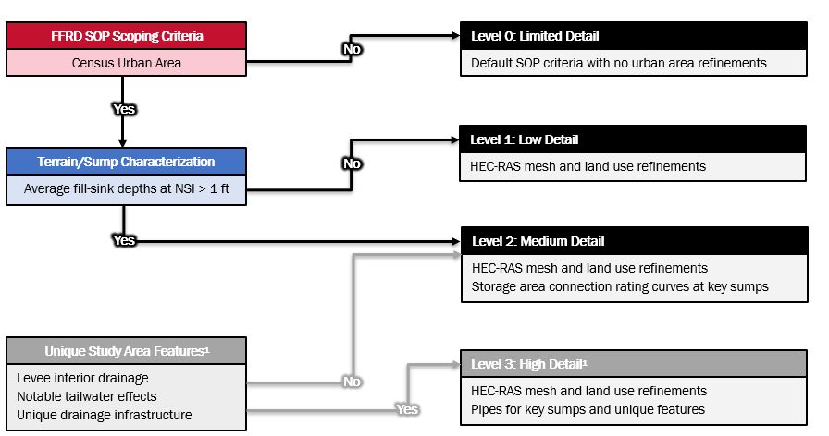
Implementation of Urban Stormwater Investigation
Confirm that the decision was to implement Urban Stormwater investigation findings into Validation Basins
PTS to provide discrete criteria and tools/methods to implement for consistency amongst validation basins
How might this alter some activities in the Scoping and Data Preparation phase?

Slide 11
Implementation of Urban Stormwater Investigation
Additional Slides from Investigation to be shared

