Slide 1
FFRD Validation Basins Cross-Basin Meeting
April 17th, 2026

Slide 2

Agenda
Introduction - FEMA
Basin Status
Technical Discussions
Basin SO3.2 Scope

Slide 3
Status Update
FEMA Standard Operations Option Period 1 ended March 29th
Interim Deliverables posted to FEMA AWS bucket
Option Period 2 Near-Term Goals
Maintain progress on Validation Basins within limits of Standard Operations funding requirements
Prioritize work that minimizes risk of rework or sequencing conflicts with SOP
Bonus if not dependent on Data Provider Outreach
Focus on targeted, small-team tasks that advance readiness without full production-scale resources
FFRD Task | End of March (SO3.1 Progress)
Scoping & Data Preparation | Compiled relevant available reference/input data Identified key data providers and datasets Geospatial Completed 4-ft and 100-ft DEM base terrain Dam/Levee Draft Dam and Levee Scoping Tables
Meteorology | Collected Base Atmospheric Data Storm Catalog (SLAM-SIM v1) Storm Typing, Normalization Grid, Seasonality Analysis
Hydrology | Uncalibrated HMS Model Developed Gage Data Prioritized Calibration Events Identified
Hydraulics | RAS Model Unit Delineation
Documentation & Feedback | Draft Project Workplans, Data Manifest, Report

Slide 4
Identified Tasks for Standard Operations Option Period 2
 | Prioritized | Possible | Dependent on Outreach | Dependent on USACE IRWA
Scoping and Data Preparation | Data Provider Outreach | Collect all FEMA Models Urban Stormwater Scoping | Refine Previous Deliverables
Geospatial | Specify EDH Requirements | Begin EDH Development Standardize Metadata/Attributes | Collect and Incorporate Bathymetric Data
Meteorology | Transposition Domain Evaluation Refine Meteorology Deliverables
Hydrology | Refine Parameters Continue Flood Mechanism Analysis (Mixed Populations) | Continue Calibration Event(s) Selection/Collection | Refine HMS Model Add Reservoirs
Hydraulics |  | Pilot 1 RAS Model Per Basin
Dam/Levee |  |  | Finalize Dam Scoping Table | SRP Source Data Collection
Review and Reporting | Maintain SOP Feedback |  | Finalize Report and BE-PWP Internal Review | Early Basin-Advisor Review

Slide 5
Technical Discussions
04-17-2026

Slide 6
SLAM-SIM vs. SLAM-SIG Domain Selection
Current Meteorology work to date based on SLAM-SIM version 1 (24/72hr) overlap
Received February 13th
Since then, a new version of SLAM-SIM and SLAM-SIG domains have been posted
SLAM-SIG domains contain both 72hr and 24hr versions, with varying GSLs
PTS to evaluate various domains in consistent manner to determine consistent domain usage
Utilize PRISM comparison metrics from South Platte Transposition Domain Investigation (Mar 2026)

Slide 7
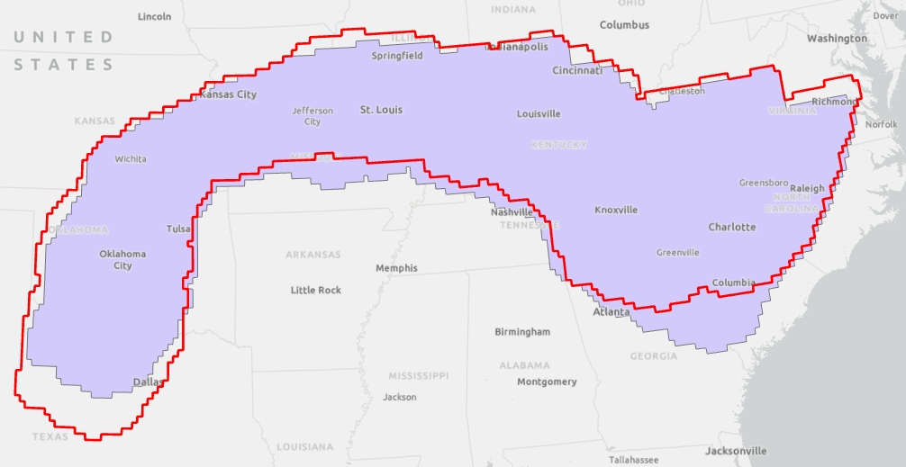
SLAM SIM version differences
SLAM-SIM
(2/13)
SLAM-SIM
(3/31)
Upper Tennessee SLAM-SIM Versions

Slide 8
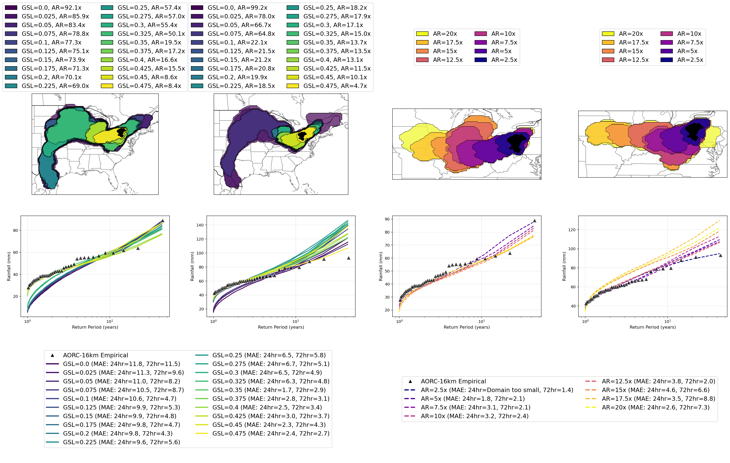
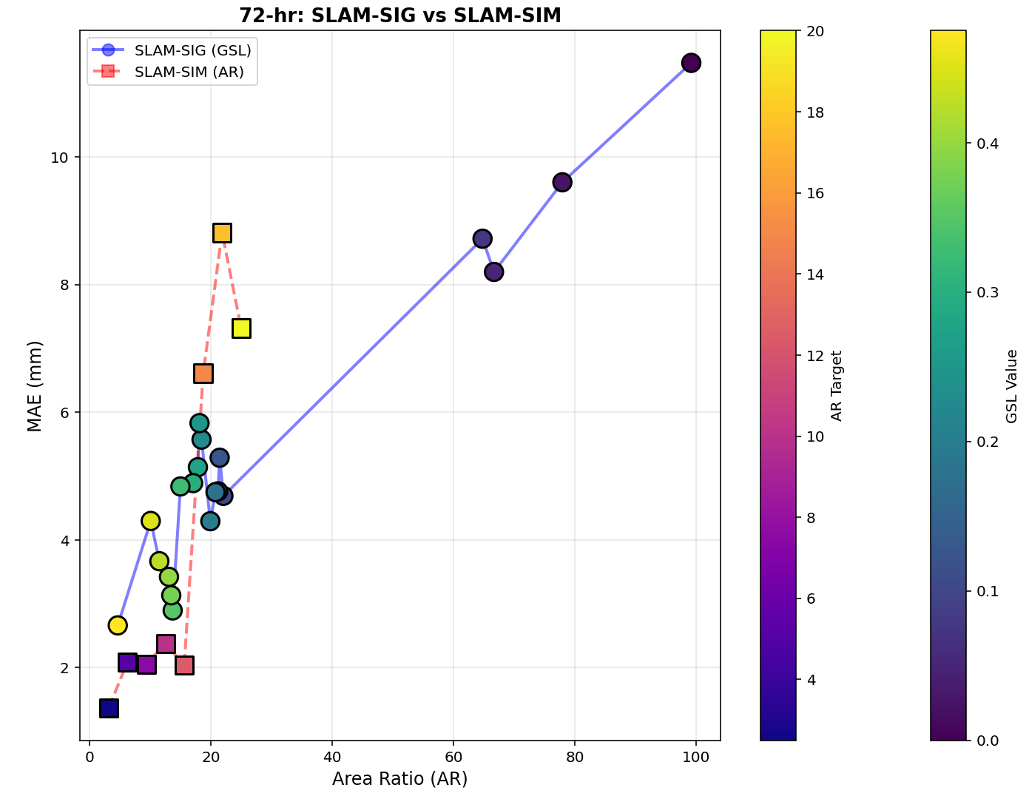
HUC4: 0501, Allegheny River Basin (72-hr)
Reference: Slides from Dan Wright – UW/UNC Team
SLAM-SIG
SLAM-SIM
Error to domain size comparison.

Slide 9
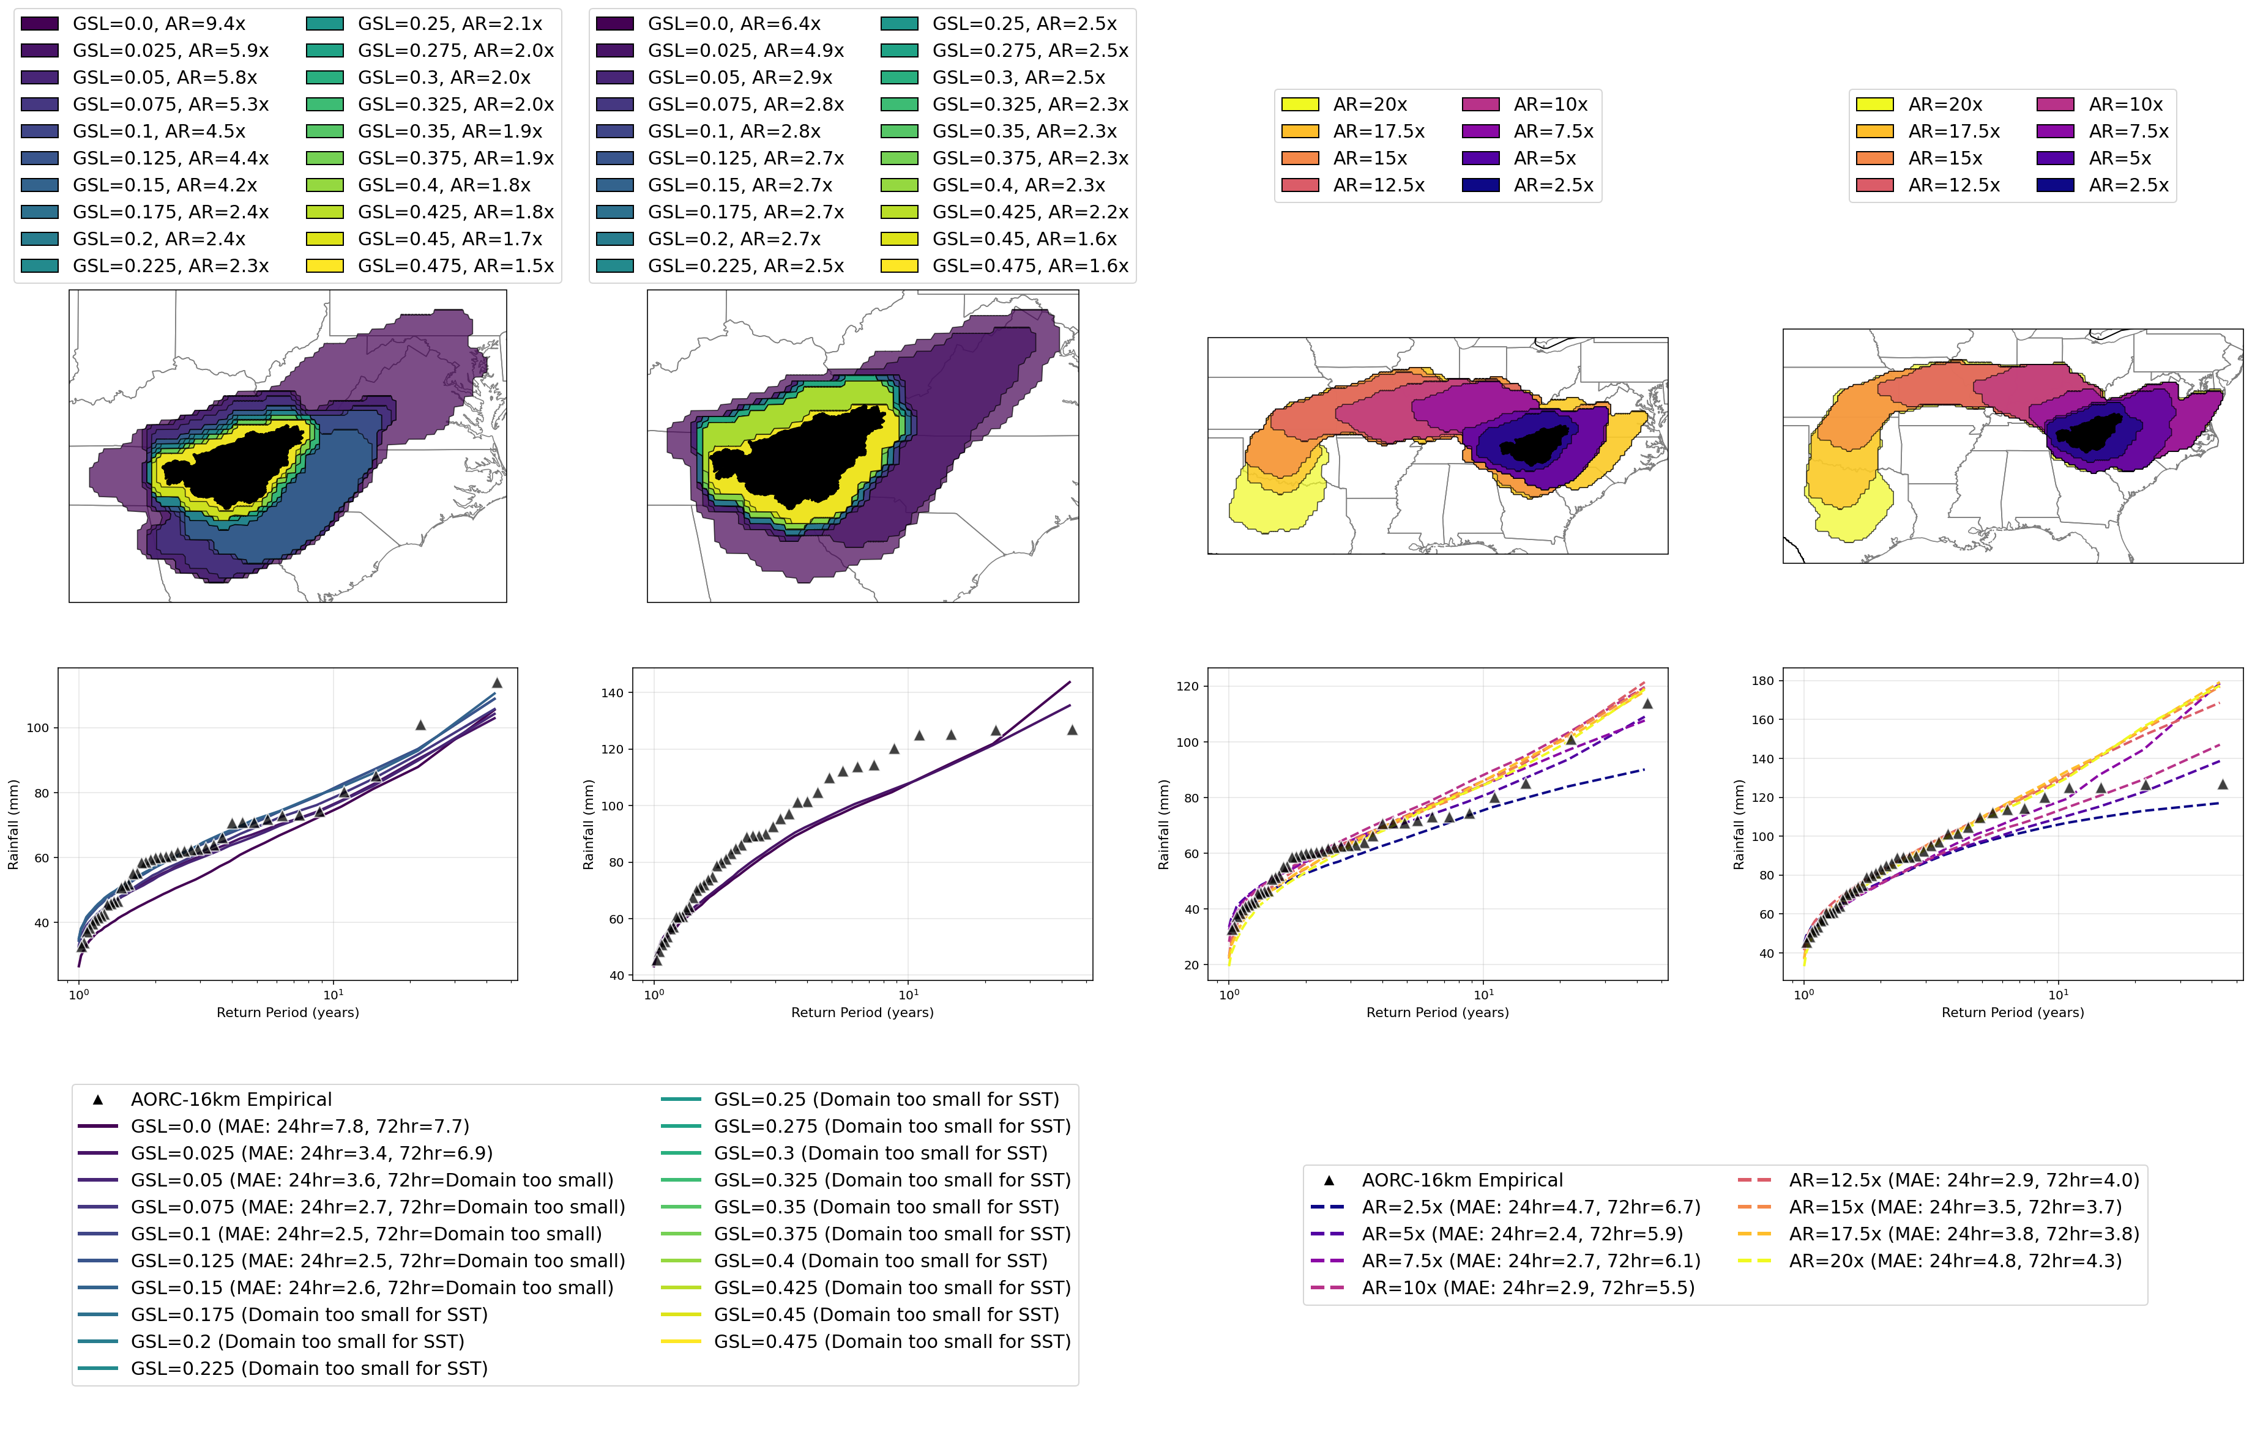
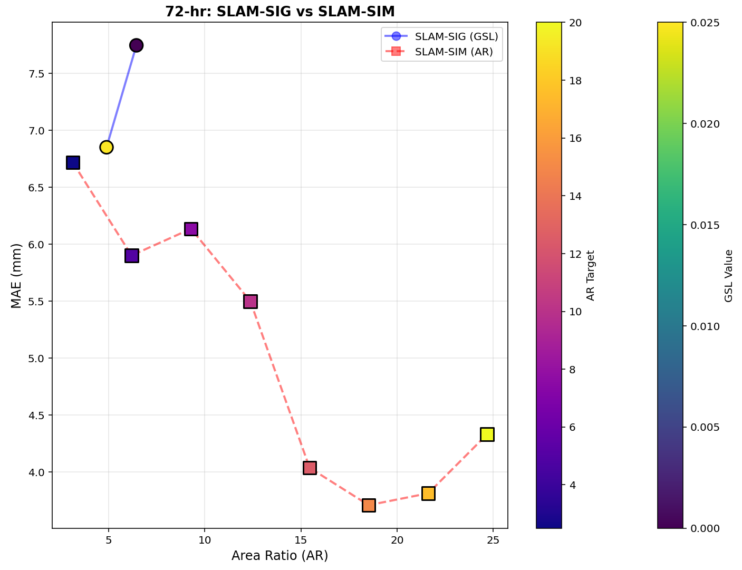
HUC4: 0601, Upper Tennessee River Basin (72-hr)
Reference: Slides from Dan Wright – UW/UNC Team
SLAM-SIG
SLAM-SIM
Error to domain size comparison.

Slide 10
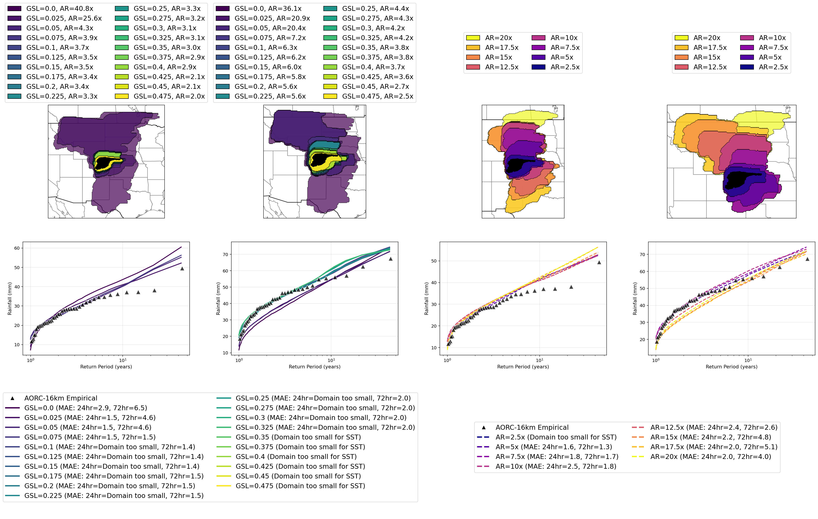
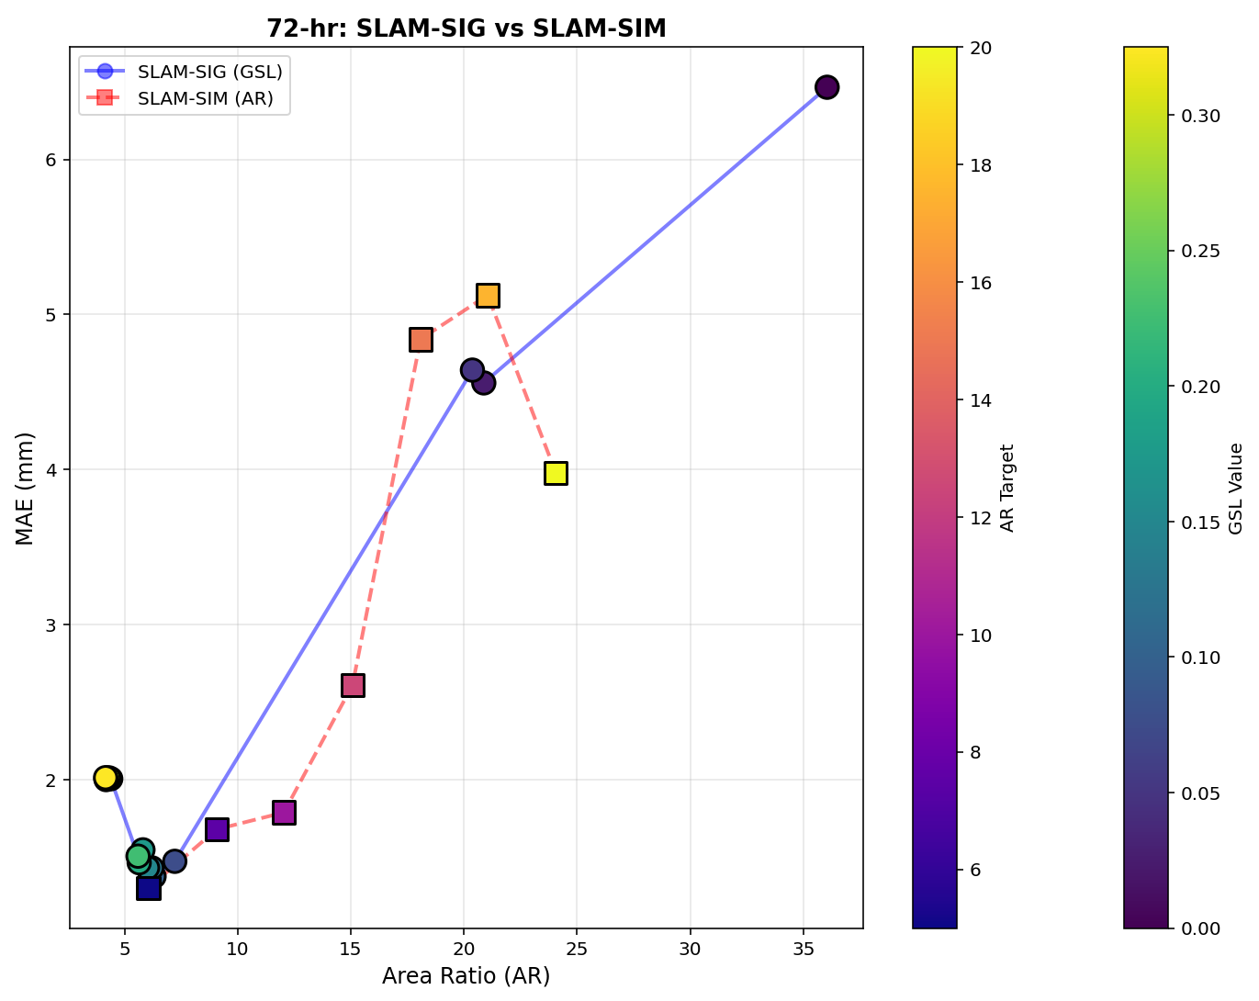
HUC4: 1019, South Platte River Basin (72-hr)
Reference: Slides from Dan Wright – UW/UNC Team
SLAM-SIG
SLAM-SIM
Error to domain size comparison.

Slide 11
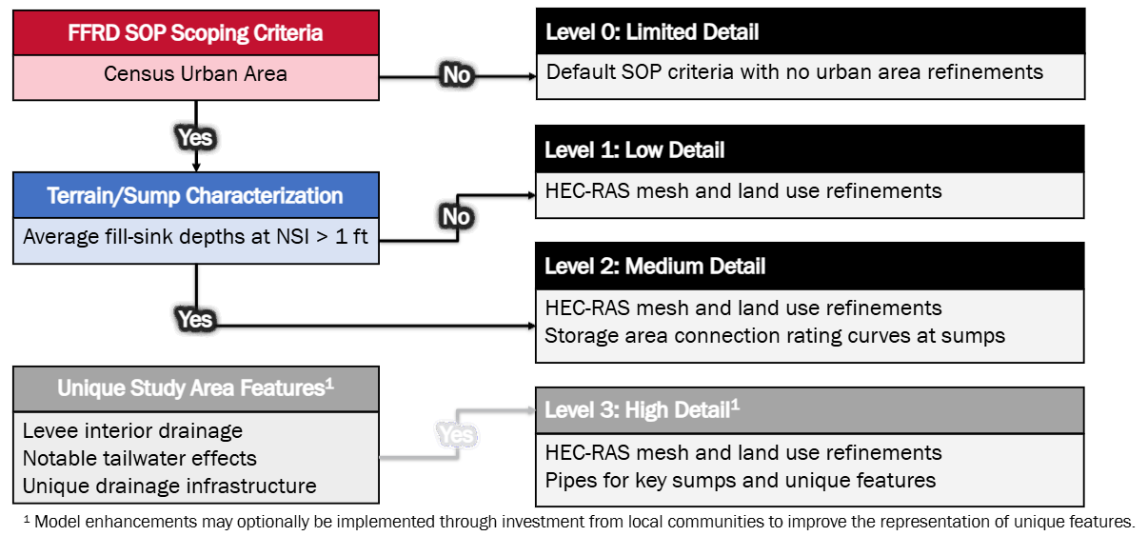
Implementation of Urban Stormwater Investigation
Confirm that the decision was to implement Urban Stormwater investigation findings into Validation Basins
PTS to provide discrete criteria and tools/methods to implement for consistency amongst validation basins
Surface Characterization & Key Collection Point Filtering
Hydraulic Routing Considerations
How might this alter some activities in the Scoping and Data Preparation phase?

Slide 12
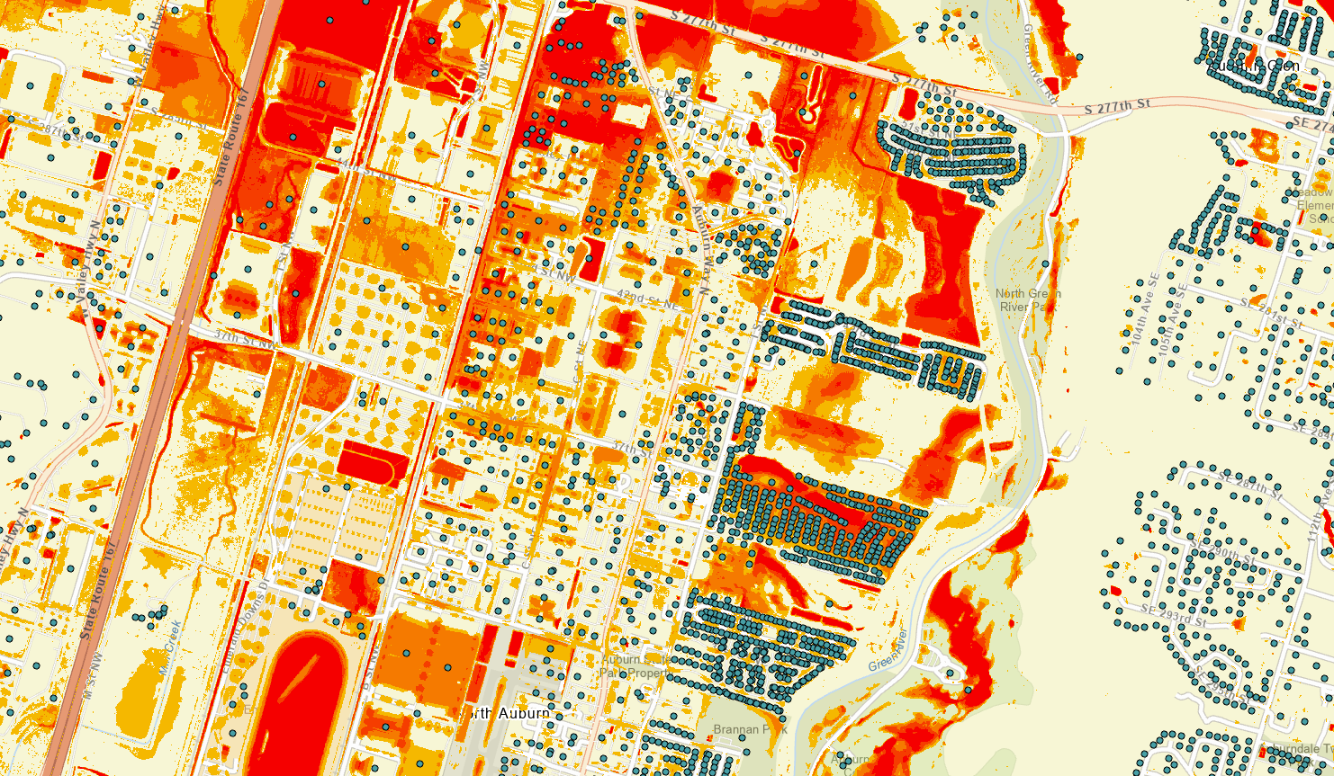
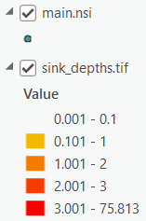
Implementation of Urban Stormwater Investigation
Create a Job Aid & Process/Tool
Within Each Urban Area
Perform Surface Characterization Process/Tool
Key Filters
Contributing Area (Refinement Extent)
Maximum Potential Consequences (NSI)
Outcome
Highlight Key Refinement Areas
Derive Initial HEC-RAS Breaklines
Update Scoping & Data Preparation Documentation
Use Collected Data in Hydraulics

Slide 13
RAS 2025 vs RAS 6 Mesh for Validation Basins
Open discussion on opinions of using RAS 2025 to develop meshes for Validation Basins.
Pros
Better mesh capabilities and alignment
Potentially more efficient run times for level of detail
Cons
Still in Beta version
Could lead to some inefficiency and troubleshooting
Develop RAS 2025 mesh > export to RAS 6 > all subsequent edits need to go through RAS 2025 (2 versions of each model)
Deviation from SOP

Slide 14
EDH and Terrain Modification Specifications
Feedback: SOP could be further specified in this area
SOP(JA2)
“All identified streams with a drainage area of greater than 0.25 square miles should be included in the EDH delivery.”
“Efforts to align with USGS 3DHP program priorities for data development should be made.”
For basins this size, this could be a large effort to…
manually refine of hydro connected terrain modifications to generate accurate flowlines
Develop USGS 3DHP spec: which includes additional attribution, 1m Horizontal accuracy, vertical components, QC
Consider: level of effort, accuracy/resolution, and intended uses
Clarify uses for EDH in FFRD
Mesh Refinement, Terrain Modifications, Bathymetry (Primary Streams), Mapping Quality, others?

Slide 15
EDH and Terrain Modification Specifications
Questions for USACE:
Clarify
Statement about aligning with USGS 3DHP Program Priorities
How 0.25 square mile drainage area limit was determined? Was this used in pilot projects?
Speak to Lessons Learned from Pilot Projects
How was EDH developed in pilot areas?
Any considerations for accuracy requirements? Were there any instances were errors in EDH impacted downstream processes?
Considerations:
Align EDH specific requirements to Primary/Secondary stream levels of detail
Add "Channel Present" requirements in addition to drainage area.
Variable Drainage Area based on Geography
Was there or should there be consideration given to existing level of detail/refinement expectations?
Does RAS2025 conceptual mesh potentially alter uses of EDH?

