Slide 1
Technical Discussions

Slide 2
RES-SIM Scoping Decision Process - Example
An example of 4 hydroelectric dams that indicate it could be operated as a system. Part of the East Fork Tuckasegee River Project
We have some initial information, but not full details of the dams yet. It isn't obvious to us yet if these would require RES-SIM.
Question for USACE:
What information would you be seeking in this case to determine whether any of these Dams would need to be included in RES-SIM?
If you were starting the Dam Scoping Process, how would you approach the RES-SIM determination in this area?

Slide 3
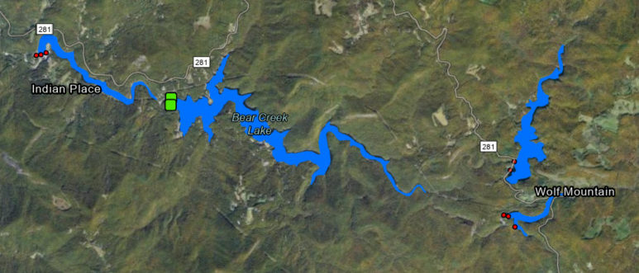
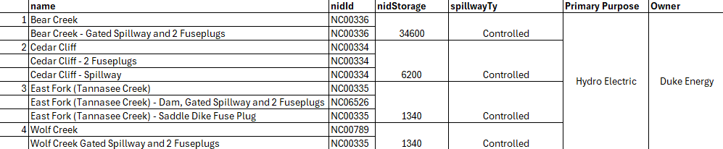
2
4
1
3

Slide 4
RAS Model Unit Delineation
There are some examples from South Platte to share.
Seeking opinions from USACE on RAS Model Unit delination relating to Size and Gage Availability.
Questions about best practices for developing overlapping model units.

