Slide 1
FFRD Validation Basins
Cross-Basin Meeting
March 20th, 2026

Slide 2

Agenda
Introduction - FEMA
Validation Basin Progress and Next Steps
Technical Discussions

Slide 3
VALIDATION BASIN PROGRESS

Slide 4
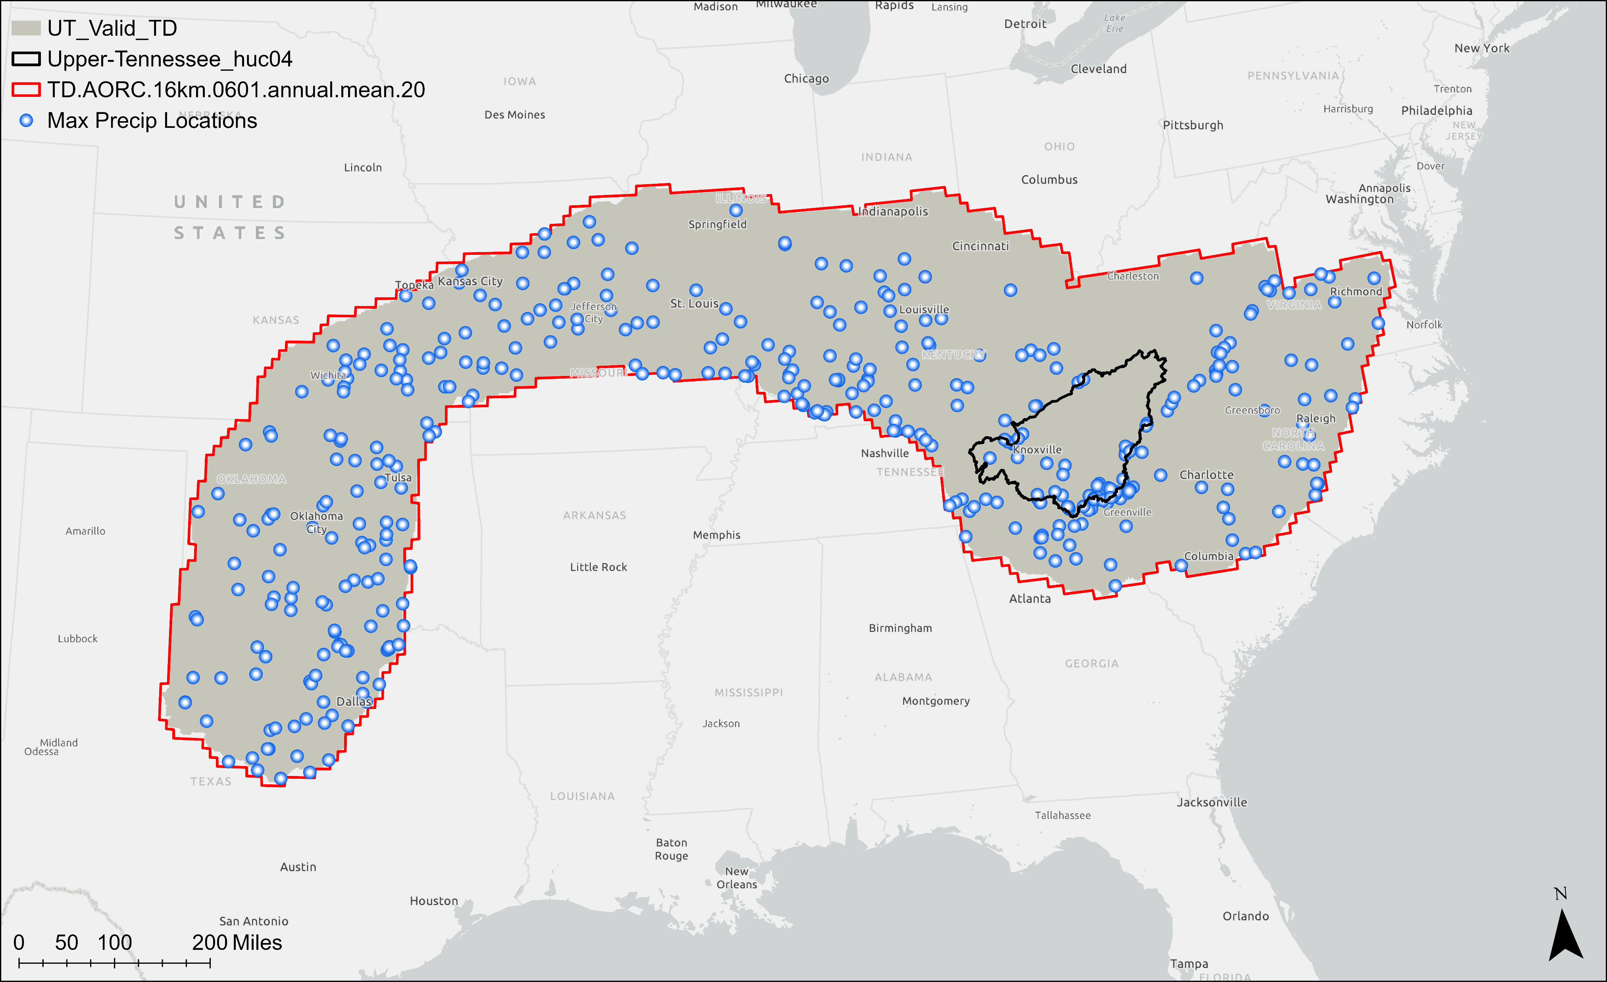
Upper Tennessee Meteorology
Completed By March
Relevant Meteorology Data Collected
Storm Catalog Generated
Normalization Grid
Storm Typing
  Tropical vs. Non-Tropical
Calibration Event Meteorology Files Developed
Meteorology Remaining Items:
Review/Checklist
Valid Placements/Fishnets

Slide 5
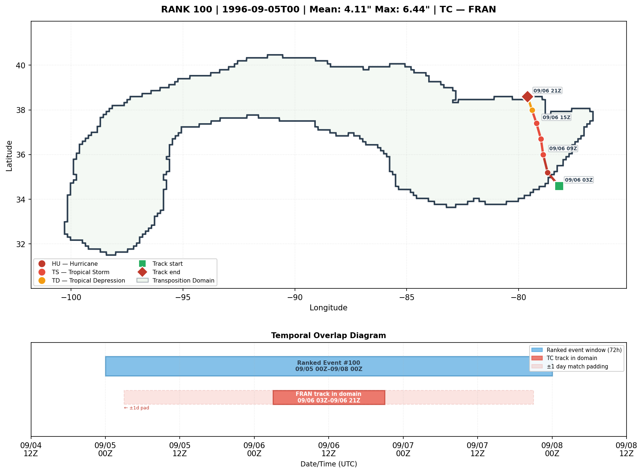
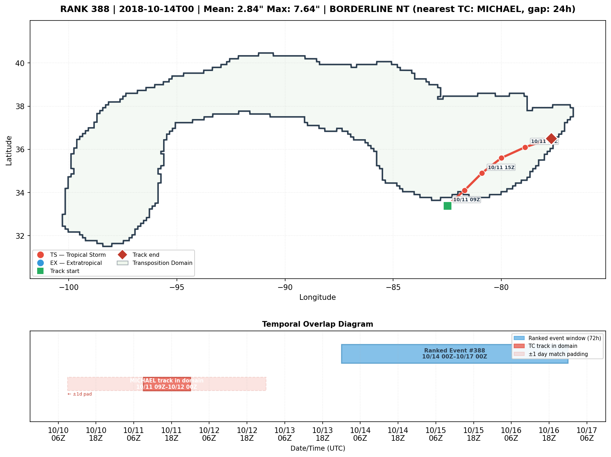
Upper Tennessee Storm Typing

Slide 6
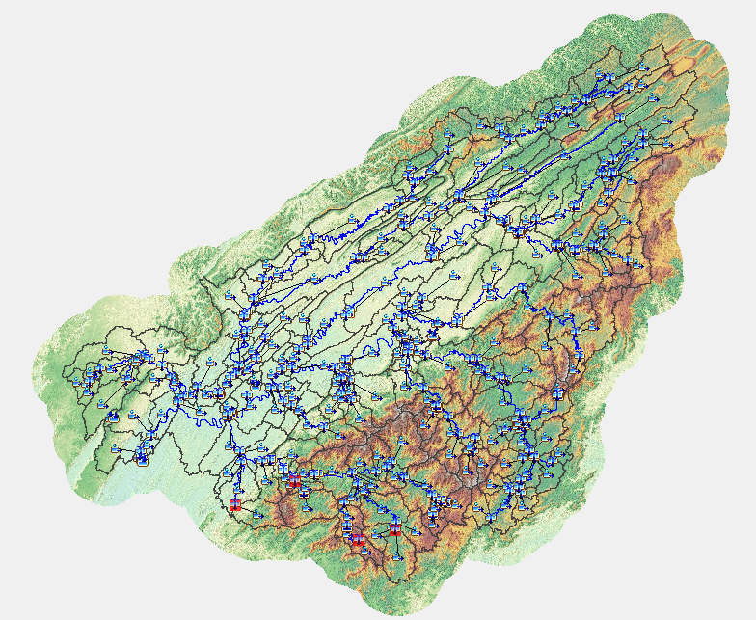
Upper Tennessee Hydrology
Completed By March
Relevant Hydro Data Collected
USGS Gages Prioritized
Calibration Events Selected
Have an initial working HMS model
HMS Refinements Still Needed (Scoping Phase):
Reservoir Rules/Rating Curves
Updates based on Mixed Populations Analysis
Updates if additional non-USGS Gage Data is obtained
Add all Observed Data
Calibrate and Refine Parameters

Slide 7
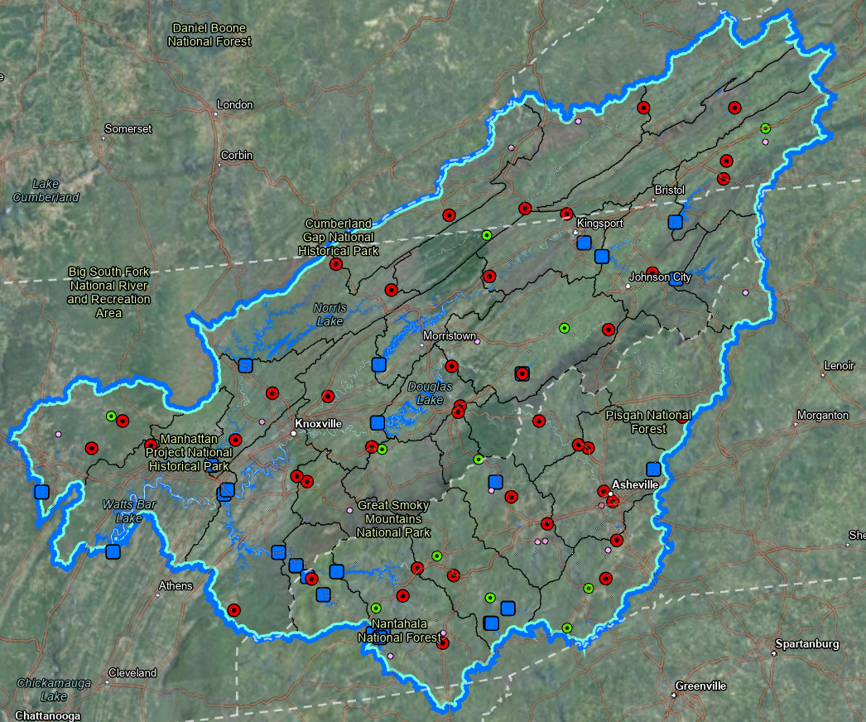
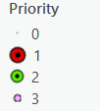
Upper Tennessee Hydraulics/Dam/Levee
Completed By March
Initial RAS Model Delineation
Model Linking Register
Initial Dam Scoping Table (HMS Focus)
Collected and Refined Levee Data
Gages
Dams > 10,000 ac-ft
Remaining Items (Scoping Phase):
Mesh Refinement Scoping and EDH
Collect/Incorporate Bathymetry
Collect more Dam Information
Revisit Dam Scoping Table to be more precise for RES-SIM/RAS
Dam/Levee Breach Data and Determinations
RAS Model Units

Slide 8
Major Scoping Phase Tasks Remaining – Upper Tennessee
Coordination with Data Providers
  This will likely necessitate refinement of some of the currently completed tasks
Finish Dam Scoping Determination for all Dams/Models
Develop Elevation Derived Hydrography and Incorporate Bathymetric Data
All Items related to Dam/Levee Breach Locations, Data Collection, and Parameters
Finalize Documentation, Deliverables, and Reviews
  Scoping and Data Preparation Report, Basin Execution Work Plan

Slide 9
Allegheny (0501) Progress Update
FFRD (Hydrology First) Task | Progress Update (Expected To Complete) | Upcoming Next Steps (To Finish Scoping & Data Preparation)
Scoping & Data Preparation | Continued Data Collection Identified Initial Flood Hazard Mechanisms per Storm Catalog Levee Refinement Table Dam Scoping Table | Perform Outreach for Data Format All Data to Standards. Develop Hydrography & Bathymetry Data Complete HMS setup with all collected Data. Confirm Res-Sim status after data collection. Finalize Documentation including Formal Scoping Report and Work Plans TAG Review & Approval
Meteorology | Completed Storm Catalog Addressed Tropical/NonTropical Storm Typing Complete Meteorology Report Identified Initial Flood Hazard Mechanisms per Storm Catalog Selected Initial Calibration Events/POR
Hydrology | Assembled HMS Model & Parameters Performed Test Run Establish RAS Model Units Model Linking Register Mesh Refinement Scoping
Reservoir Operations Modeling | Inserted initial dams in HMS model as identified in the dam scoping table.
Documentation & Feedback | Progress Report & Checklist of Data, Next Steps Submitted Terrain Standards, Storm Typing Memo/Determination, and Dam Scoping Approach

Slide 10
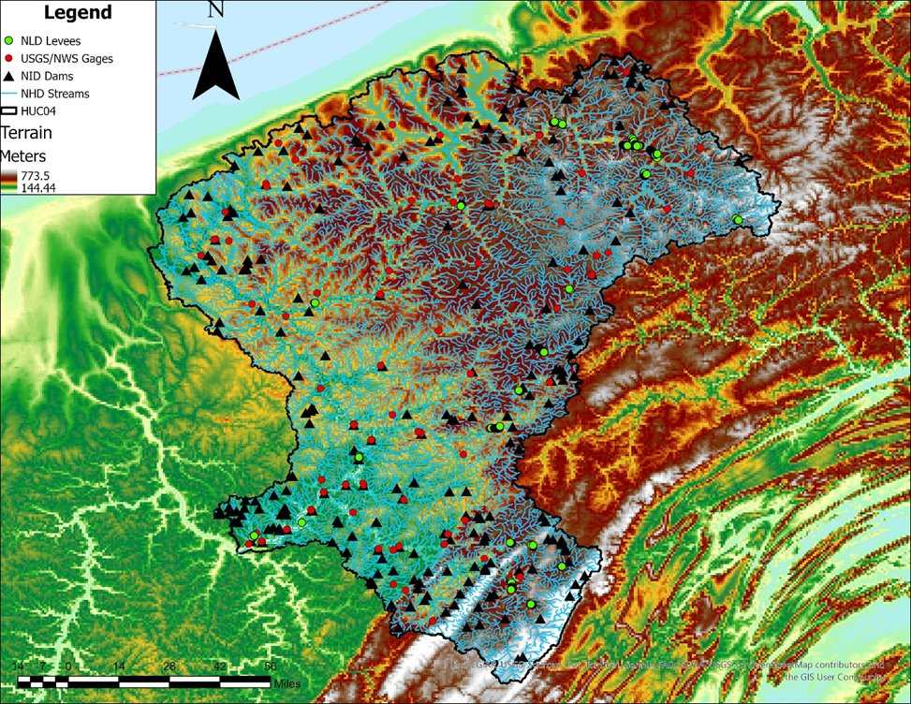
Allegheny (0501) Progress Update
General Notes
Identified Initial List of Data Contributors
Data Collection
  Terrain (Processed)
  Landuse/Soils
  Dams / Levees
  Gage Data
  Streamlines (Not Topo Adjusted/Bathymetry)
  US Census Urban Areas
PTS: | ARC
Watershed Name: | Allegheny
HUC4 ID: | 0501
Drainage Area (mi²): | 11,729
# of HUC 8s: | 9
# of HUC 10s: | 71
Urban Areas: (Based on Census Data) | 28 (430 mi²)
USGS Streamgages: | 93
Levees: (Based on NLD) | 78
Dams: (Based on NID) | 241
Stream miles: (Based on NHD) | 14,445

Slide 11
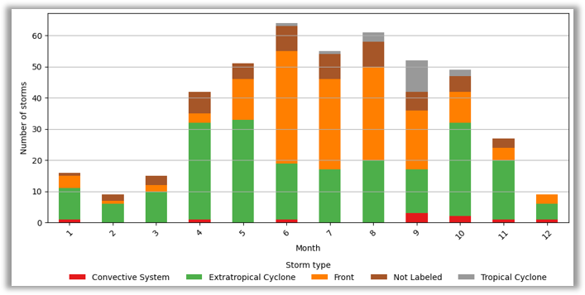
Allegheny (0501) Progress Update
Meteorology Status
Storm Catalog Developed & Atmospheric Collected
Finishing Storm Typing (Tropical / NonTropical)
  ~46 of 450 Remaining to Type
Storm Type​ | Kunkel et al. (2012)​ | Agel et al. (2015)​ | Alshehri et al. (2024)​ | ARC et al. (2026)​
Tropical Cyclone​ | 36.00​ | 19.00​ | 17.00​ | 2.22​
Extratropical Cyclone​ | 16.00​ | 66.00​ | 31.00​ | 47.33​
Front​ | 47.00​ | NA​ | 49.00​ | 34.22​
Convective System​ | NA​ | NA​ | NA​ | 3.78​
Other/Not Labeled​ | NA​ | 15.00​ | 3.00​ | 12.44​

Slide 12
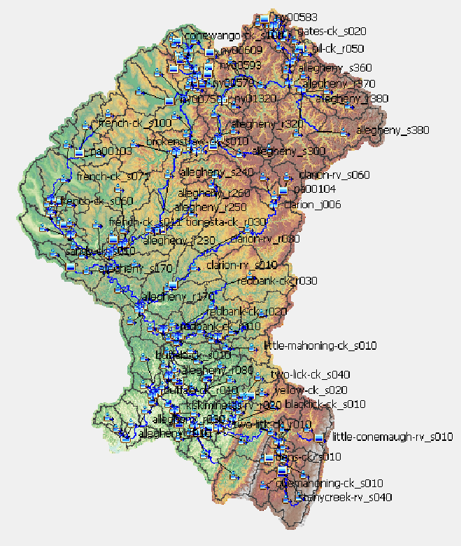
Allegheny (0501) Progress Update
HEC-HMS Model Status
HMS Model Constructed with Initial Subbasin Parameters, Naming Convention
Dams Included As Placeholders – Ready for Data Outreach
Initial Routing Parameters Included
Performed Test Simulation
HMS Subbasin Stats | # of Units
# of Subbasins | 150
Min (SQMI) | 0.3
Average (SQMI) | 78
Max (SQMI) | 600

Slide 13
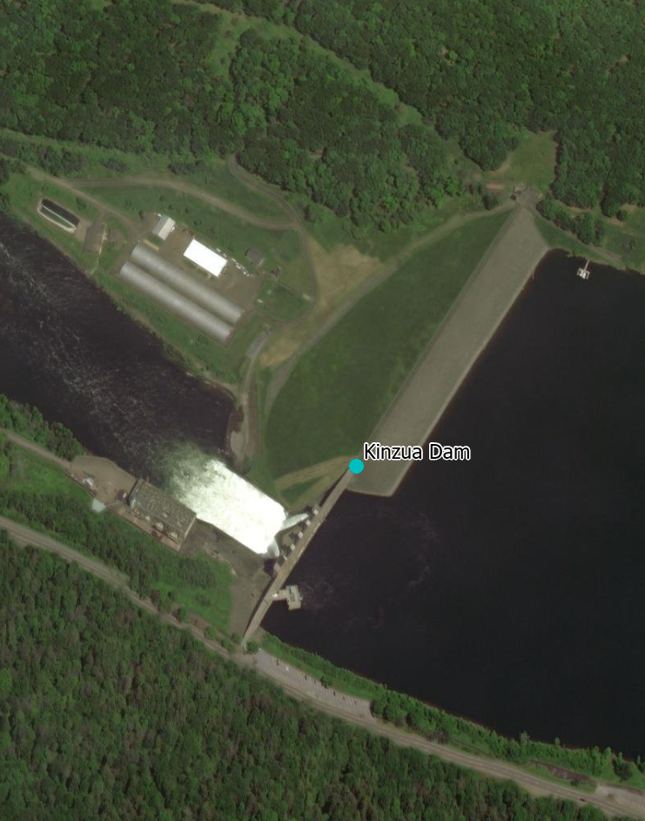
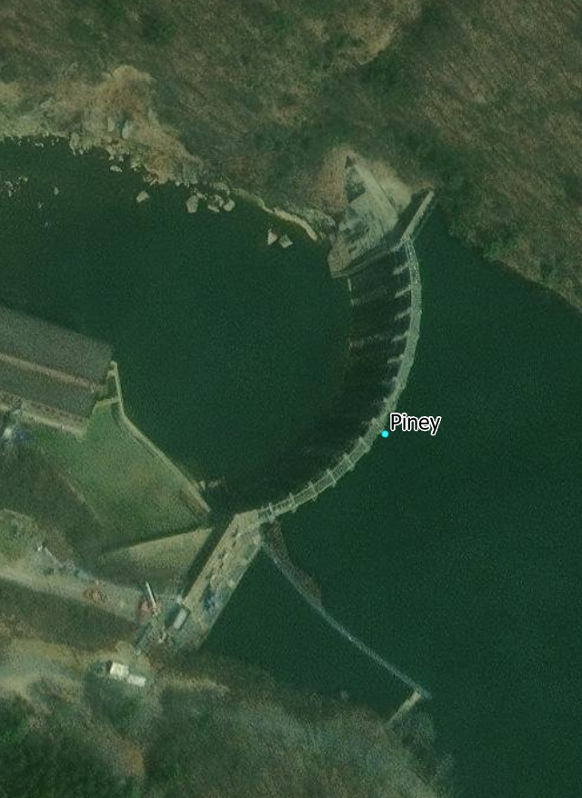
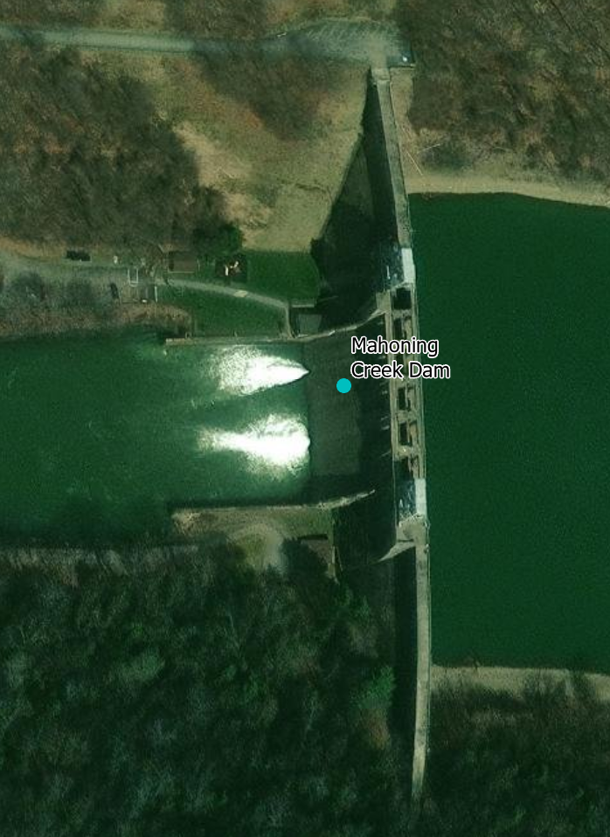
Allegheny (0501) Progress Update
Dam Scoping Table Status
List of dams initially identified for Res-SIM
  Kinzua
  Piney
  Conemaugh
  Loyalhanna
  Mahoning
Reviewing initial list of Res-SIM Dams (Keep in HMS)
Validation Basin​ | Total Dams​ | HEC-ResSim​ | HEC-HMS​ | HEC-RAS (Type A, B, C)​ | HEC-RAS (Type D)​ | Not Modeled (Type E)​
Allegheny​ | 241​ | 5​ | 41​ | 76​ | 157​ | 8​

Slide 14
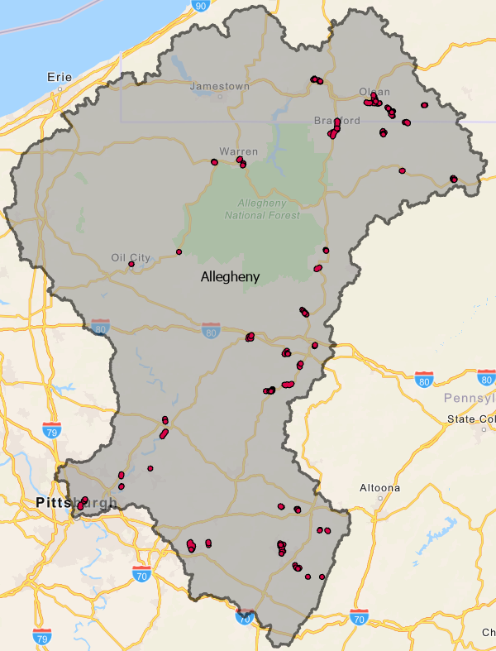
Allegheny (0501) Progress Update
Levee Refinement Status
Coordinated with USACE on Levee Refinement Status & Assignments
Provided terrain files for select systems.
Allegheny Initial Levee Stats | # of Systems
Total # of Levees | 78
Levee Refinement (Reviewed - Complete) | 70
USACE Levee Refinement (In Review/Process) | ~8

Slide 15
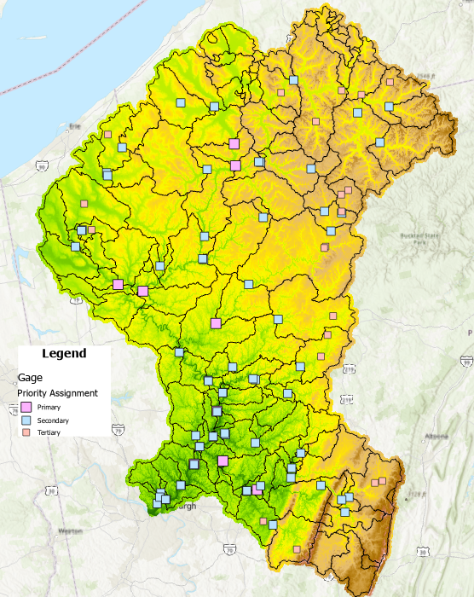
Allegheny (0501) Progress Update
Calibration Events Status
Using Storm Catalog to Rank and Select Events & POR
Initial Flood Hazard Mechanisms
  Snowmelt Versus Rainfall Only
  Plan to select at least 2 snowmelt events
Gage Category | # of Units
Primary | 9
Secondary | 64
Tertiary | 20
Total | 93

Slide 16
Allegheny (0501) Progress Update
Year | Anchor Date | # of Gages Report >2yr | Max Reported Frequency | Average Reported Frequency | Max Discharge (cfs)
2004 | 9/11/2004 | 30 | 413.7 | 38.7 | 185000
1996 | 1/16/1996 | 32 | 337.1 | 34.7 | 182000
2024 | 4/6/2024 | 21 | 15.7 | 5.0 | 151000
2011 | 3/7/2011 | 23 | 26.3 | 6.5 | 146000
2007 | 3/18/2007 | 23 | 44.7 | 7.6 | 145000
2018 | 1/12/2018 | 19 | 11.3 | 5.3 | 142000
2017 | 1/12/2017 | 30 | 63.7 | 8.8 | 138000
1991 | 1/1/1991 | 29 | 12.7 | 4.4 | 133000
2022 | 2/18/2022 | 29 | 29.7 | 4.8 | 129000
1998 | 1/8/1998 | 21 | 62.4 | 6.8 | 124000
2005 | 1/11/2005 | 26 | 32.3 | 5.6 | 122000
2008 | 2/5/2008 | 18 | 16.4 | 4.8 | 116000
2014 | 5/21/2014 | 11 | 68.8 | 18.9 | 49100
2010 | 1/25/2010 | 17 | 12.1 | 4.9 | 36900
1994 | 3/24/1994 | 12 | 11.5 | 3.8 | 31500
1997 | 11/8/1997 | 12 | 9.1 | 5.3 | 31000
1999 | 1/23/1999 | 13 | 27.5 | 4.9 | 24600
2013 | 12/21/2013 | 11 | 8.7 | 3.9 | 23000

Slide 17
South Platte (1019) Progress Update
FFRD Task | Progress Update | Upcoming Next Steps
Scoping & Data Preparation | Data Collection Identify Key Data Providers & Datasets Terrain Development Scoping Single Events for Calibration Continuous simulation Dam & Levee Draft Levee Scoping/Refinement Table Draft Dam Scoping Table | Key Data Provider Coordination Format collected data per SOP and agreed upon standards.
Meteorology | Storm Catalog Development Storm Typing Transposition Domain Validation | Confirm Calibration Events/POR
Hydrology | Began to assemble HMS Model & Parameters | Finalize HMS model & Parameters with Stakeholder Data
Hydraulics | RAS Model Unit Identification/Delineation
Documentation & Feedback | Submitted South Platte Storm Typing Memo Submitted South Platte Transposition Domain Memo | Continue Refinement With Project Progress

Slide 18
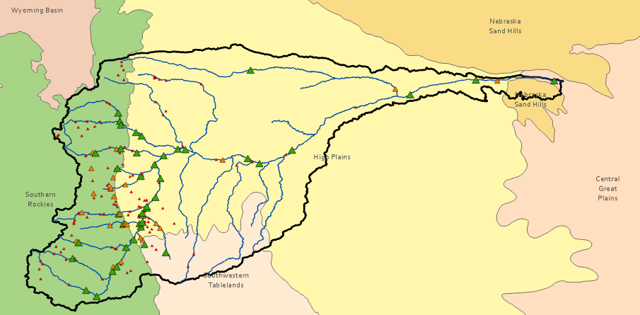

Hydrologic Drivers

Slide 19
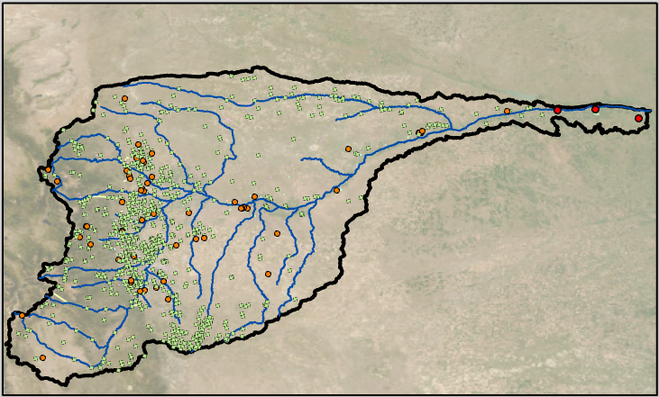
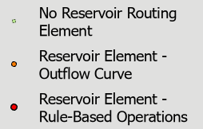
Dams

Slide 20
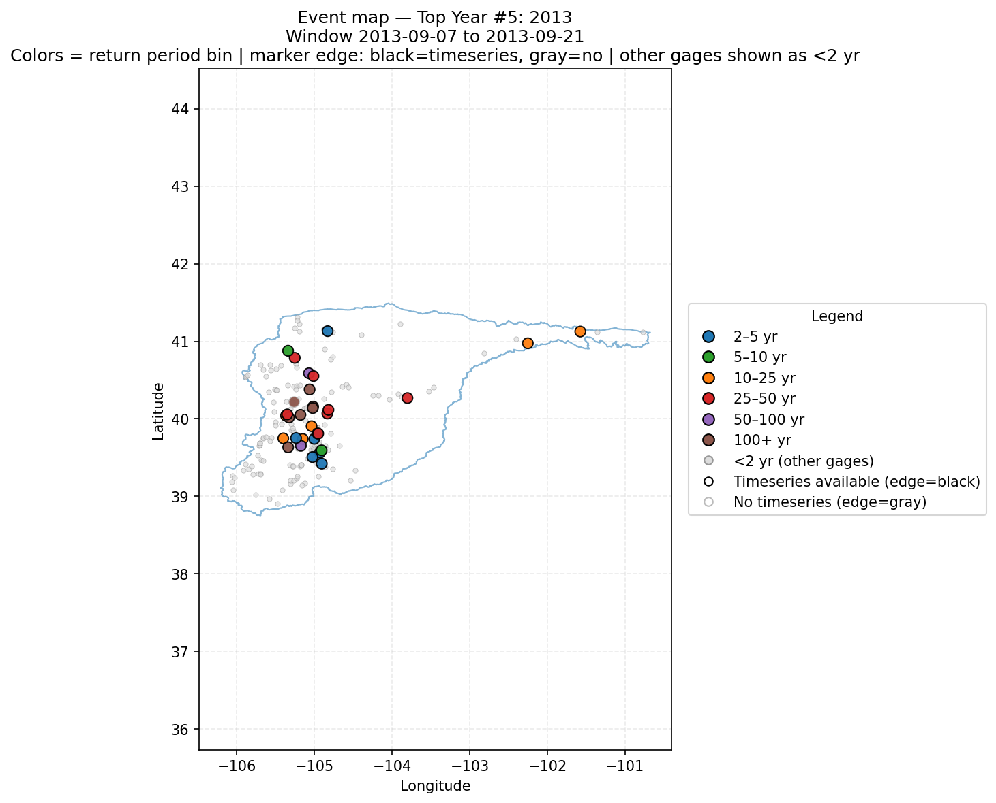
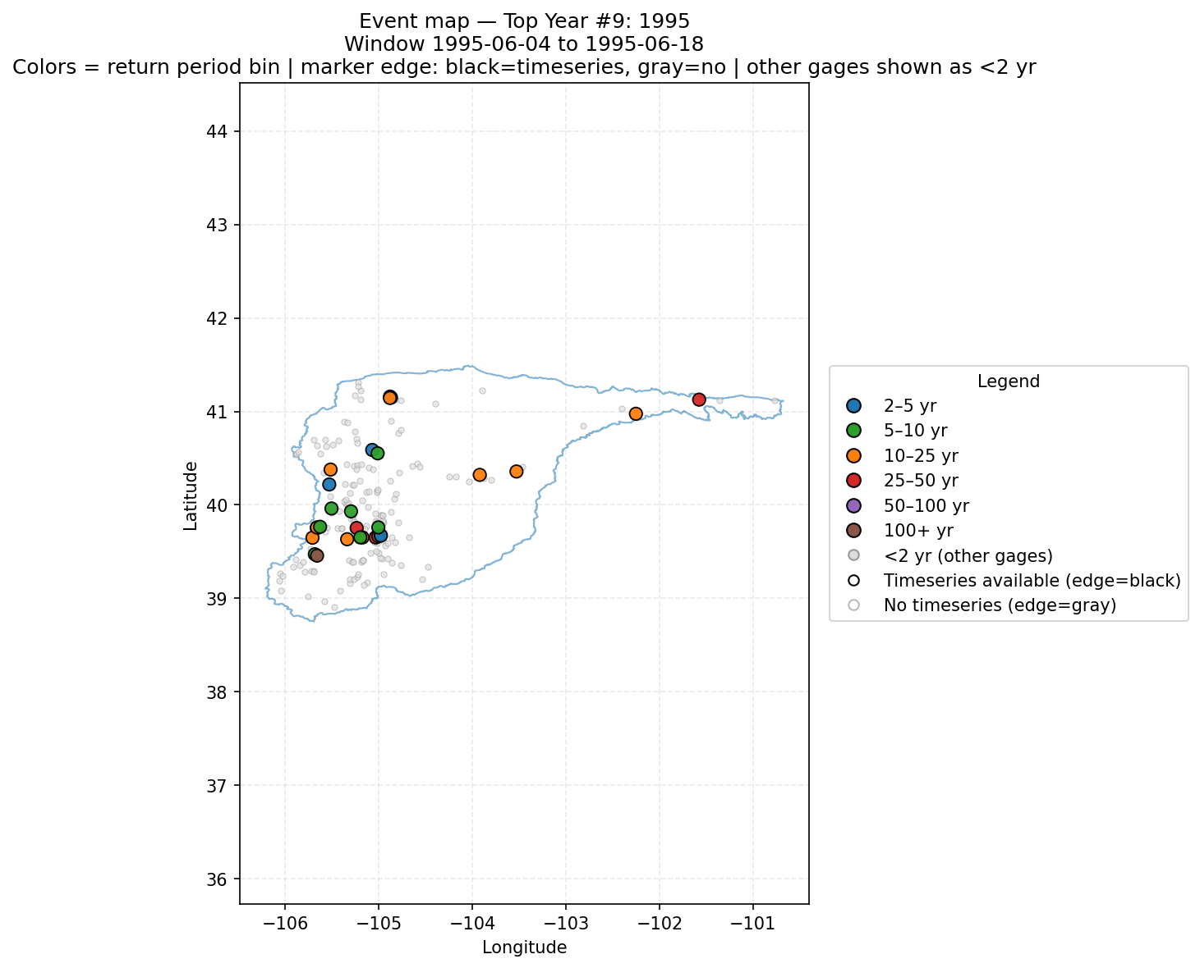
Single Event Selection

Slide 21
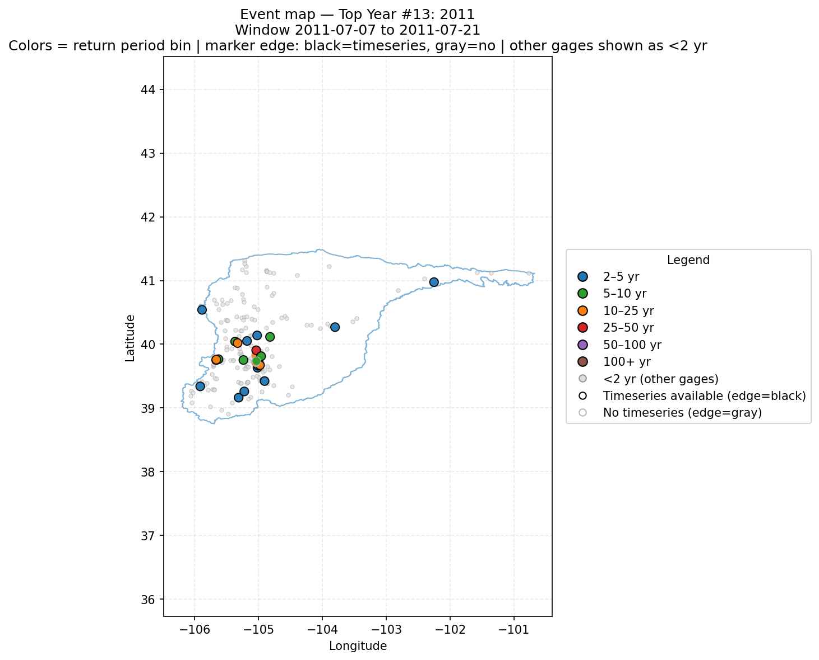
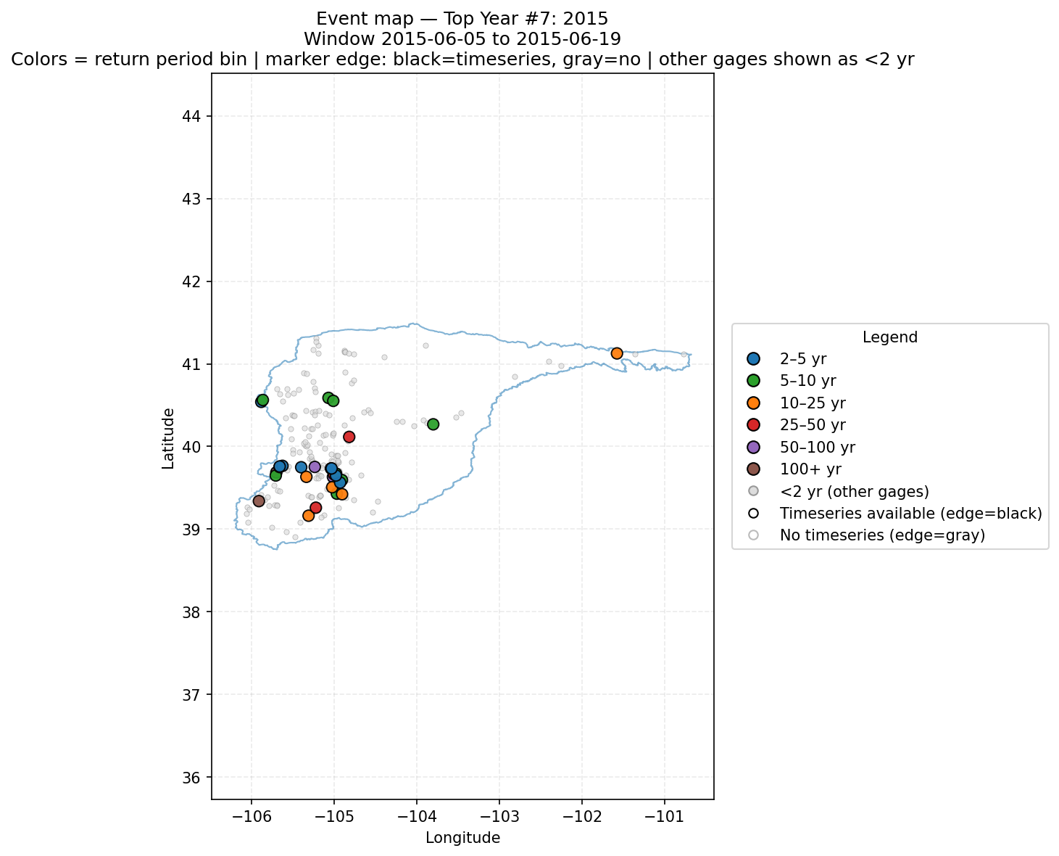

Slide 22
Technical Discussions

Slide 23
RES-SIM Scoping Decision Process - Example
An example of 4 hydroelectric dams that indicate it could be operated as a system. Part of the East Fork Tuckasegee River Project
We have some initial information, but not full details of the dams yet. It isn't obvious to us yet if these would require RES-SIM.
Question for USACE:
What information would you be seeking in this case to determine whether any of these Dams would need to be included in RES-SIM?
If you were starting the Dam Scoping Process, how would you approach the RES-SIM determination in this area?

Slide 24
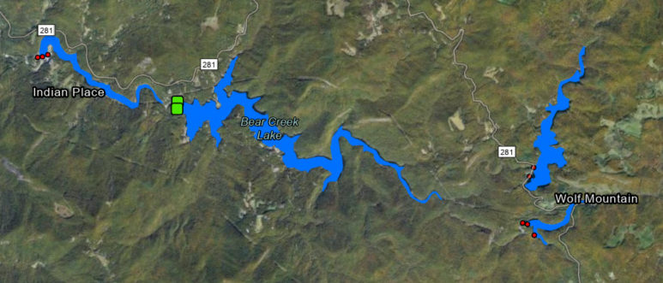
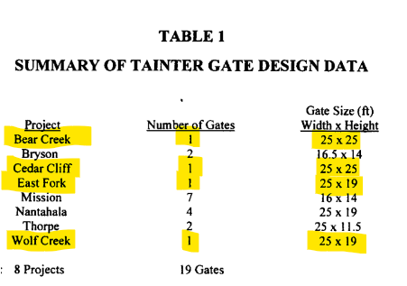
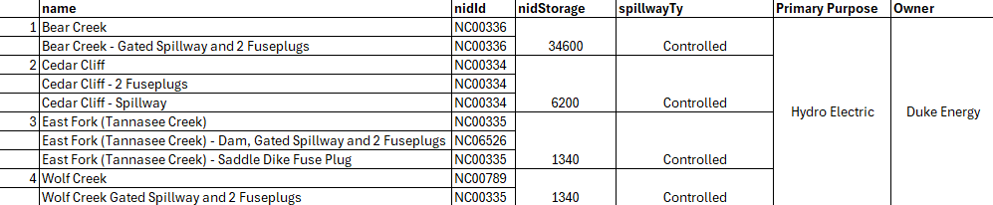
2
1
4
3

Slide 25
RAS Model Unit Delineation
There are some examples from South Platte to share.
Seeking opinions from USACE on RAS Model Unit delineation relating to Size and Gage Availability.
Questions about best practices for developing overlapping model units.

