Slide 1
Technical Discussions

Slide 2
Technical: Dam Scoping Process
Issue/Inquiry
Upon review of the FFRD SOP Version 1 – some clarification of selection and modeling of dams may be warranted. This clarification helps to select and identify how dams would be included in the modeling framework.
Why It Matters
Having a common process/workflow for how dams are integrated into the modeling framework can ensure general consistency amongst future studies.
Proposed Actions/Solutions:
The PTS Dam Safety SME’s have developed a proposed Dam Scoping Process Workflow that could be utilized by study teams to initially identify how dams should be integrated into the modeling framework.
PTS would propose to use this process workflow for the Validation Basins as temporary supplemental guidance.
PTS would recommend that future versions of the FFRD SOP (Version 2 or later) would include these process/workflows to provide clarification.

Slide 3
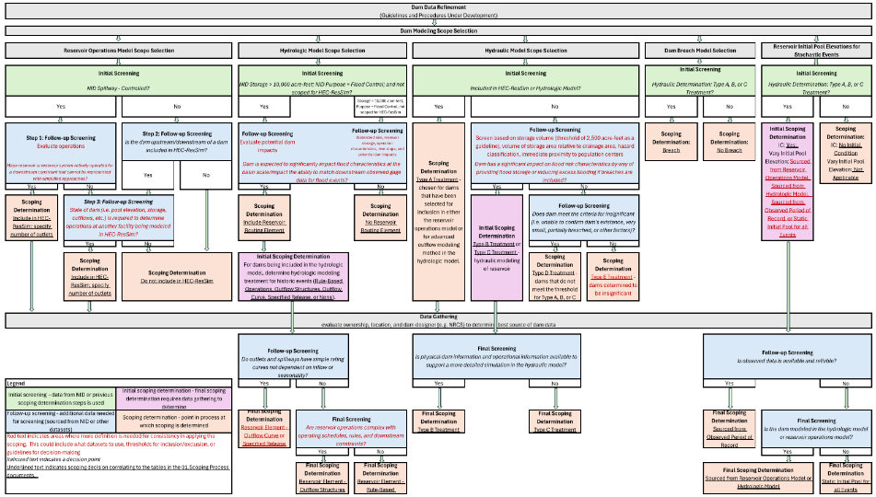
Technical: Dam Scoping Process
Dam Scoping Flow Chart (proposed by PTS)
Dam Scoping Table Summary
Validation Basin | Total Dams | HEC-ResSim | HEC-HMS | HEC-RAS (Type A, B, C) | HEC-RAS (Type D) | Not Modeled (Type E)
Allegheny | 241 | 5 | 41 | 76 | 157 | 8
South Platte | 906 | 3 | 54 | 461 | 432 | 13
Upper Tennessee | 610 | 55 | 8 | 122 | 371 | 117
TOTAL | 1,757 | 63 | 103 | 659 | 960 | 138

Slide 4
Technical: Allegheny Storm Typing
The Issue: The standard tropical vs. non‑tropical storm classification does not adequately represent the dominant storm processes affecting the Allegheny region.
Why it Matters: This oversimplification can lead to storms being paired with hydrologic model initial conditions that do not match the actual storm mechanism.
Proposed Actions/Solution: Adopt and operationalize the nationwide storm typed dataset developed by Alsheri et al. (2024).
What is Needed:
Meteorologically homogenous storm transposition domain.
72-hour storm catalog dataset.
GHCNd dataset concatenated for all GHCNd rain gauges across CONUS. Developed by Alshehri et al. (2024). Dataset contains over 77 million rows of daily recorded rainfall attributed by date, rainfall statistics, and storm type.

Slide 5
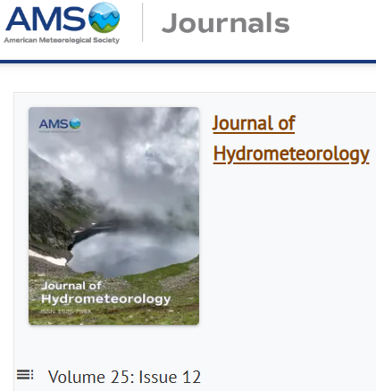
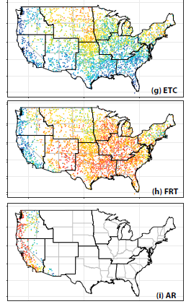
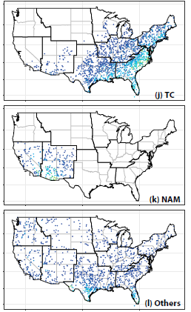

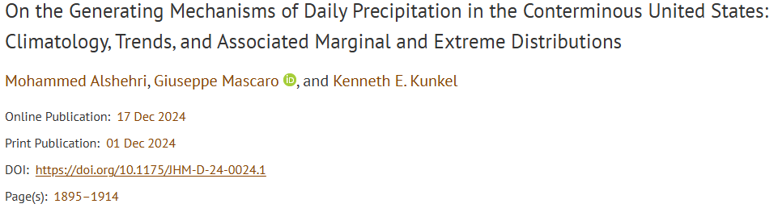
Technical: Allegheny Storm Typing
6 Different Storm Types
~3k GHCNd Rain Gauges
1980-2018 Daily POR
~77M rows of data
https://journals.ametsoc.org/view/journals/hydr/25/12/JHM-D-24-0024.1.xml?tab_body=supplementary-materials

Slide 6
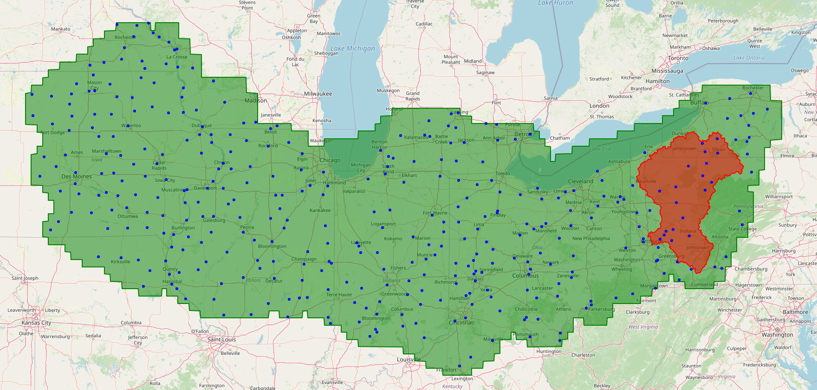

Technical: Allegheny Storm Typing
Storm Typing by Proximity
t=1200
t=1200
t=0600
r=500-km
t=2400

Slide 7
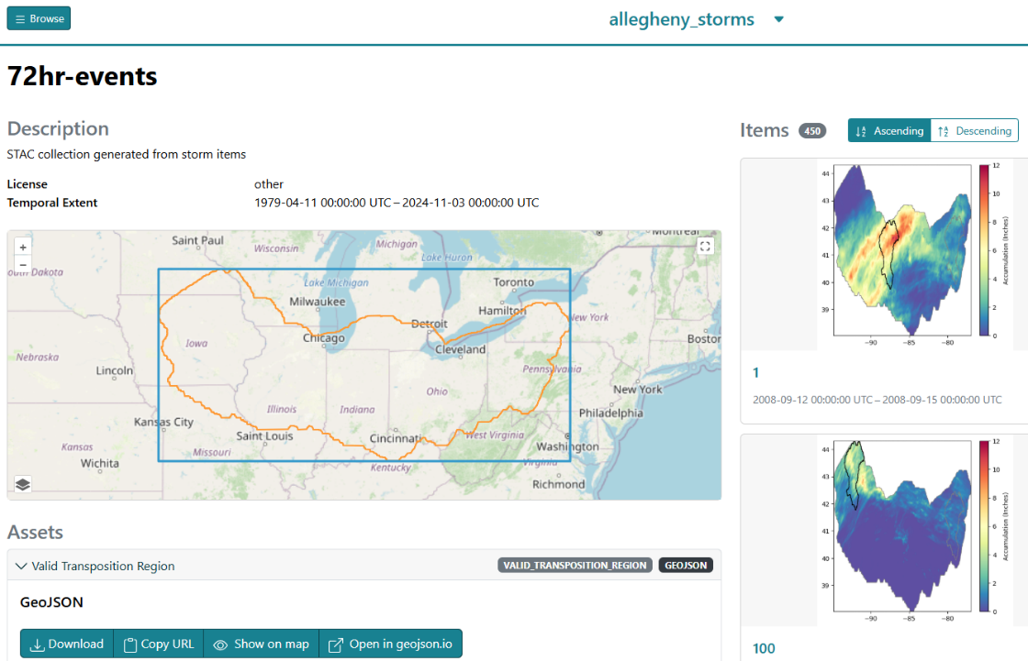
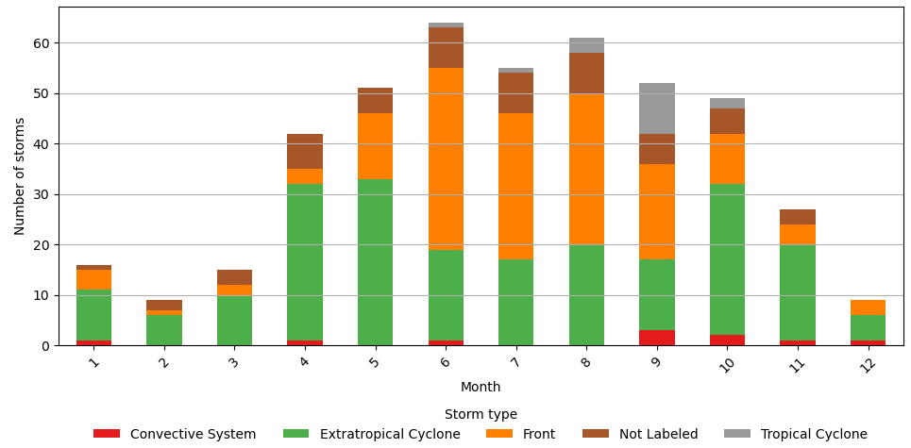
Technical: Allegheny Storm Typing
Draft Storm Catalog Built. Evaluating Storm Types
Storm Type | Kunkel et al. (2012) | Agel et al. (2015) | Alshehri et al. (2024) | ARC et al. (2026)
Tropical Cyclone | 36.00 | 19.00 | 17.00 | 2.22
Extratropical Cyclone | 16.00 | 66.00 | 31.00 | 47.33
Front | 47.00 | NA | 49.00 | 34.22
Convective System | NA | NA | NA | 3.78
Other/Not Labeled | NA | 15.00 | 3.00 | 12.44

Slide 8
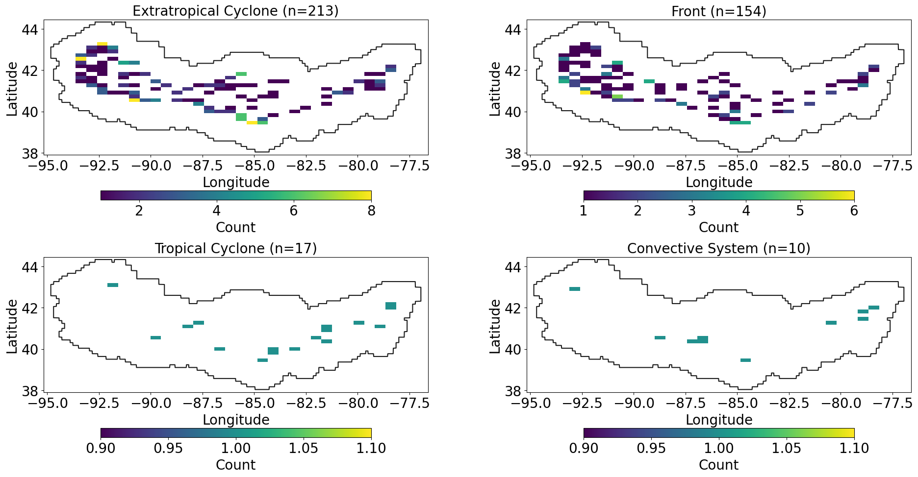
Technical: Allegheny Storm Typing

Slide 9
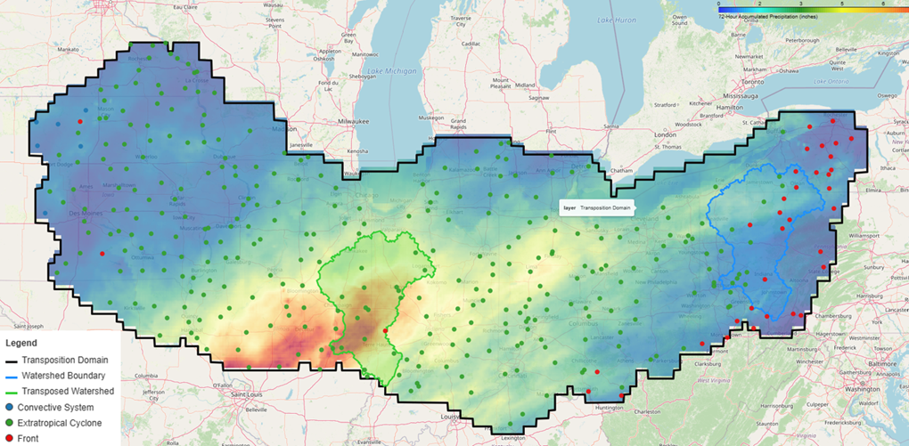
Example: Extratropical Cyclone (2015-12-26 )
72-hr Accumulated Precip

Slide 10
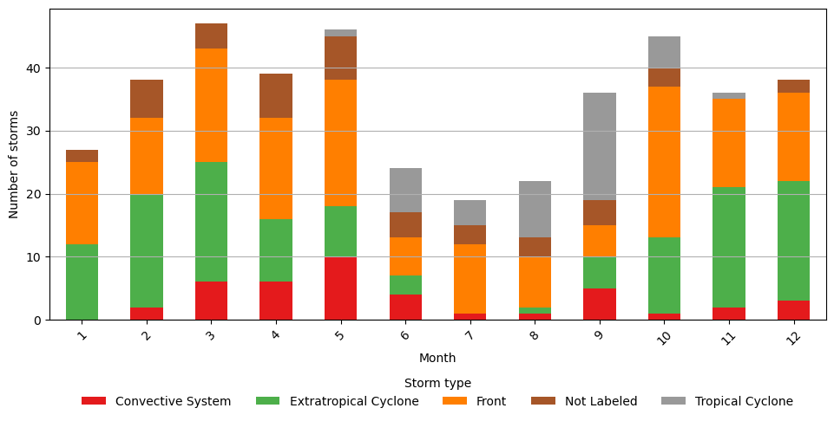
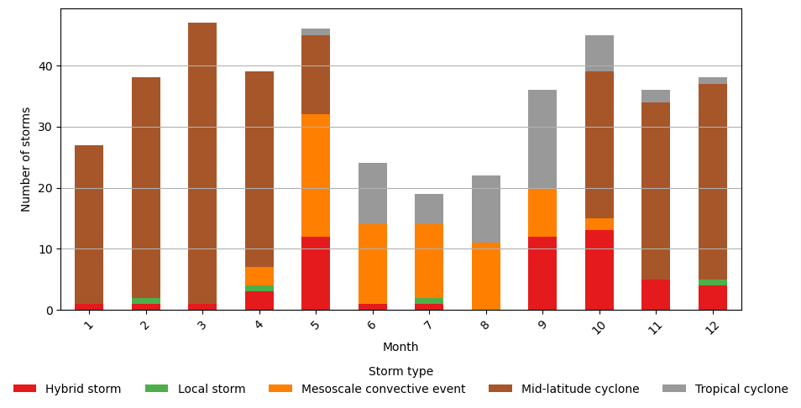
Example: Trinity Storm Catalog
Storm Type | Proportion (%)
Front | 38.61
Extratropical Cyclone | 30.22
Not Labeled | 10.79
Tropical Cyclone | 10.55
Convective System | 9.83
Storm Type | Proportion (%)
Mid-latitude Cyclone | 57.07
Mesoscale Convective System | 16.55
Hybrid Storm | 12.95
Tropical Cyclone | 12.47
Local Storm | 0.96
Storm Types when using proposed method
Storm Types Benchmark

Slide 11
Technical: Transposition Domains
Issue:
There were noticeable differences between the “provided” domain versus the “geometrically valid" domain.
Outcomes:
UW updated the domain drawing methodology so that valid transpositions are now checked as the domains are built (i.e., during the raster-based growth process).
ARC confirmed new transposition domain through stormhub for Allegheny. All set.
STARR II noted that the new process introduced a hole in the transposition domain, which violates the QC check “Is the transposition domain polygon in the correct projection? Is it a complete, closed polygon with no holes?”

Slide 12
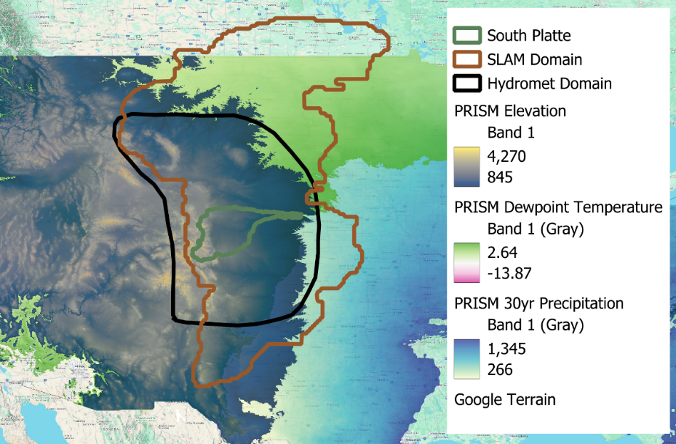
SLAM Domain Investigation
A foundational assumption of SST is that the transposition domain is meteorologically homogenous, and storms are therefore physically transferable
This analysis evaluated whether the SLAM domain satisfies this assumption for South Platte
PRISM 30-year normals were analyzed along with storm catalogs to compare SLAM and Hydromet domains against the South Platte Basin
Figure 1. South Platte Basin (green) and Hydromet transposition domain (black) mapped over PRISM precipitation (blue), dewpoint (light green), and elevation (dark green) data. PRISM data was bound to South Platte’s minimum and maximum values.
Notes:
Explore the enhanced Mapping Kneeboard, a collaborative PTS initiative that highlights the advantages of Power BI dashboards over the traditional method of referencing numerous Excel spreadsheets. These modernized dashboards summarize and present data in a way that builds on the historic Mapping Kneeboard PowerPoint presentations. The enhanced data visualization provides FEMA leadership with a comprehensive, real-time view of project statuses, enabling quick and informed decision-making.

Slide 13
Physiographic & Climatological Fit
Hydromet domain closely mirrors South Platte basin in elevation, precipitation, and dewpoint
SLAM domain mean elevation is 2,100+ feet lower than South Platte
  KS statistic of 0.553 indicates substantial distributional separation
SLAM domain includes warmer, more humid regions with systematically higher dewpoint values
Table 1. Summary table of domain similarity relative to the South Platte watershed
Variable | Most Similar to South Platte | Strongest Divergence Observed
Precipitation | Hydromet Domain | Minor differences overall
Elevation | Hydromet Domain | SLAM Domain (KS = 0.553)
Dewpoint | Hydromet Domain | SLAM Domain

Slide 14
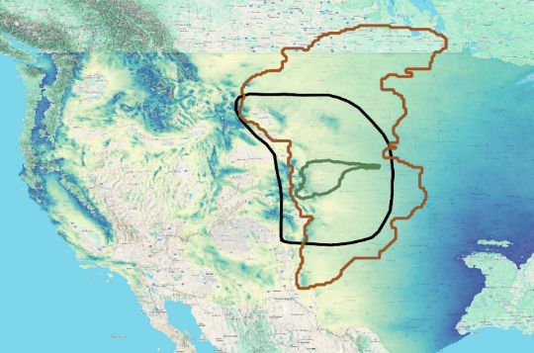
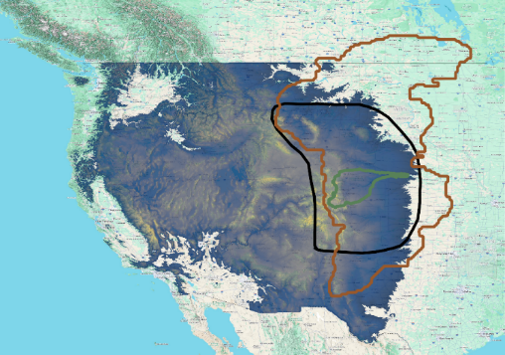
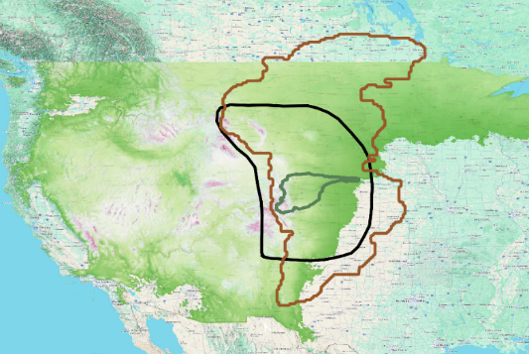

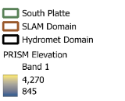



Meteorological Homogeneity
SLAM domain integrates multiple distinct precipitation regimes (Pacific frontal, Gulf of Mexico upslope, monsoonal) and cannot be considered meteorologically homogenous
  SLAM domain extension into Canada may further skew statistics
Hydromet domain represents a hydroclimatic regime consistent with SST assumptions
Figure 4. South Platte Basin (green), Hydromet transposition domain (black), and SLAM domain (brown) mapped over PRISM precipitation values on the left, PRISM elevation values in the middle, and PRISM dewpoint values on the right.

Slide 15
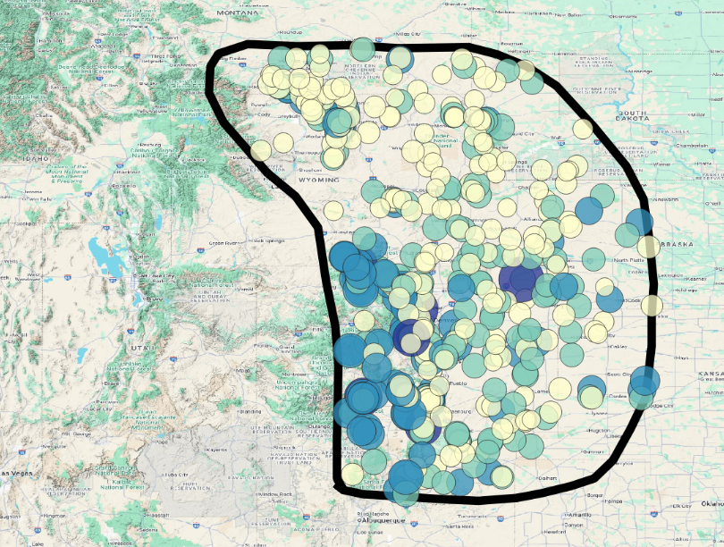
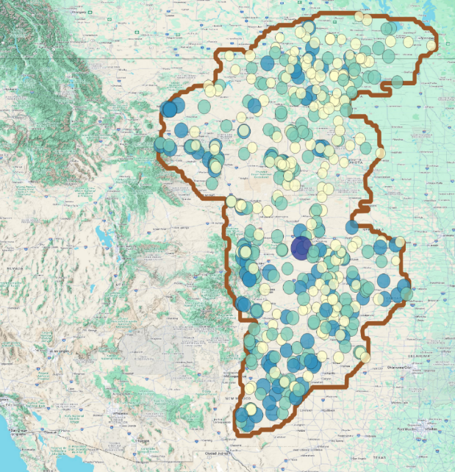
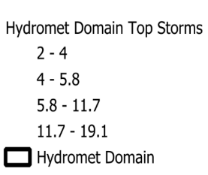
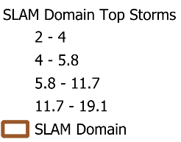


Storm Catalog Characteristics
Both domains show similar peak storm precipitation (~4.6 in average maximums), but differ in storm structure
SLAM storms have higher means (1.82 in) and minimum (0.35 in) precipitation, suggesting overestimation
Figure 1. On the left, the Hydromet domain with storms sized and colored by magnitude. On the right, the SLAM domain with storms sized and colored by magnitude.

Slide 16
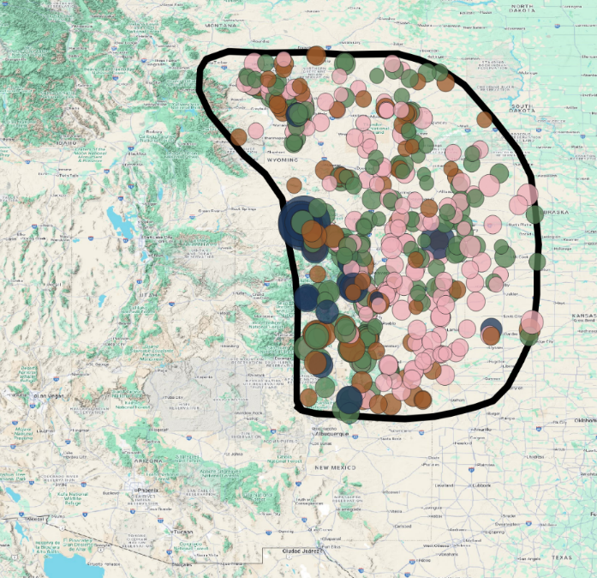
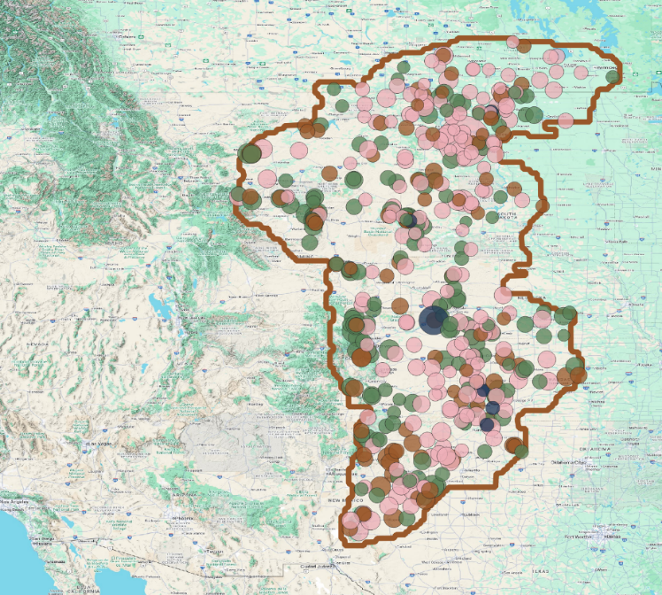
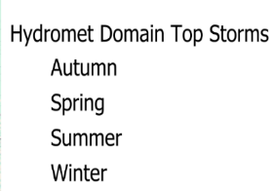
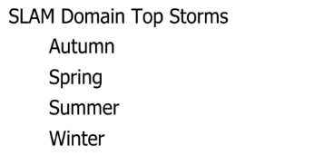





Storm Catalog Characteristics
The Hydromet domain preserves realistic winter storm intensity concentration along the Continental Divide while SLAM domain produces only 7 winter storms with scattered spatial distribution.
Figure 3. On the left, the Hydromet domain with storms sized by magnitude and colored by season. On the right, the SLAM domain with storms sized by magnitude and colored by season.

Slide 17
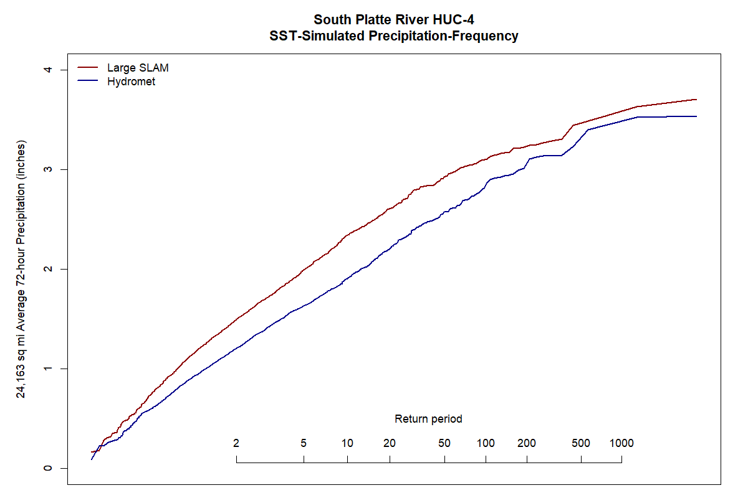

Slide 18
Key Conclusions
There's a significant difference between the two domains that would result in a difference in the flood frequency analysis
Those differences are first and second order – magnitude of the precip (first order) and there's second order impact of seasonality
We wanted to test if these domains impact – yes, it indicates there are differences and they are large effects that will really significantly impact what we're seeing in the flood models
  The transposition domain needs to be right for the storm catalog and the hydrologic model to be right
  SLAM being asked to generate 20x area ratio, vs drawing hand drawn homogenous

Slide 19
Recommendations
Use the Hydromet domain for subsequent SST analysis
How do we improve the SOP?
  Investigate the implications of area ratio
  Develop the transposition domain validation process
Figure 5. South Platte Basin (green) and Hydromet transposition domain (black) mapped over PRISM precipitation (blue), dewpoint (light green), and elevation (dark green) data. PRISM data was bound to South Platte’s minimum and maximum values.

