Slide 1
FFRD Validation Basins
Cross-Basin Meeting
March 6th, 2026

Slide 2

Agenda
Data Technical Outreach
Validation Basin Progress
Technical Discussions

Slide 3
Data Technical Outreach
Status Update Discussion
Schedule Implications

Slide 4
VALIDATION BASIN PROGRESS

Slide 5
Upper Tennessee (0601) Progress Update
Task | Progress Update | Upcoming Next Steps
Scoping and Data Preparation | Compiled relevant available reference/input data Identified key data providers and datasets Geospatial Completed 4-ft and 100-ft DEM base terrain Dam/Levee Completed with Initial Dam and Levee Scoping Tables | Coordinate with Tennessee Valley Authority and other data providers to obtain key datasets Identify Bathymetry sources/plan Refine Dam Scoping Table based on Data Collection outreach efforts
Meteorology | Selected initial Calibration Events Prepared base atmospheric data Completed Storm Catalog/Normalization Grid | Finalize Storm Catalog Storm Typing
Hydrology | Compiled and Reviewed available observed gage data Prioritized Gage Locations (draft) HMS Model Parameters | HMS Test Run Explore Mixed Populations Process applied to Validation Basins
Hydraulics | Delineated RAS Model Unit Boundaries Model Linking Register | Mesh Refinement Scoping
Documentation | Updating Project Work Plans, Report, and Data Manifest | Continue updating as progress is made
Update Since Last Call
Critical

Slide 6
Allegheny (0501) Progress Update
FFRD (Hydrology First) Task | Progress Update | Upcoming Next Steps
Scoping & Data Preparation | Data Collection Continued Data Collection & Formatting | Key Data Provider Coordination Format collected data per SOP and agreed upon standards. Refine Key Flood Hazard Mechanisms based on Storm Catalog
Meteorology | Continued Storm Catalog Development Initial Storm Typing Recommendation | Finalize Storm Catalog Confirm Calibration Events based on Storm Typing and Flood Hazard Mechanisms
Hydrology | Continued to assemble HMS Model & Parameters | Model Linking Register Mesh Refinement Scoping
Reservoir Operations Modeling | Inserting dams in HMS model as identified in the dam scoping table.
Documentation & Feedback | Updating Project Work Plans, Report, and Data Manifest Submitted Terrain and Storm Typing Memo’s | Continue Refinement With Project Progress

Slide 7
South Platte (1019) Progress Update
FFRD (Hydrology First) Task | Progress Update | Upcoming Next Steps
Scoping & Data Preparation | Data Collection Identify Key Data Providers & Datasets Terrain Development Flood Hazard Mechanisms Initial Identification of Key Mechanisms Dam & Levee Draft Levee Scoping/Refinement Table Draft Dam Scoping Table | Key Data Provider Coordination Format collected data per SOP and agreed upon standards.
Meteorology | Storm Catalog Development Initial Storm Typing Transposition Domain Validation | Confirm Calibration Events/POR
Hydrology | Began to assemble HMS Model & Parameters | RAS Model Unit Identification/Delineation
Documentation & Feedback | Submitted South Platte Storm Typing Memo | Continue Refinement With Project Progress

Slide 8
Technical Discussions

Slide 9
Technical: Dam Scoping Process
Issue/Inquiry
Upon review of the FFRD SOP Version 1 – some clarification of selection and modeling of dams may be warranted. This clarification helps to select and identify how dams would be included in the modeling framework.
Why It Matters
Having a common process/workflow for how dams are integrated into the modeling framework can ensure general consistency amongst future studies.
Proposed Actions/Solutions:
The PTS Dam Safety SME’s have developed a proposed Dam Scoping Process Workflow that could be utilized by study teams to initially identify how dams should be integrated into the modeling framework.
PTS would propose to use this process workflow for the Validation Basins as temporary supplemental guidance.
PTS would recommend that future versions of the FFRD SOP (Version 2 or later) would include these process/workflows to provide clarification.

Slide 10
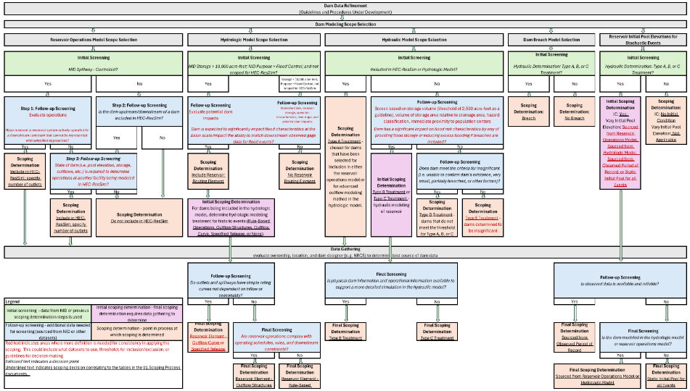
Technical: Dam Scoping Process
Dam Scoping Flow Chart (proposed by PTS)
Dam Scoping Table Summary
Validation Basin | Total Dams | HEC-ResSim | HEC-HMS | HEC-RAS (Type A, B, C) | HEC-RAS (Type D) | Not Modeled (Type E)
Allegheny | 241 | 5 | 41 | 76 | 157 | 8
South Platte | 906 | 3 | 54 | 461 | 432 | 13
Upper Tennessee | 610 | 55 | 8 | 122 | 371 | 117
TOTAL | 1,757 | 63 | 103 | 659 | 960 | 138

Slide 11
Technical: Allegheny Storm Typing
The Issue: The standard tropical vs. non‑tropical storm classification does not adequately represent the dominant storm processes affecting the Allegheny region.
Why it Matters: This oversimplification can lead to storms being paired with hydrologic model initial conditions that do not match the actual storm mechanism.
Proposed Actions/Solution: Adopt and operationalize the nationwide storm typed dataset developed by Alsheri et al. (2024).
What is Needed:
Meteorologically homogenous storm transposition domain.
72-hour storm catalog dataset.
GHCNd dataset concatenated for all GHCNd rain gauges across CONUS. Developed by Alshehri et al. (2024). Dataset contains over 77 million rows of daily recorded rainfall attributed by date, rainfall statistics, and storm type.

Slide 12
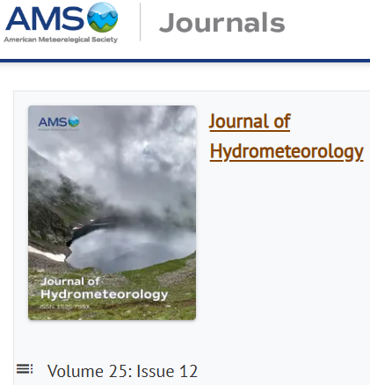
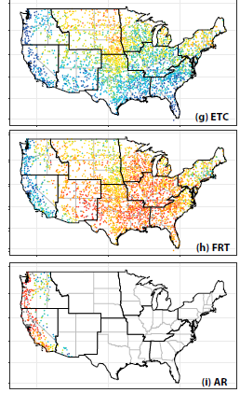
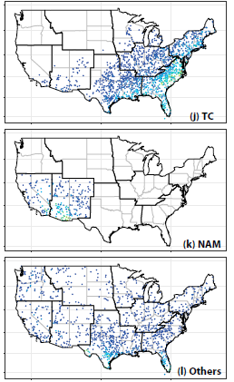

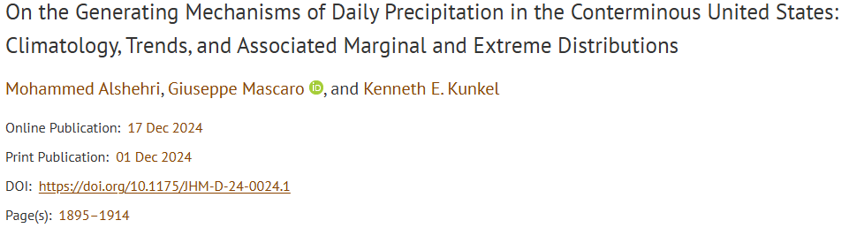
Technical: Allegheny Storm Typing
6 Different Storm Types
~3k GHCNd Rain Gauges
1980-2018 Daily POR
~77M rows of data
https://journals.ametsoc.org/view/journals/hydr/25/12/JHM-D-24-0024.1.xml?tab_body=supplementary-materials

Slide 13
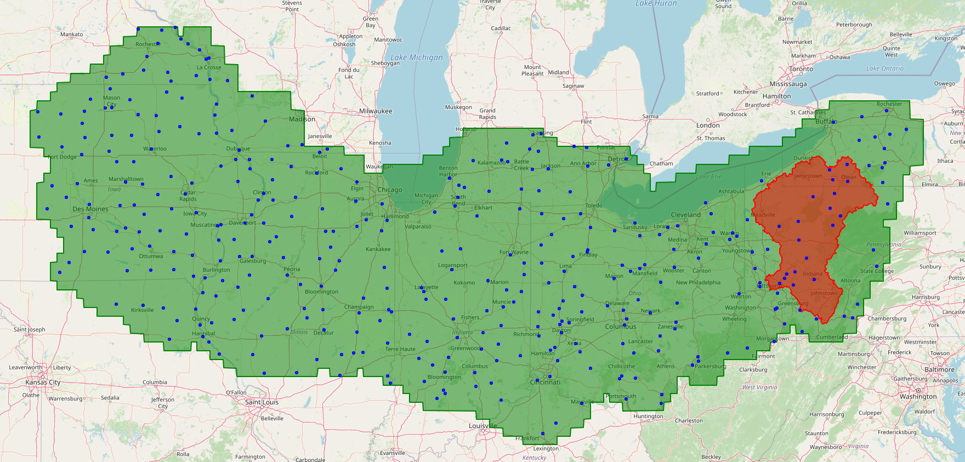

Technical: Allegheny Storm Typing
Storm Typing by Proximity
t=1200
t=1200
t=0600
r=500-km
t=2400

Slide 14
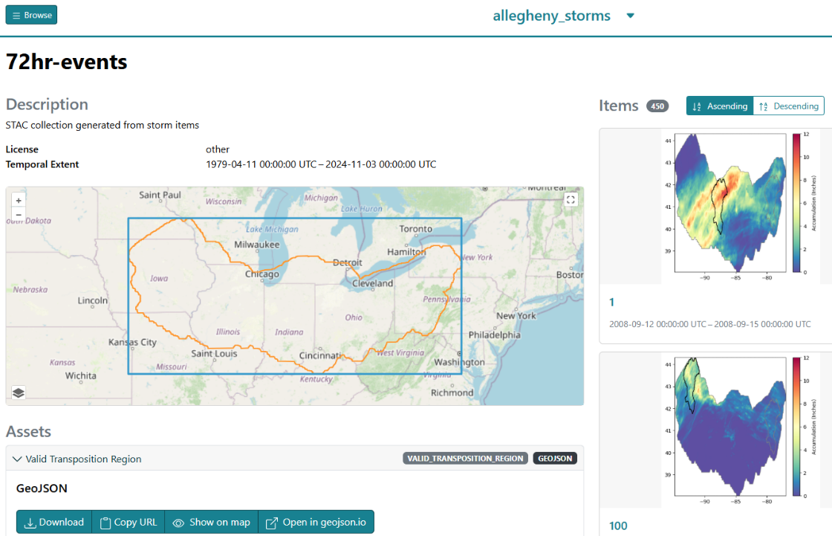
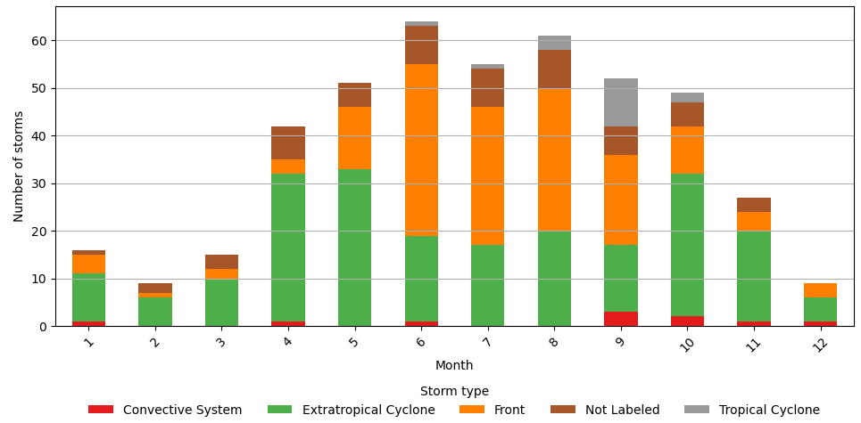
Technical: Allegheny Storm Typing
Draft Storm Catalog Built. Evaluating Storm Types
Storm Type | Kunkel et al. (2012) | Agel et al. (2015) | Alshehri et al. (2024) | ARC et al. (2026)
Tropical Cyclone | 36.00 | 19.00 | 17.00 | 2.22
Extratropical Cyclone | 16.00 | 66.00 | 31.00 | 47.33
Front | 47.00 | NA | 49.00 | 34.22
Convective System | NA | NA | NA | 3.78
Other/Not Labeled | NA | 15.00 | 3.00 | 12.44

Slide 15
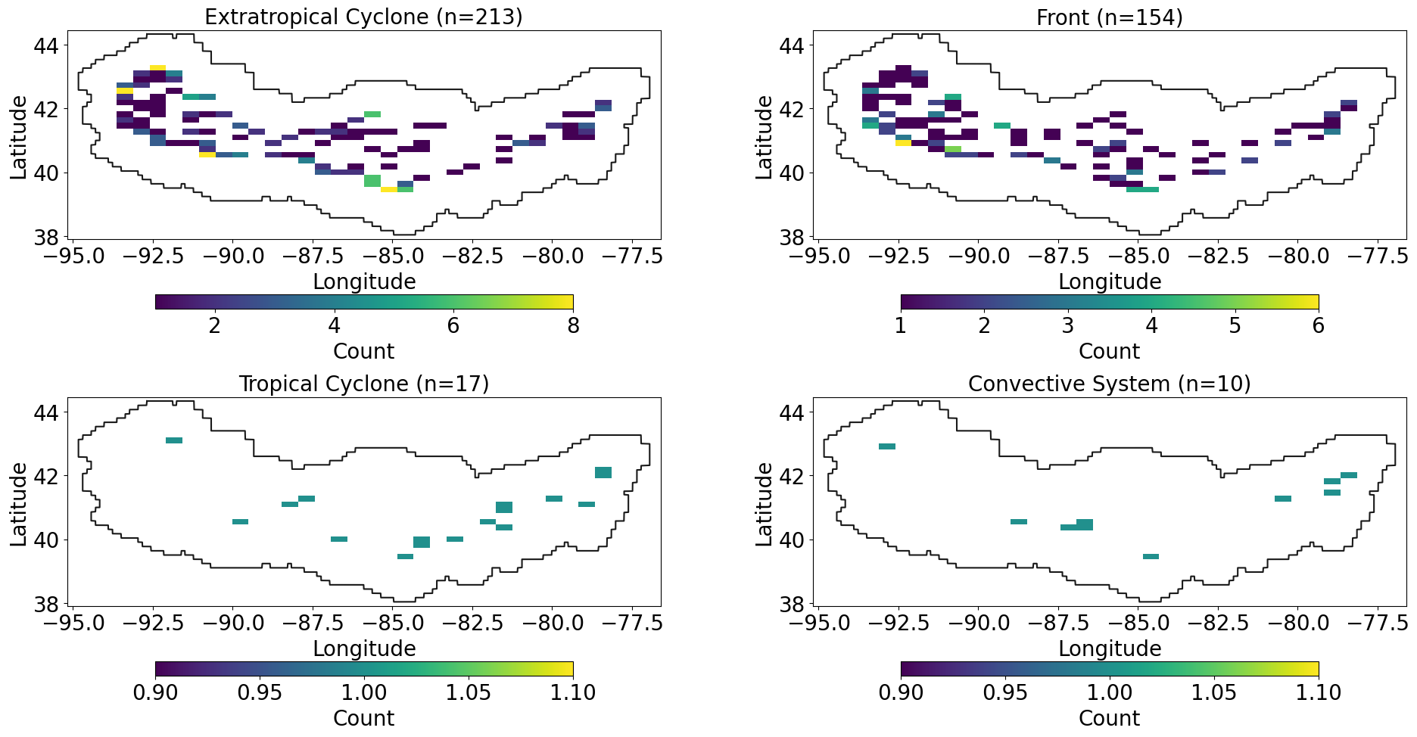
Technical: Allegheny Storm Typing

Slide 16
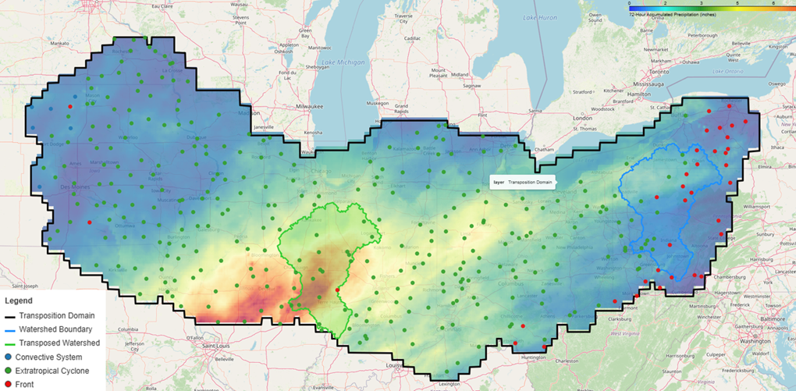
Example: Extratropical Cyclone (2015-12-26 )
72-hr Accumulated Precip

Slide 17
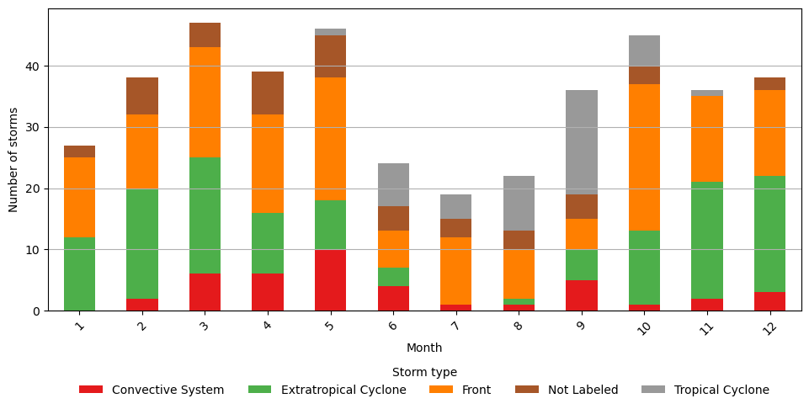
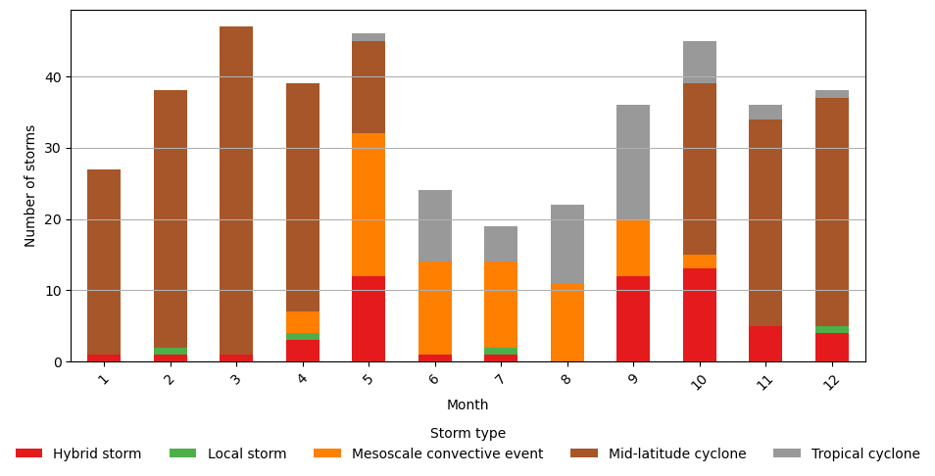
Example: Trinity Storm Catalog
Storm Type | Proportion (%)
Front | 38.61
Extratropical Cyclone | 30.22
Not Labeled | 10.79
Tropical Cyclone | 10.55
Convective System | 9.83
Storm Type | Proportion (%)
Mid-latitude Cyclone | 57.07
Mesoscale Convective System | 16.55
Hybrid Storm | 12.95
Tropical Cyclone | 12.47
Local Storm | 0.96
Storm Types when using proposed method
Storm Types Benchmark

Slide 18
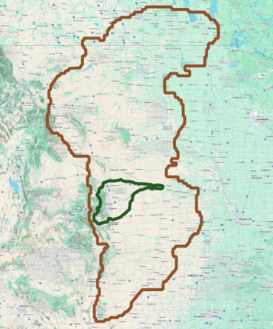
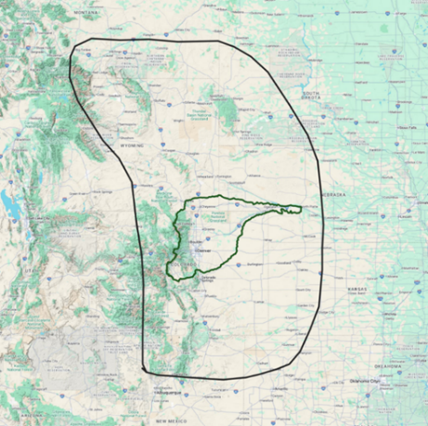
Transposition Domain Investigation
What is the best transposition domain to use for South Platte?
We have two domains drawn with two different methodologies:
SLAM
Purely statistical method
Most similar region of extreme rainfall statistics
Each additional pixel adds the next most similar
GSL overall measure of similarity
Hydromet
Physically-based method
Most similar region of rainfall-generating mechanisms
Both data-driven and subjective judgement
Changing the area is not a "knob you can turn"
Independent validation challenging
Figure 1. South Platte Basin (green) and SLAM transposition domain (brown).
Figure 2. South Platte Basin (green) and Hydromet transposition domain (black).

Slide 19
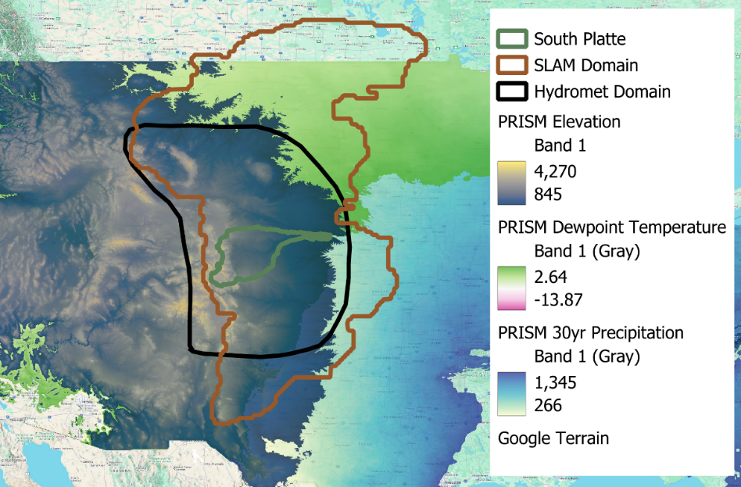
SLAM Domain Investigation
A foundational assumption of SST is that the transposition domain is meteorologically homogenous, and storms are therefore physically transferable
This analysis evaluated whether the SLAM domain satisfies this assumption for South Platte
PRISM 30-year normals were analyzed along with storm catalogs to compare SLAM and Hydromet domains against the South Platte Basin
Figure 3. South Platte Basin (green) and Hydromet transposition domain (black) mapped over PRISM precipitation (blue), dewpoint (light green), and elevation (dark green) data. PRISM data was bound to South Platte’s minimum and maximum values.
Notes:
Explore the enhanced Mapping Kneeboard, a collaborative PTS initiative that highlights the advantages of Power BI dashboards over the traditional method of referencing numerous Excel spreadsheets. These modernized dashboards summarize and present data in a way that builds on the historic Mapping Kneeboard PowerPoint presentations. The enhanced data visualization provides FEMA leadership with a comprehensive, real-time view of project statuses, enabling quick and informed decision-making.

Slide 20
Physiographic & Climatological Fit
Precipitation, elevation, and dewpoint variables were analyzed from PRISM
Hydromet domain closely mirrors South Platte basin in elevation, precipitation, and dewpoint
SLAM domain mean elevation is 2,100+ feet lower than South Platte
  KS statistic of 0.553 indicates substantial distributional separation
SLAM domain includes warmer, more humid regions with systematically higher dewpoint values
Table 1. Summary table of domain similarity relative to the South Platte watershed
Variable | Most Similar to South Platte | Strongest Divergence Observed
Precipitation | Hydromet Domain | Minor differences overall
Elevation | Hydromet Domain | SLAM Domain (KS = 0.553)
Dewpoint | Hydromet Domain | SLAM Domain

Slide 21
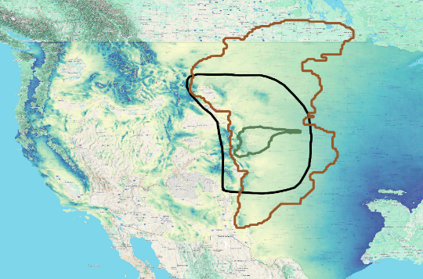
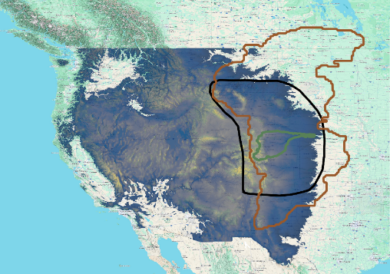
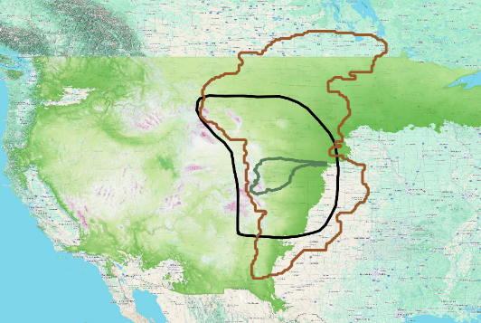

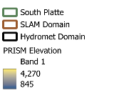



Meteorological Homogeneity
SLAM domain extends into Canada and may further skew statistics
SLAM domain integrates different moisture sources, so precipitation drivers are different as compared to South Platte
  e.g., Pacific frontal, Gulf of Mexico upslope, monsoonal precipitation regimes that differ from South Platte and cannot be considered meteorologically homogenous
Hydromet domain represents a hydroclimatic regime consistent with SST assumptions
Figure 4. South Platte Basin (green), Hydromet transposition domain (black), and SLAM domain (brown) mapped over PRISM precipitation values on the left, PRISM elevation values in the middle, and PRISM dewpoint values on the right., bound to South Platte min/max values.

Slide 22
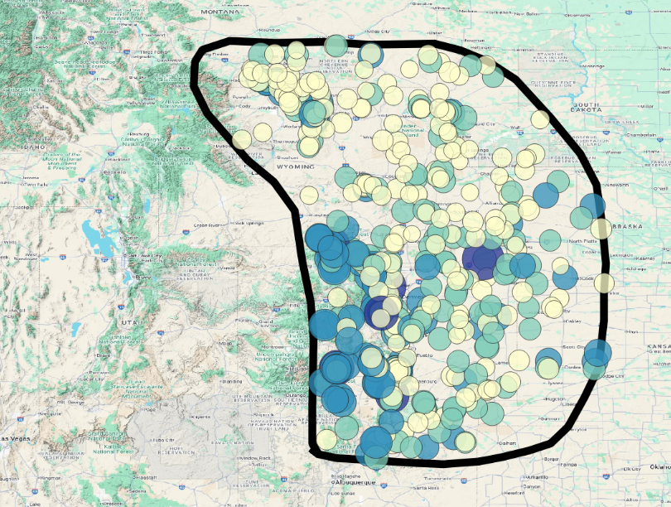
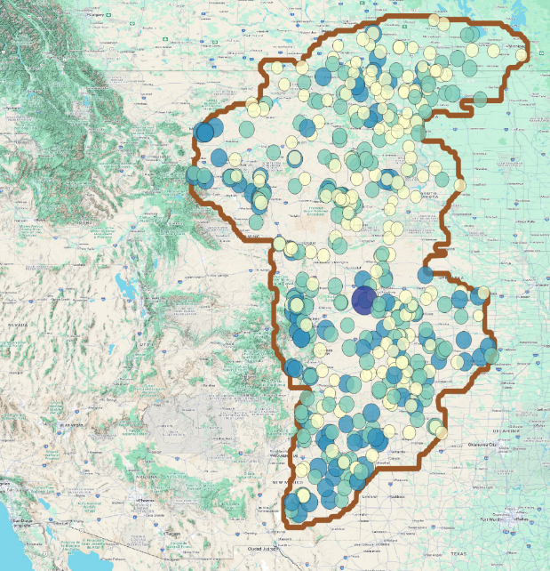
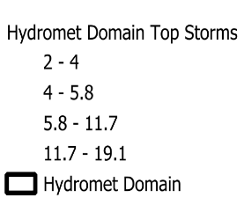
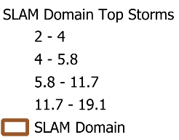


Storm Catalog Characteristics
Both domains show similar peak storm precipitation but differ in storm structure
SLAM storms have higher means (1.82 in) and minimum (0.35 in) precipitation, suggesting overestimation
Table 2. Storms counts and average min/mean/max values between domains.
Domain | N Storms | Min | Mean | Max
Hydromet | 458 | 0.20 | 1.37 | 4.63
SLAM | 459 | 0.35 | 1.82 | 4.61
Figure 5. On the left, the Hydromet domain with storms sized and colored by magnitude. On the right, the SLAM domain with storms sized and colored by magnitude.

Slide 23
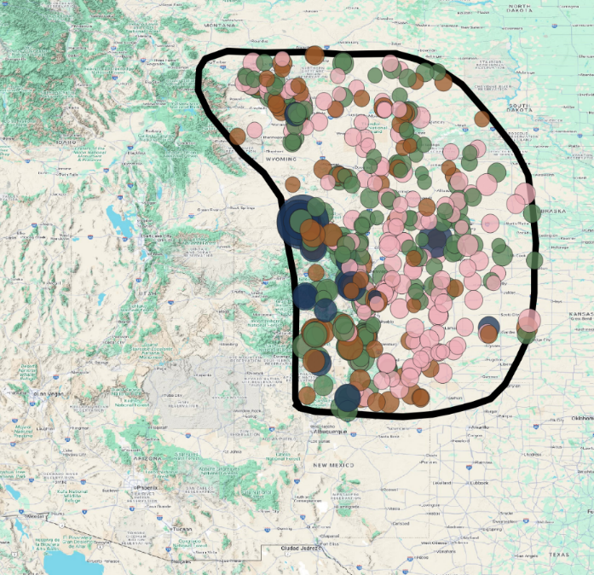
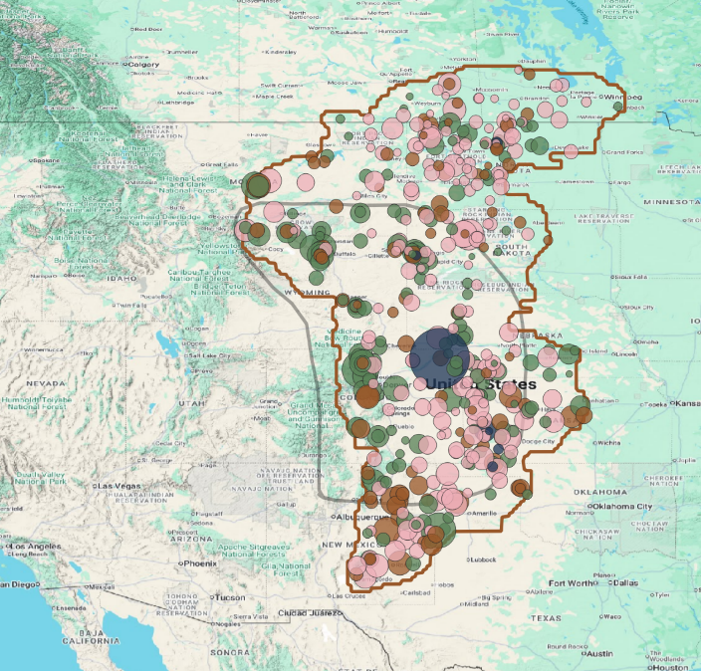
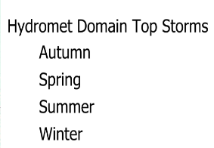
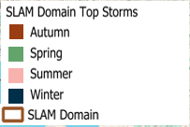

Storm Catalog Characteristics
The Hydromet domain preserves realistic winter storm intensity concentration along the Continental Divide while SLAM domain produces only 7 winter storms with scattered spatial distribution.
Figure 6. On the left, the Hydromet domain with storms sized by magnitude and colored by season. On the right, the SLAM domain with storms sized by magnitude and colored by season.

Slide 24
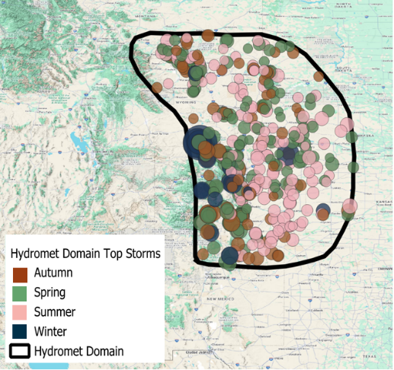

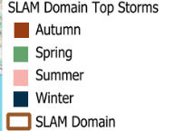
Storm Catalog Characteristics
Seasonal structure and min and mean values differ between domains
Table 3. Storm counts and average min/mean/max values between domains for seasonal storms.
Domain | Season | N Storms | Min | Mean | Max
SLAM | Winter | 7 | 0.41 | 1.66 | 5.90
Hydromet |  | 16 | 0.06 | 1.16 | 10.31
SLAM | Spring | 159 | 0.43 | 1.91 | 4.61
Hydromet |  | 183 | 0.24 | 1.47 | 4.67
SLAM | Summer | 191 | 0.28 | 1.75 | 4.62
Hydromet |  | 155 | 0.15 | 1.29 | 4.00
SLAM | Autumn | 102 | 0.36 | 1.83 | 4.50
Hydromet |  | 104 | 0.20 | 1.35 | 4.64
Figure 7. On the top, the Hydromet domain with storms sized by magnitude and colored by season. On the boittom, the SLAM domain with storms sized by magnitude and colored by season. Hydromet domain overlayed in light grey over SLAM domain forreference.

Slide 25
Key Conclusions
We set out to test which transposition domain would be best used for SST for South Platte:
  The Hydromet domain statistically aligned more with South Platte precipitation, elevation, and dewpoint values.
  Moisture sources differ substantially between the SLAM domain and what South Platte experiences.
  Differences are apparent in the storm catalogs as well: seasonality and storm location is affected by which domain is used, which could impact flood models.
The differences between the domains are both first and second order – magnitude of precipitation (first order) and an impact of seasonality (second order).
Results suggest the transposition domain needs to be right for the storm catalog to be right. If there are significant differences between the domains, it could result in differences in the flood frequency analysis due to storm catalog differences.

Slide 26
Recommendations
Use the Hydromet domain for subsequent SST analysis
How do we improve the SOP?
  Investigate the implications of area ratio
  Develop the transposition domain validation process
  As a follow-up, compare storm catalogs in HEC-HMS to evaluate precipitation frequency differences between domains to understand how domain differences impact hydrology
Figure 8. South Platte Basin (green) and Hydromet transposition domain (black) mapped over PRISM precipitation (blue), dewpoint (light green), and elevation (dark green) data. PRISM data was bound to South Platte’s minimum and maximum values.

