Slide 1
FFRD Validation Basins Cross-Basin Meeting
February 20th, 2026

Slide 2

Agenda
Data Technical Outreach
Mixed Populations
Technical Discussions
Validation Basin Progress

Slide 3
Data Technical Outreach
Status Update Discussion
Schedule Implications

Slide 4
VALIDATION BASIN PROGRESS

Slide 5
Upper Tennessee (0601) Progress Update
Task | Progress Update | Upcoming Next Steps
Scoping and Data Preparation | Compiled relevant available reference/input data Identified key data providers and datasets Geospatial Completed 4-ft and 100-ft DEM base terrain Dam/Levee Completed with Initial Dam and Levee Scoping Tables | Coordinate with Tennessee Valley Authority and other data providers to obtain key datasets Identify Bathymetry sources/plan Refine Dam Scoping Table based on Data Collection outreach efforts
Meteorology | Selected initial Calibration Events Prepared base atmospheric data Running Storm Catalog | Finalize Storm Catalog Storm Typing
Hydrology | Compiled and Reviewed available observed gage data Prioritized Gage Locations (draft) Delineated/Named initial HMS model Elements | HMS Parameterization and Test Run
Hydraulics | Delineated RAS Model Unit Boundaries Model Linking Register – in progress | Mesh Refinement Scoping
Documentation | Updating Project Work Plans, Report, and Data Manifest | Continue updating as progress is made
Update Since Last Call
Critical

Slide 6
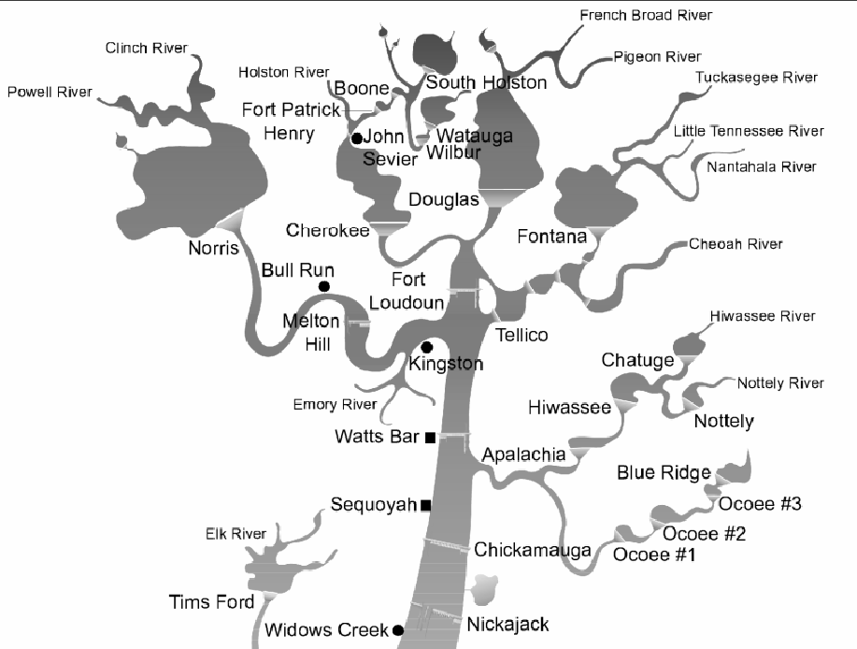
Upper Tennessee Modeling Statistics
27 RAS Model Units
Average Size: 642 square miles
Range: 300 – 1,005 square miles
HMS Model
197 Sub-Basins at an Average Size of ~88 square miles
24 Reservoirs
Res-Sim Model
14 Reservoirs Initially Identified
Source: TVA Resevoir Operations Study 2004

Slide 7
Allegheny (0501) Progress Update
FFRD (Hydrology First) Task | Progress Update | Upcoming Next Steps
Scoping & Data Preparation | Data Collection Continued Data Collection (atmospheric) Continued Coordination on Identifying Data Providers Dam & Levee Updated Levee Scoping/Refinement Table Updated Dam Scoping Table | Key Data Provider Coordination Format collected data per SOP and agreed upon standards. Refine Key Flood Hazard Mechanisms based on Storm Catalog
Meteorology | Storm Catalog Development Underway Initial Storm Typing Literature Review | Finalize Storm Catalog Confirm Calibration Events based on Storm Typing and Flood Hazard Mechanisms
Hydrology | Update Subbasin – RAS Model Unit Identification/Delineation Continued to assemble HMS Model & Parameters | Model Linking Register Mesh Refinement Scoping
Reservoir Operations Modeling | Updated the Dam Scoping Table – Initial Identification of ResSim Elements
Documentation & Feedback | Updating Project Work Plans, Report, and Data Manifest | Continue Refinement With Project Progress

Slide 8
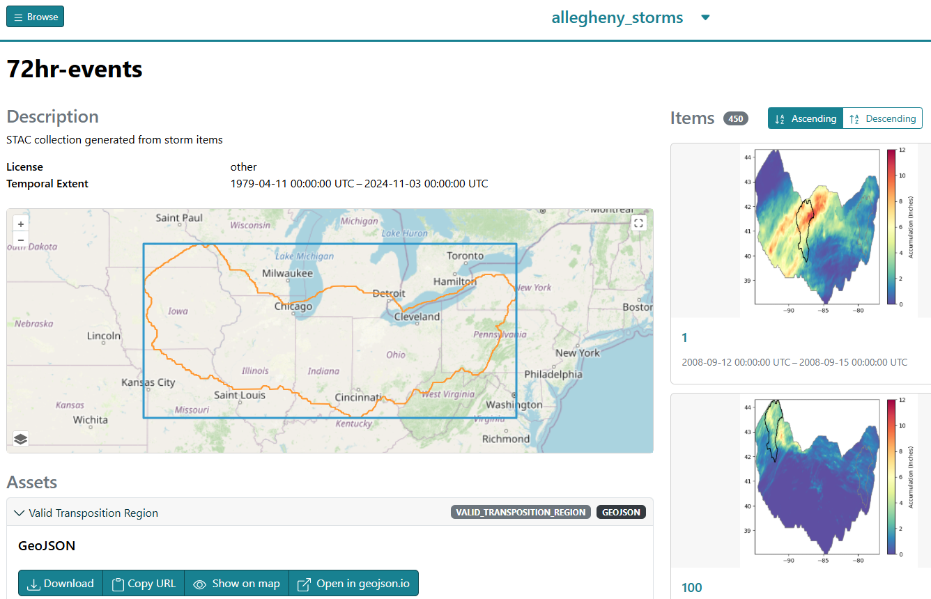
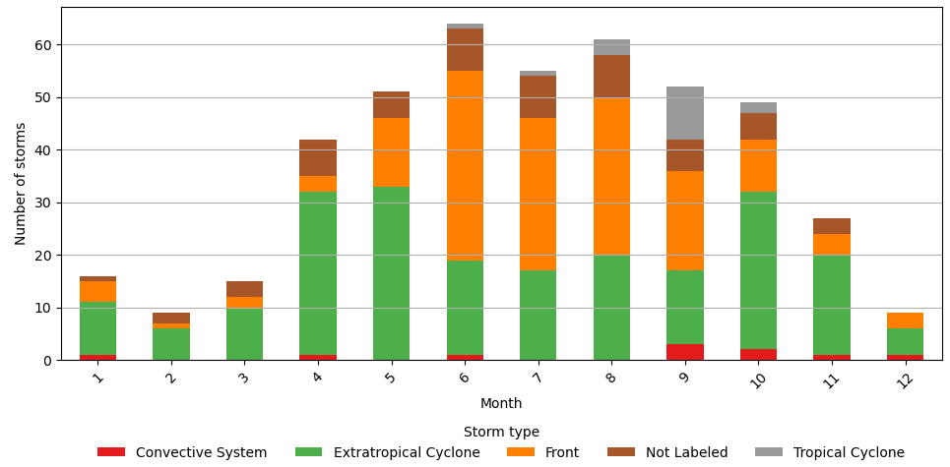
Allegheny Storm Catalog
Draft Storm Catalog Built. Evaluating Storm Types
Storm Type | Number of Storms | Percentage (%)
Extratropical Cyclone | 213 | 47.33
Front | 154 | 34.22
Not labeled | 56 | 12.44
Convective system | 17 | 3.78
Tropical Cyclone | 10 | 2.22

Slide 9
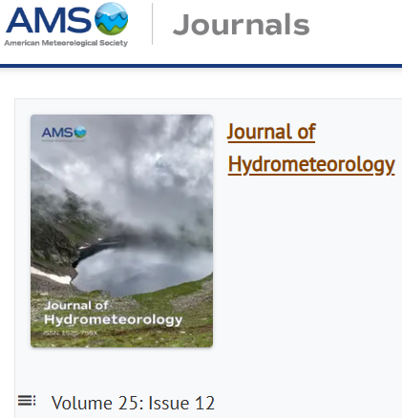
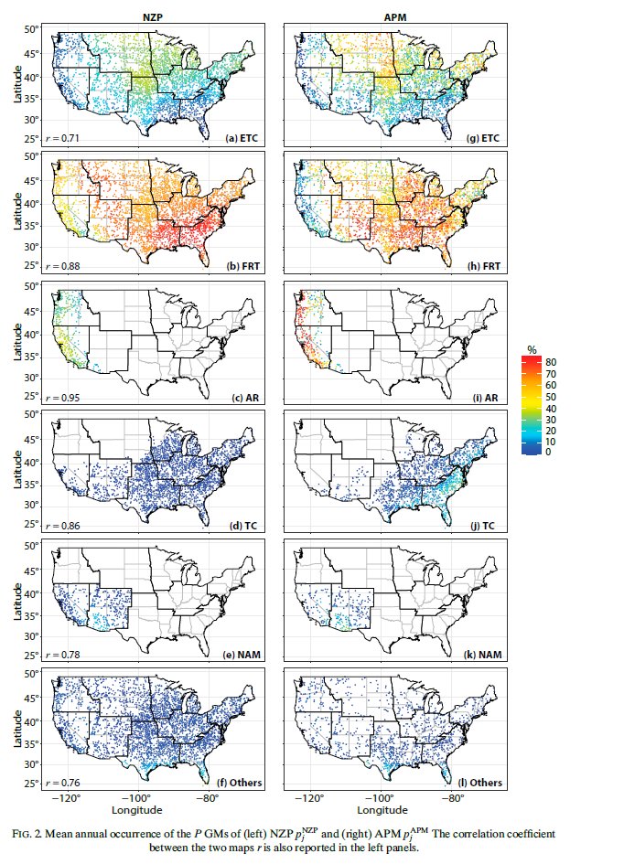
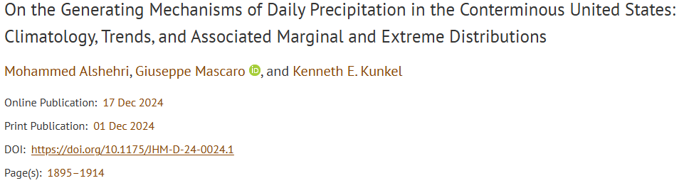
Allegheny Storm Catalog (BACKUP SLIDE)
https://journals.ametsoc.org/view/journals/hydr/25/12/JHM-D-24-0024.1.xml?tab_body=supplementary-materials

Slide 10
South Platte (1019) Progress Update
FFRD (Hydrology First) Task | Progress Update | Upcoming Next Steps
Scoping & Data Preparation | Data Collection Identify Key Data Providers & Datasets Terrain Development Flood Hazard Mechanisms Initial Identification of Key Mechanisms Dam & Levee Draft Levee Scoping/Refinement Table Draft Dam Scoping Table | Key Data Provider Coordination Format collected data per SOP and agreed upon standards.
Meteorology | Storm Catalog Development Initial Storm Typing | Confirm Calibration Events/POR
Hydrology | Began to assemble HMS Model & Parameters | RAS Model Unit Identification/Delineation
Documentation & Feedback | Submitted South Platte Storm Typing Memo | Continue Refinement With Project Progress

Slide 11
Technical Discussions

Slide 12
Technical: Terrain Tiling Clarification
Issue/Inquiry:
FFRD SOP does not define a standard CONUS-wide tiling pattern for individual Cloud-Optimized GeoTIFF (COG) files.
This creates ambiguity and inconsistent interpretations across teams, and potentially widely varying deliverables to FEMA.
Ideally, the CONUS-wide tiling scheme should be aligned between hydraulics and hydrology terrains.
A tiling scheme which aligns with the COG internal block size will allow for greatest efficiency when working with terrain data at large scale in the cloud.
Currently, with a hydrology DEM resolution of 100-ft, the smallest possible tiling size is too large (> 3 GB).
4-ft: hydraulics
12-ft: mapping
100-ft: hydrology
512: GDAL default COG internal block size
16: COG internal blocks must be divisible by 16
Minimum tile size
38,400 x 38,400 cells ❌ ~3.5-5.0 GB per COG file (compressed, without overviews)
https://gdal.org/en/stable/drivers/raster/cog.html#general-creation-options

Slide 13
Technical: Terrain Tiling Clarification
Proposed Actions or Outcomes:
Revise the standard hydrology DEM resolution to 96-ft to improve agreeability with hydraulics DEMs, allowing far greater flexibility in establishing a standard tiling scheme.
4-ft: hydraulics
12-ft: mapping
96-ft: hydrology
512: GDAL default COG internal block size
16: COG internal blocks must be divisible by 16
Establish a pre-defined CONUS-wide tiling scheme(s) for hydraulics and hydrology DEMs, requiring tiles to be edge-matched with no overlap or gaps, consistent with current standards for edge snapping.
Establish standards for COG internal block size and (potentially) compression, e.g., 512 x 512, ZSTD w/PREDICTOR=3
Outcome: Alignment of individual tiles with COG internal blocks will improve performance when working with FFRD terrains at “big data” scale (i.e., reading data from many adjacent COGs simultaneously).
Minimum tile size
1,536 x 1,536 cells ✅ ~6.0-8.0 MB per COG file (compressed, with overviews)

Slide 14
Technical: Calibration Event Selection Question
Inquiry:
In 5 out of 6 calibration events we have good spatial coverage, seasonality, and storm types.
We are missing a rain-on-snow event, however there are not many significant rain-on-snow events in recent years with calibration data availability. There is one ~2YR-5YR rain-on-snow event at some locations at the watershed.
Should we include this event to capture all types of events? Or prioritize another Thunderstorm or Tropical event that is more significant across the basin?
Proposed Actions or Outcomes:
We are planning to include the rain-on-snow event as a calibration event to help dial in snow parameters even though it is not an extremely significant across the basin.

Slide 15
Reservoir Modeling Clarification
Clarification:
Job Aid 1 states “For more complex reservoir operations, modelers typically rely on HEC-ResSim to model operating schedules, rules, and downstream constraints, however rule-based operations in HEC-HMS can serve as a close approximation.”
This has been interpreted 2 ways
1. Complex Reservoir Operations are included in Res-Sim and also approximated in HMS
2. Complex Reservoir Operations are included in Res-Sim, but reservoir is not included in HMS
If interpretation 1 is correct,
Are there any best practices or lessons learned to best align Res-Sim and HMS results during stochastic phase?
Are there any risks to calibration during conformance if the HMS and Res-Sim results are different?

Slide 16
Technical: Transposition Domains
Issue:
There were noticeable differences between the “provided” domain versus the “geometrically valid" domain.
Outcomes:
UW updated the domain drawing methodology so that valid transpositions are now checked as the domains are built (i.e., during the raster-based growth process).
ARC confirmed new transposition domain through stormhub for Allegheny. All set.
STARR II noted that the new process introduced a hole in the transposition domain, which violates the QC check “Is the transposition domain polygon in the correct projection? Is it a complete, closed polygon with no holes?”

