Slide 1
FFRD Validation Basins Cross-Basin Meeting
February 6th, 2026

Slide 2

Agenda
Validation Basin Project Intro
Technical Discussion Topics
Basin Progress
Scope, Timeline, Team Roles

Slide 3
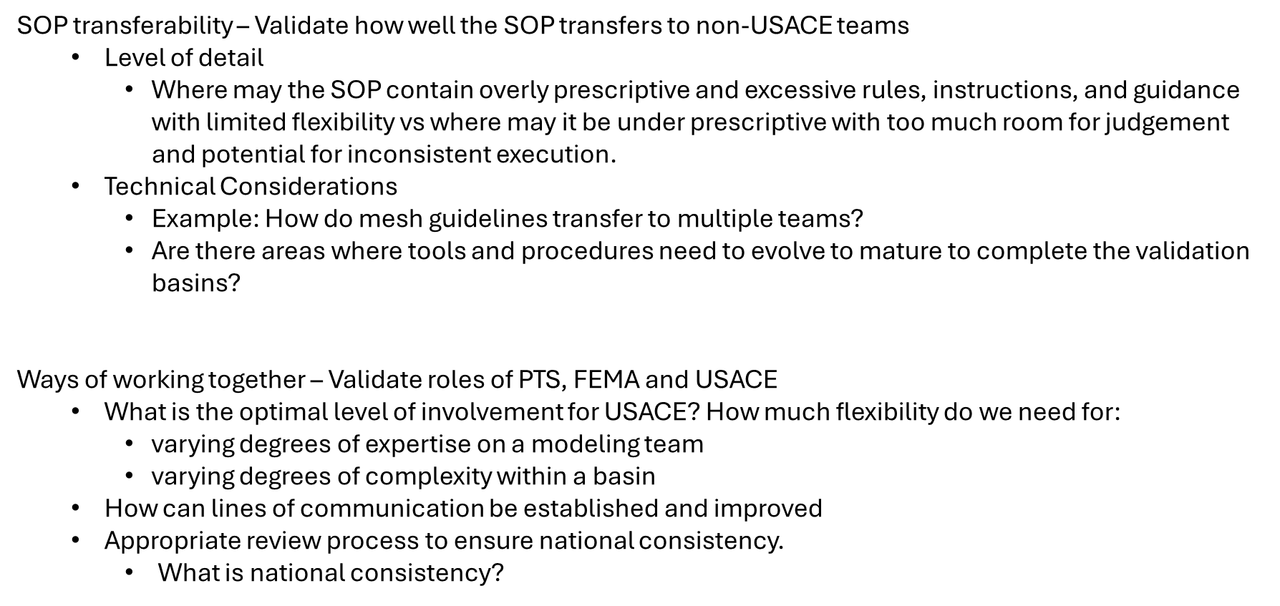
What are we 'validating'?

Slide 4
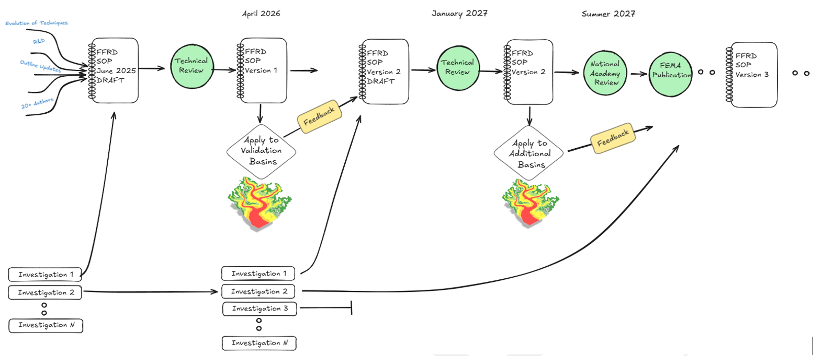
SOP and Validation Basins
DEC 2025
WE ARE HERE
Notes:
Validate Standard Operating Procedure (SOP) V1
Confirm it is usable in practice
Identify Gaps, Technical Accuracy, and Reproducibility
Feedback to be incorporated into Version 2.0
Validate ability to implement FFRD
Level of Effort
Schedule/Milestones
Regional Coordination
Tools

Slide 5
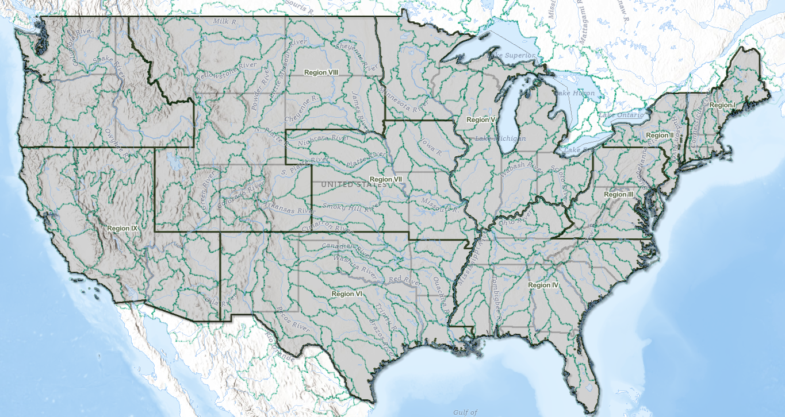
2026 FFRD Validation Basins (HUC-4)
South Platte (1019)
Allegheny
(0501)
PTS: | ARC | Compass | STARR II
Watershed Name: | Allegheny | Upper Tennessee | South Platte
Drainage Area (mi²): | 11,729 | 17,293 | 24,163
# of HUC 8s: | 9 | 16 | 18
Urban Areas: (Based on Census Data) | 28 (430 mi²) | 33 (1,394 mi²) | 23 (1,061 mi²)
USGS Streamgages: | 80 | 352 | 237
Levees: (Based on NLD) | 75 | 3 | 25
Dams: (Based on NID) | 241 | 609 | 906
Stream miles: (Based on NHD) | 14,445 | 26,047 | 60,180
Upper Tennessee (0601)
x

Slide 6
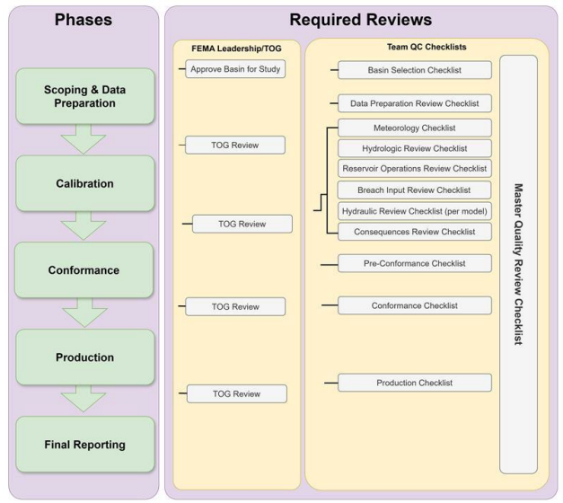
FFRD Workflow
Scoping and Data Preparation
Data Collection and Preparation
Terrain, Storms Catalog, Model Delineation
Tables 4.4-4.9 in SOP V1
Project Planning
Calibration
Individual Model Development
HMS, RAS, RES-SIM
Calibrate to 6 historic events
Conformance
Initial Model Integration
Link SST, HMS, RAS, RES-SIM
Test and Calibrate Stochastic Simulation
~20,000 events or 1 Realization
Production
Final Integrated Model
Full Monte Carlo Simulati0on
~1,000,000 events or 50 Realizations
Produce Gridded Hazard Outputs
Produce Structure Risk Outputs

Slide 7
2026 Validation Basin Estimated Timeline
Validation Basin Part 1 | Validation Basin Part 2
Now – March 31, 2026 | TBD (April target) - Remainder of 2026
Scoping and Data Preparation Aiming at ~80% complete (Hydrology and Meteorology Tasks) Meteorology (build storm catalog) Initial HMS Model Set-Up Section 6.2.1.5 in SOP V1 Draft Basin Progress Report | Remaining Scoping and Data Preparation Tasks Calibration Conformance Production TOG Reviews

Slide 8
Broader Validation Basin Roles
FEMA
Program Manager(s)
FEMA Regional Support
Communications Strategy Branch
IT Support
Technical Oversight Group
USACE and FEMA Representatives
USACE
Basin Advisors
Cloud Environment Support
Levee Data and Methods Support
Dam Data and Methods Support
District Support and Knowledge
University Partners
Transposition Domains
Stochastic Storm Transposition Research

Slide 9
PTS Project Team Leads
Role(s) | ARC | Compass | STARR II
CAM | Geoff Uhlemann | Andy Bonner | Mathew Mampara
Technical Team Lead | John Covey | Hayden Edwards | Erica Schmitz
Project Manager | John Covey | Hayden Edwards | Shilpa Anand
Meteorology Lead | Zach Herbert | Mohsen Tahmasebi | Alyssa Dietrich
Hydrology Lead | Britton Wells | KC Robinson | Laura Chap
Hydraulics Lead | Kyle O’Neil | Reuben Cozmyer | Brandon Gonzalez
Levee Technical | John Covey | Brad Winters | Will Zung
Dam Technical | Patrick Miles | Levi Hein | Ed Beadenkopf
Data/Cloud Lead | Thomas Williams | Gray Minton | Seth Lawler
QAQC/Review Lead | Chris Ide | Garrett Sprouse | David Sutley
Notes:
Highlight reasoning why these roles exist. These projects are a little bit different than traditional riskMAP studies.

Slide 10
Planned Meetings
Pending finalization of FEMA-USACE IRWA
Bi-weekly cross-basin meetings (1.5 hr virtual meetings)
PTS, USACE basin liaisons, FEMA HQ, FEMA regional POCs (Cross-basin Team)
Regular cross‑basin check‑in to share progress, address issues, and confirm validation decisions across all basins.
Ad-hoc technical meeting
PTS, USACE basin advisor, FEMA
Reconcile technical questions that arise during modeling and garner confirmation of general approach from USACE if deviations from the SOP are required.
Technical Oversight Group (TOG)
Meetings after each major project phase
Notes:
Get input on IRWA status. Are there multiple agreements? Does this hault all activity or are there still ways

Slide 11
FEMA Regional Role
Support data collection with regional partners and data owners
Validate methodology is defensible and useful at regional level
Inform future regional and national guidance
Ground-truth data sources, model assumptions and decision points
Identify areas where Regional discretion is needed
Expand use-cases for FFRD work products

Slide 12
Data Provider Outreach (Hydrology Focused)
Key Data Providers
Metropolitan Areas
Dam Data Providers
Levee Owners
CTP’s or State Entities
FEMA Regions
Key Datasets
On-going or existing models/studies to be aware of
FEMA, USGS, USACE
High Water Marks, Local Gage Data, and Flood Imagery
Other Local Datasets
Stormwater System Information
Dam Data
Operations Manuals
Observed Elevation/Discharge
Bathymetry or Storage Elevation
Design Plans/Drawings/Structure Information

Slide 13
BASIN PROGRESS

Slide 14
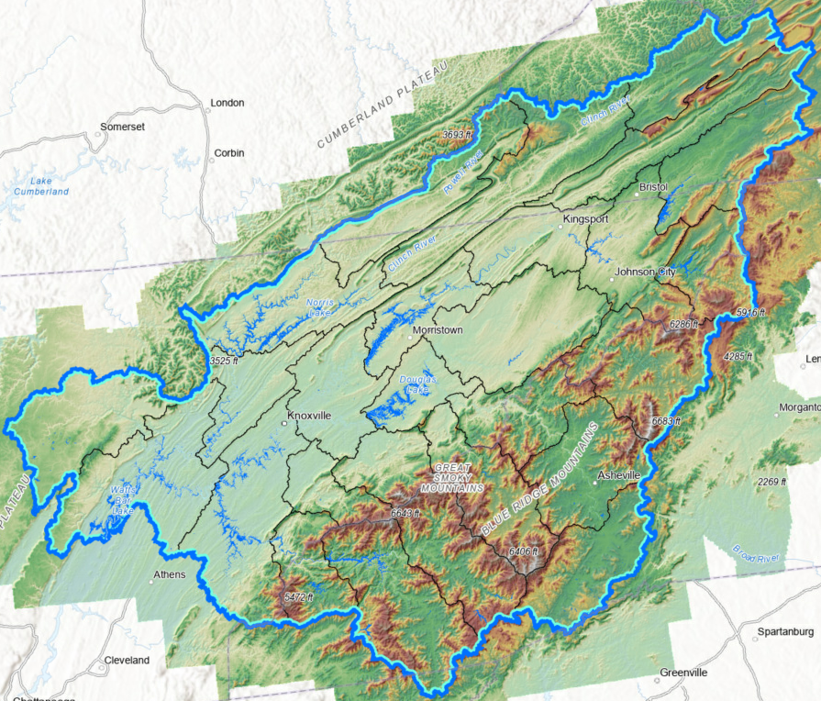
Upper Tennessee - Unique Considerations
Upper Tennessee (0601)
Heavily influenced by TVA-Operated Reservoirs
Riverine-like lakes
Hydro-Electric Dams
Wealth of existing TVA studies and models
Riverware and Hydrologic Models (UBC/Sac-SMA)
Gage Data
Probabilistic Flood Hazard Analysis Results and Storms Database
Mountainous Portions
Karst and Sub-Surface Flow
Recently impacted by Hurricane Helene
Notes:
Opportunity to see if USACE has any existing data.
Stakeholder engagement important
Res-Sim important
Bathymetry Important
In-reservoir routing important

Slide 15
Upper Tennessee (0601) Progress Update
Task | Progress Update | Upcoming Next Steps
Scoping and Data Preparation | Compiled relevant available reference/input data Identified key data providers and datasets Geospatial Completed 4-ft and 100-ft DEM base terrain Prepared Other Base Geospatial Layers Dam/Levee Nearly Complete with Initial Dam and Levee Scoping Tables | Coordinate with Tennessee Valley Authority and other data providers to obtain key datasets Identify Bathymetry sources/plan Refine Dam Scoping Table based on Data Collection outreach efforts
Meteorology | Selected initial Calibration Events Prepared base atmospheric data | Generate Storm Catalog Storm Typing
Hydrology | Compiled and Reviewed available observed gage data Prioritized Gage Locations (draft) | HMS Model Delineation HMS Parameterization and Test Run
Hydraulics | Delineated RAS Model Boundaries | Model Linking Register Mesh Refinement Scoping
Documentation | Updating Project Work Plans, Report, and Data Manifest | Continue updating as progress is made
Critical

Slide 16
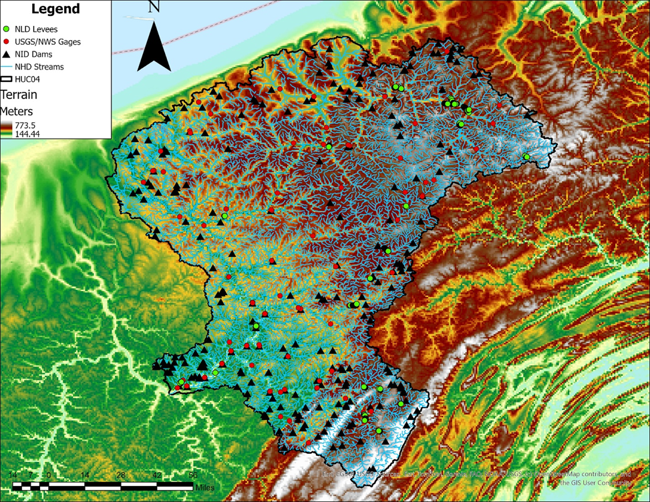
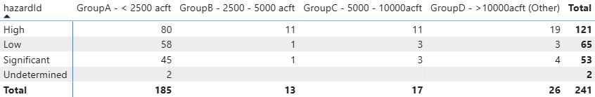
Allegheny (0501) - Unique Basin Considerations
Numerous dams including large flood risk reduction dams.
Numerous levee’s which may include additional NLD refinement coordination.
Some urban areas including portions of Pittsburgh, PA and CSO systems.
Mountainous areas including snowmelt and ice.
Ongoing FEMA Studies in Watershed
Of 121 High Hazard Dams only 10 are USACE
Of 41 Dams Designed for Flood Risk Reduction Only 9 are USACE

Slide 17
Allegheny (0501) Progress Update
FFRD (Hydrology First) Task | Progress Update | Upcoming Next Steps
Scoping & Data Preparation | Data Collection General Data Collection (Urban Areas, Soils, etc) Identify Key Data Providers & Datasets Terrain Development Flood Hazard Mechanisms Initial Identification of Key Mechanisms Dam & Levee Draft Levee Scoping/Refinement Table Draft Dam Scoping Table | Key Data Provider Coordination Submit Draft Levee Table for USACE Refinement Input Submit Draft Dam Table for USACE Input Submit Draft Flood Hazard Mechanisms for USACE Input
Meteorology | Conceptual Evaluation of Transposition Domain & Storm Catalog Setup | Assemble Atmospheric Data Develop Storm Catalog Identify Calibration Events/POR
Hydrology | Initial Subbasin – RAS Model Unit Identification/Delineation Initial Stream Gage Review & Categorization | Assemble HMS Model & Initial Parameters Model Linking Register Mesh Refinement Scoping
Reservoir Operations Modeling | Draft Dam Scoping Table – Initial Identification of ResSim Elements | Coordinate with USACE on ResSim confirmation & information collection
Documentation & Feedback | Updating Project Work Plans, Report, and Data Manifest | Continue Refinement With Project Progress

Slide 18
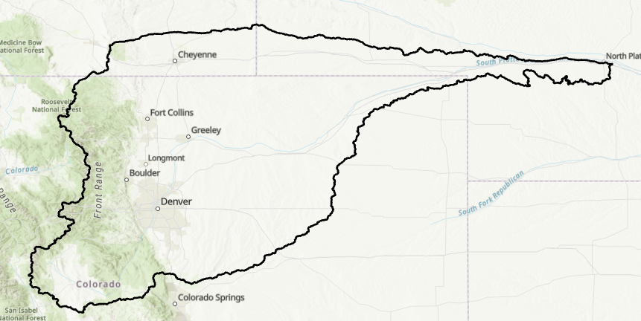
South Platte (1019) Unique Basin Considerations
Extensive Water Management Infrastructure
1/3 of Basin is publicly owned
Large topographic range with attendance hydromet characteristics
Large urban areas (70% of CO population in the basin)
Mountain Headwaters: Snowmelt; High sediment load
Notes:
37 inchees of annual precip in the mts; 7-15 in in the eastern plains

Slide 19
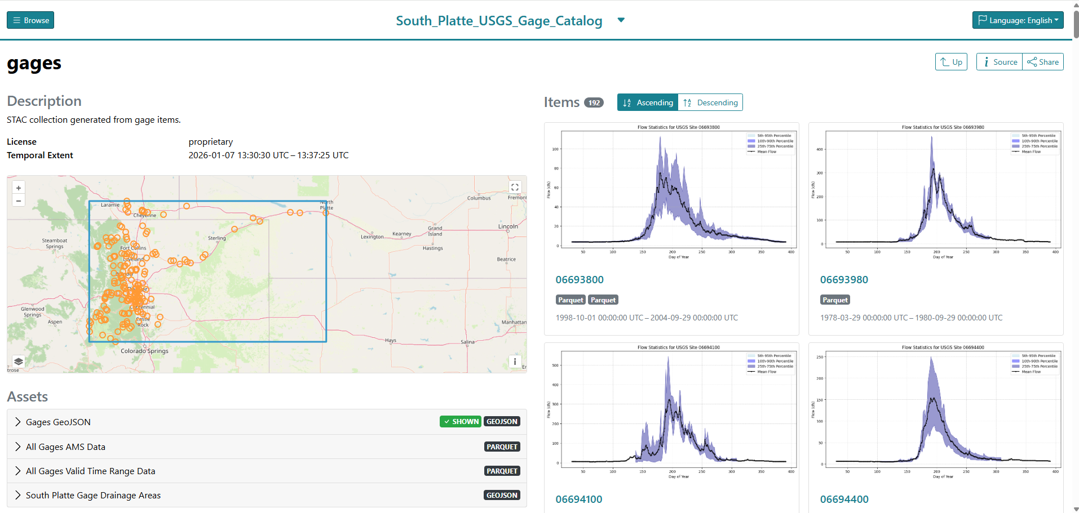
South Platte (1019) Progress Update

Slide 20
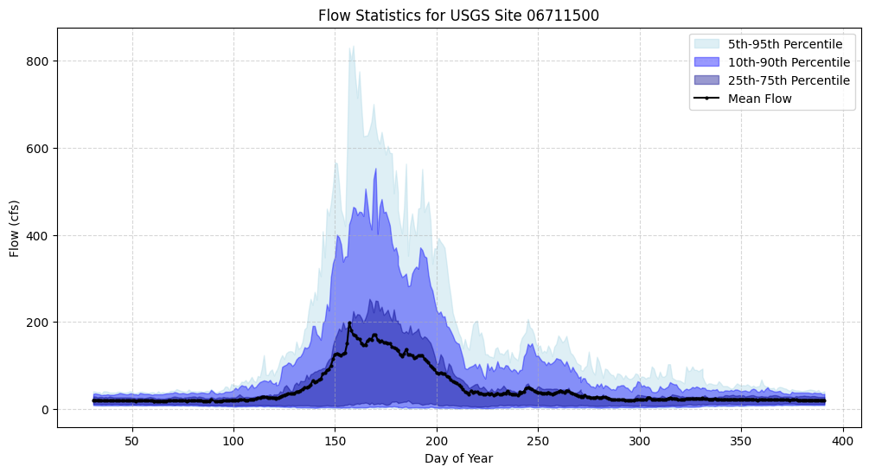
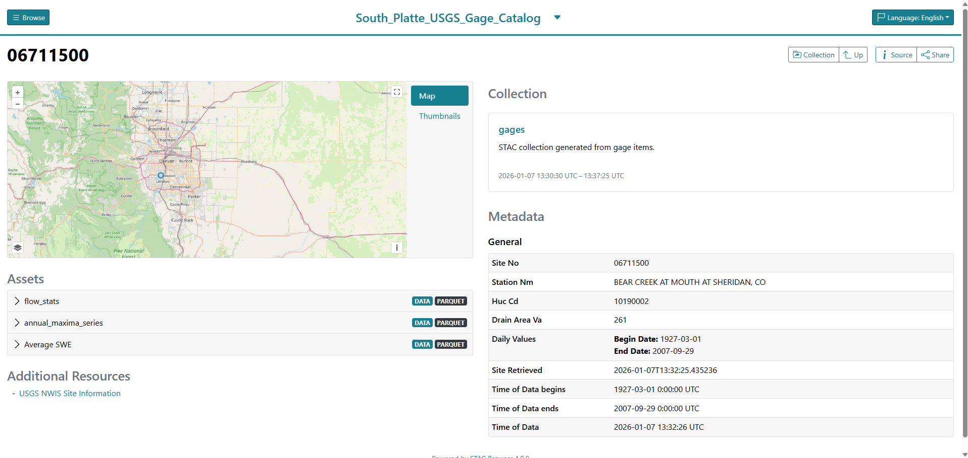
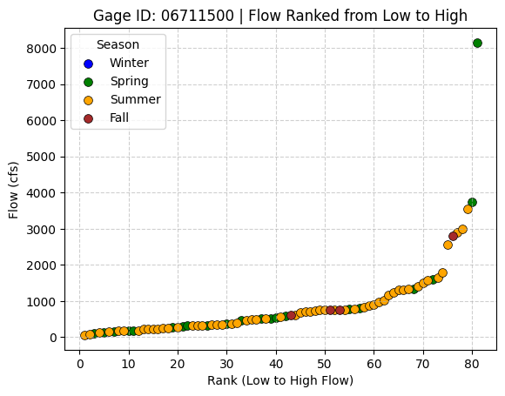
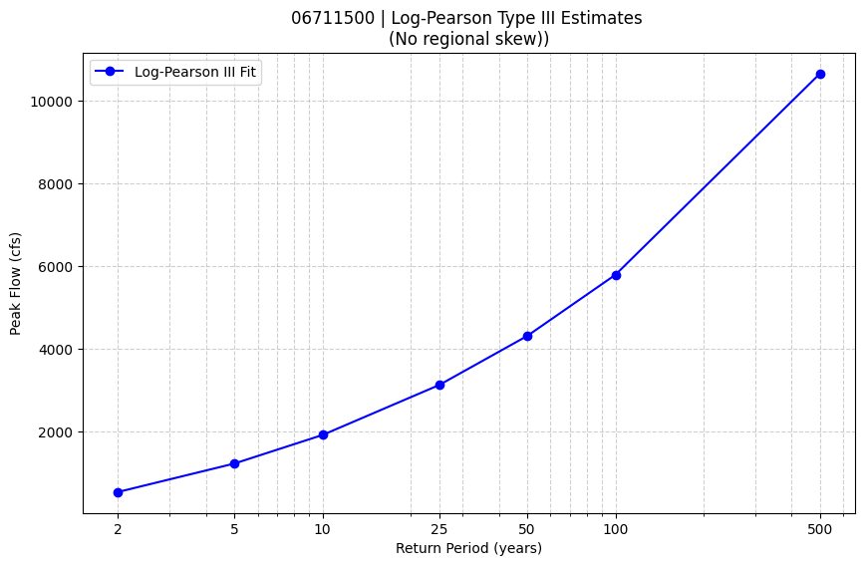
Gage Items

Slide 21
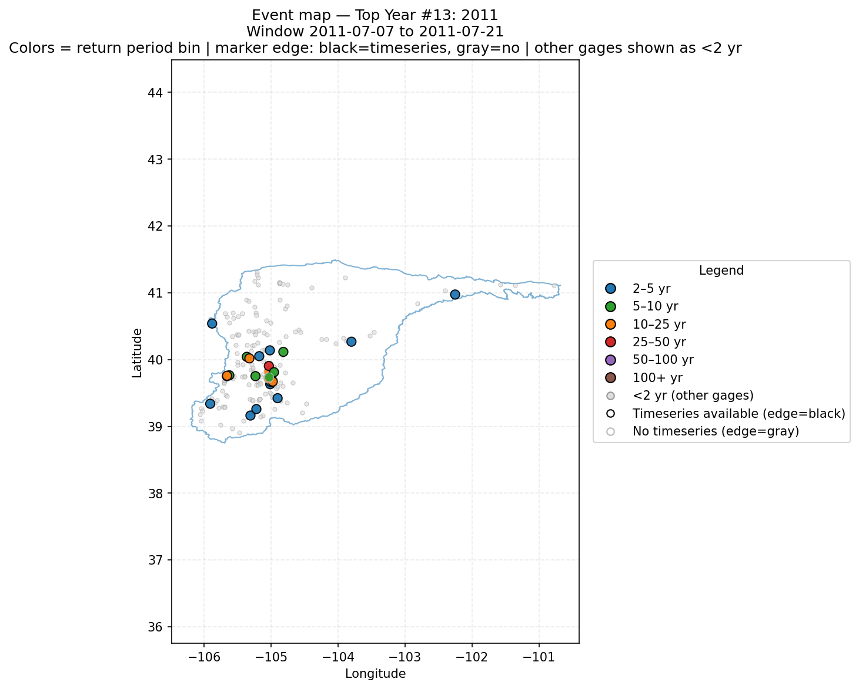
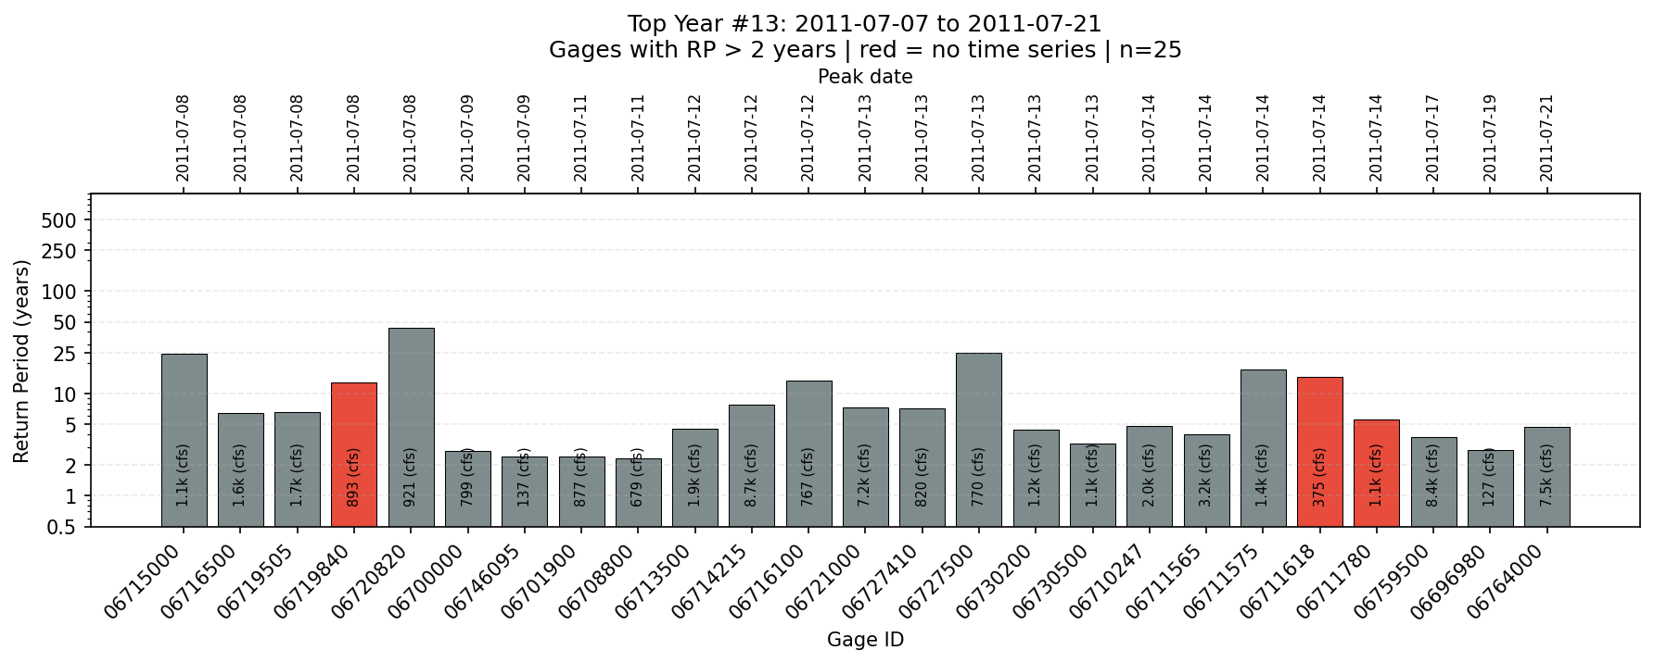
Calibration Events

Slide 22
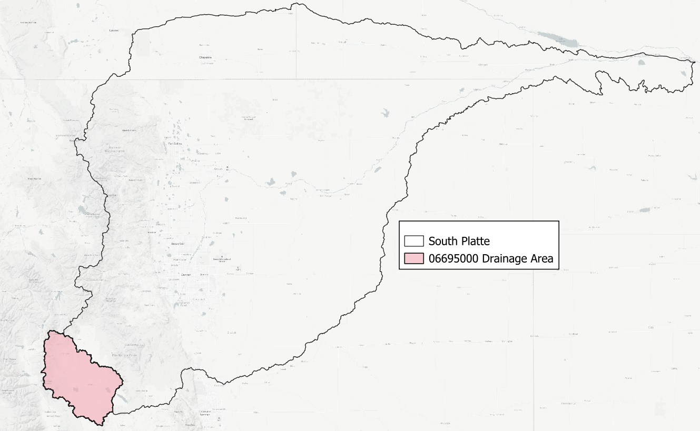
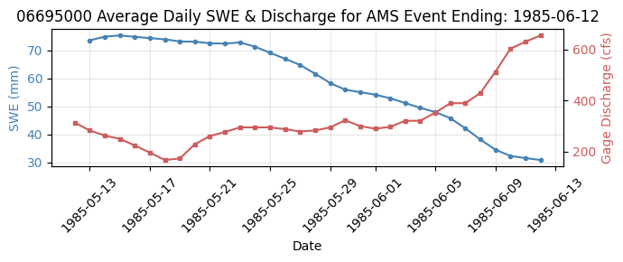
Flood Mechanism ID

Slide 23
Technical Discussions

Slide 24
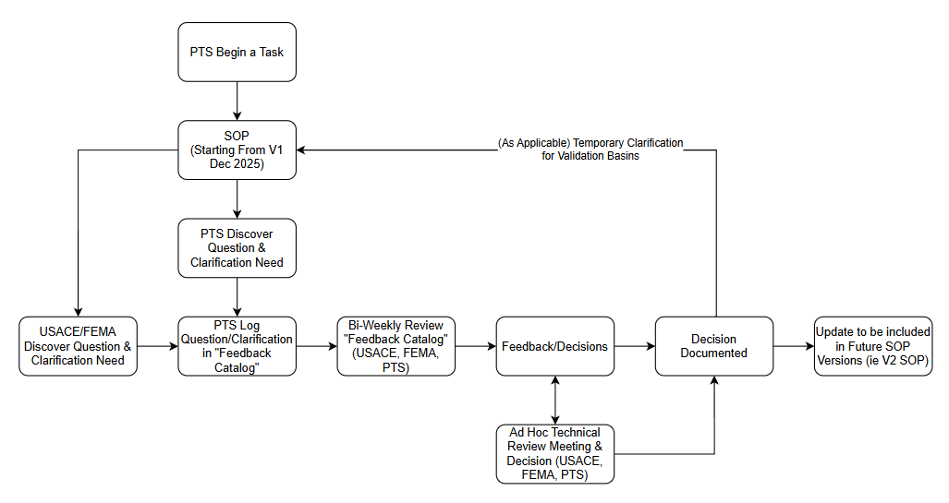
SOP V1 Validation Feedback
Near Term: PTS to document questions and feedback internally
Add to USACE basin log once developed
PTS and USACE to determine where PTS-provided SOP Language could be helpful

Slide 25
Technical: Levee – NLD Refinement Inquiries
Issue/Inquiry:
The NLD Refinement SOP is performed using a 1-meter terrain that differs from the FFRD SOP terrain. Should NLD refinement be updated with the FFRD terrain (4ft) or using the 1-meter NLD Refinement terrain?
Proposed Actions or Outcomes:
USACE (Michael Gonia) to discuss issue with FFRD SOP team for further clarification/input.
For watersheds with prior NLD refinement (Allegheny), a comparison will be performed of alignment line and crest profile between terrain sources. If mutually agreed to be insignificant then NLD refinement will not be updated.
For watersheds with new or no prior NLD refinement (all validation basins), NLD refinement will be performed using the finer resolution 1-meter NLD Refinement terrain.
PTS to coordinate regarding any ongoing levee studies.

Slide 26
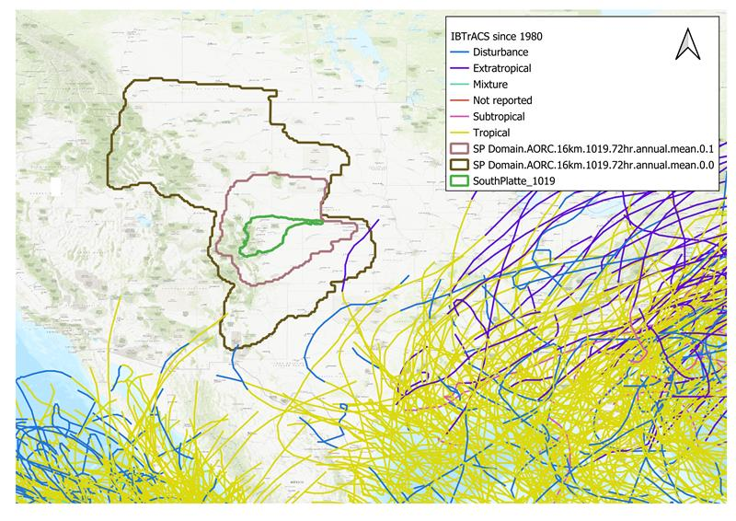
Technical: Storm Typing Methodology
Issue/Inquiry:
Storm typing the South Platte catalog based on current SOP guidance to type storms as tropical/non-tropical would not add any value to the storm catalog as nearly all storms would be non-tropical.
Proposed Actions or Outcomes:
The Colorado–New Mexico Regional Extreme Precipitation study developed storm‑typed PFEs for Colorado, including most of the South Platte basin, based on three dominant storm types (synoptic, mesoscale convective, and local). We recommend storm typing the South Platte catalog using this same framework.

Slide 27
Technical: Terrain Tiling Clarification
Issue/Inquiry:
The FFRD SOP does not define standard tile dimensions, alignment, or subdivision logic for individual GeoTIFF files. This creates ambiguity and inconsistent interpretations across teams. Additionally, while internal COG tiling (e.g., 128×128 blocks) is well understood, expectations for file‑level tiling are not explicitly articulated in the SOP.
Proposed Actions or Outcomes:
Select a smaller default tile size (e.g., 8192 × 8192 pixels at 4‑ft resolution) to balance spatial coverage, file size, and usability, avoiding excessively large uncompressed files (e.g., 16384 × 16384 pixels ≈ 1.1 GB per band).
Require tiles to be edge‑matched with no overlap or gaps, consistent with assumptions already made by practitioners and references to edge snapping in the SOP.
Align file‑level tile boundaries to a predefined grid derived from the FFRD projection and resolution, promoting consistency across basins and supporting future large‑scale or cross‑basin analyses

Slide 28
Technical: RAS Model Unit SOP Inconsistency
Issue/Inquiry:
The SOP is slightly conflicting in the priorities for RAS model unit delineation.
In Job Aid 1, it specifies to avoid gage locations and dams as model unit boundaries.
However, other sections and pilot projects seemed to favor having gage locations and dams at model boundaries in order to utilize observed data directly.
Proposed Actions or Outcomes:
For the Upper Tennessee area, it made most sense to have RAS Model Units delineated at Reservoir Locations. (Visual Example)
Potential issues with breaching and gage results to be mitigated by including model overlap during model development.
Notes:
Is it a priority to still have observed data as an input during the calibration phase? Use HMS if not available? Were these lessons learned?

Slide 29
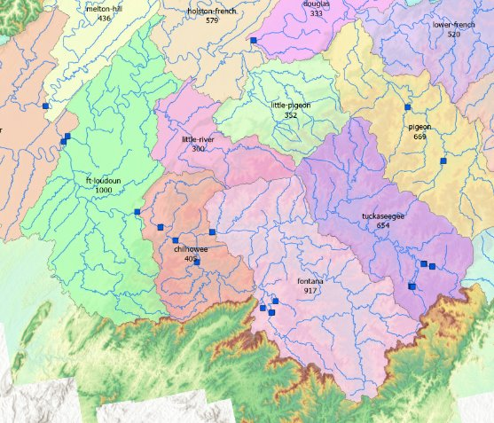
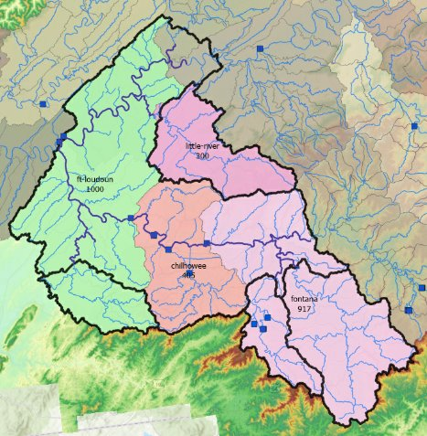
Technical: RAS Model Unit SOP Inconsistency

Slide 30
Technical: Calibration Event Selection Question
Inquiry:
In 5 out of 6 calibration events we have good spatial coverage, seasonality, and storm types.
We are missing a rain-on-snow event, however there are not many significant rain-on-snow events in recent years with calibration data availability. There is one ~2YR rain-on-snow event at some locations at the watershed.
Should we include this event to capture all types of events? Or prioritize another Thunderstorm or Tropical event that is more significant across the basin?
Proposed Actions or Outcomes:
We are planning to include the rain-on-snow event as a calibration event to help dial in snow parameters even though it is not an extremely significant across the basin.

